Slide 1
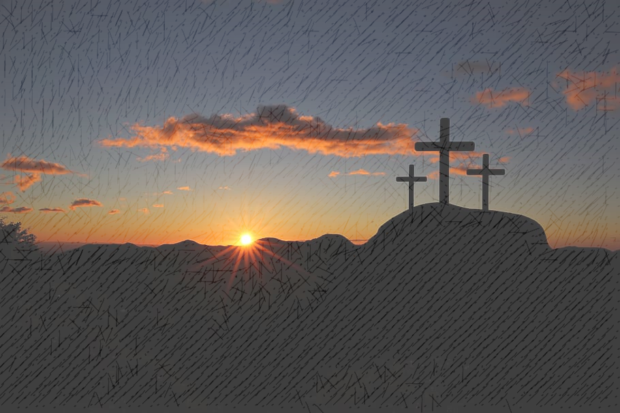
King Jesus: High and Lifted Up
John 19:17-27

Slide 2
King Jesus: High and Lifted Up
John 19:17-27
Four Gospels – perfect harmony

Slide 3
King Jesus: High and Lifted Up
John 19:17-27
Four Gospels – perfect harmony
Unique contributions

Slide 4
King Jesus: High and Lifted Up
John 19:17-27
1. “King of the Jews” vv.17-22

Slide 5
King Jesus: High and Lifted Up
John 19:17-27
1. “King of the Jews” vv.17-22
Simon’s stint – Matt.27:32; Mark 15:21; Luke 23:26

Slide 6
King Jesus: High and Lifted Up
John 19:17-27
1. “King of the Jews” vv.17-22
Simon’s stint – Matt.27:32; Mark 15:21; Luke 23:26
John = concise

Slide 7
King Jesus: High and Lifted Up
John 19:17-27
1. “King of the Jews” vv.17-22
Simon’s stint – Matt.27:32; Mark 15:21; Luke 23:26
John = concise
The ‘titulus’ – Aramaic, Latin & Greek

Slide 8
King Jesus: High and Lifted Up
John 19:17-27
1. “King of the Jews” vv.17-22
Simon’s stint – Matt.27:32; Mark 15:21; Luke 23:26
John = concise
The ‘titulus’ – Aramaic, Latin & Greek
Snub to Jewish leaders

Slide 9
King Jesus: High and Lifted Up
John 19:17-27
1. “King of the Jews” vv.17-22
Simon’s stint – Matt.27:32; Mark 15:21; Luke 23:26
John = concise
The ‘titulus’ – Aramaic, Latin & Greek
Snub to Jewish leaders
Caiaphas & Pilate – witnesses to Jesus

Slide 10
King Jesus: High and Lifted Up
John 19:17-27
“King of the Jews” vv.17-22
Gambling and Grieving vv.23-27

Slide 11
King Jesus: High and Lifted Up
John 19:17-27
“King of the Jews” vv.17-22
Gambling and Grieving vv.23-27
Prophecy fulfilled: “They divided my clothes among them and cast lots for my garment” Psalm 22:18

Slide 12
King Jesus: High and Lifted Up
John 19:17-27
“King of the Jews” vv.17-22
Gambling and Grieving vv.23-27
Prophecy fulfilled: “They divided my clothes among them and cast lots for my garment” Psalm 22:18
Four gambling soldiers

Slide 13
King Jesus: High and Lifted Up
John 19:17-27
“King of the Jews” vv.17-22
Gambling and Grieving vv.23-27
Prophecy fulfilled: “They divided my clothes among them and cast lots for my garment” Psalm 22:18
Four gambling soldiers
Don’t be quick to judge!

Slide 14
King Jesus: High and Lifted Up
John 19:17-27
“King of the Jews” vv.17-22
Gambling and Grieving vv.23-27
Prophecy fulfilled: “They divided my clothes among them and cast lots for my garment” Psalm 22:18
Four gambling soldiers
Don’t be quick to judge!
Four grieving women

Slide 15
King Jesus: High and Lifted Up
John 19:17-27
“King of the Jews” vv.17-22
Gambling and Grieving vv.23-27
Prophecy fulfilled: “They divided my clothes among them and cast lots for my garment” Psalm 22:18
Four gambling soldiers
Don’t be quick to judge!
Four grieving women
Jesus’ words to ‘beloved disciple’: “When Jesus saw his mother there, and the disciple whom he loved standing nearby, he said to his her, ‘Woman, here is your son,’ and to the disciple, ‘Here is your mother.’ From that time on, this disciple took her into his home” vv.26-27

Slide 16
King Jesus: High and Lifted Up
John 19:17-27
“King of the Jews” vv.17-22
Gambling and Grieving vv.23-27
Prophecy fulfilled: “They divided my clothes among them and cast lots for my garment” Psalm 22:18
Four gambling soldiers
Don’t be quick to judge!
Four grieving women
Jesus’ words to ‘beloved disciple’: “When Jesus saw his mother there, and the disciple whom he loved standing nearby, he said to his her, ‘Woman, here is your son,’ and to the disciple, ‘Here is your mother.’ From that time on, this disciple took her into his home” vv.26-27
Immediate care for mother

Slide 17
King Jesus: High and Lifted Up
John 19:17-27
“King of the Jews” vv.17-22
Gambling and Grieving vv.23-27
“It is Finished” vv.28-30

Slide 18
King Jesus: High and Lifted Up
John 19:17-27
“King of the Jews” vv.17-22
Gambling and Grieving vv.23-27
“It is Finished” vv.28-30
“I am thirsty” v.28

Slide 19
King Jesus: High and Lifted Up
John 19:17-27
“King of the Jews” vv.17-22
Gambling and Grieving vv.23-27
“It is Finished” vv.28-30
“I am thirsty” v.28
Fulfilment of Ps.22 & 69

Slide 20
King Jesus: High and Lifted Up
John 19:17-27
“King of the Jews” vv.17-22
Gambling and Grieving vv.23-27
“It is Finished” vv.28-30
“I am thirsty” v.28
Fulfilment of Ps.22 & 69
Use of “hyssop”

Slide 21
King Jesus: High and Lifted Up
John 19:17-27
“King of the Jews” vv.17-22
Gambling and Grieving vv.23-27
“It is Finished” vv.28-30
“I am thirsty” v.28
Fulfilment of Ps.22 & 69
Use of “hyssop”
Triumphant cry

Slide 22
King Jesus: High and Lifted Up
John 19:17-27
“King of the Jews” vv.17-22
Gambling and Grieving vv.23-27
“It is Finished” vv.28-30
“I am thirsty” v.28
Fulfilment of Ps.22 & 69
Use of “hyssop”
Triumphant cry
Mission accomplished!

Slide 23
King Jesus: High and Lifted Up
John 19:17-27
“King of the Jews” vv.17-22
Gambling and Grieving vv.23-27
“It is Finished” vv.28-30
Making sure vv.31-37

Slide 24
King Jesus: High and Lifted Up
John 19:17-27
“King of the Jews” vv.17-22
Gambling and Grieving vv.23-27
“It is Finished” vv.28-30
Making sure vv.31-37
Two minute “offence time”

Slide 25
King Jesus: High and Lifted Up
John 19:17-27
“King of the Jews” vv.17-22
Gambling and Grieving vv.23-27
“It is Finished” vv.28-30
Making sure vv.31-37
Two minute “offence time”
The “Roman” solution

Slide 26
King Jesus: High and Lifted Up
John 19:17-27
“King of the Jews” vv.17-22
Gambling and Grieving vv.23-27
“It is Finished” vv.28-30
Making sure vv.31-37
Two minute “offence time”
The “Roman” solution
“Pierced”

Slide 27
King Jesus: High and Lifted Up
John 19:17-27
“King of the Jews” vv.17-22
Gambling and Grieving vv.23-27
“It is Finished” vv.28-30
Making sure vv.31-37
Two minute “offence time”
The “Roman” solution
“Pierced”
Denial attempt 1. Docetism – Jesus only ‘seemed’ to be human

Slide 28
King Jesus: High and Lifted Up
John 19:17-27
“King of the Jews” vv.17-22
Gambling and Grieving vv.23-27
“It is Finished” vv.28-30
Making sure vv.31-37
Two minute “offence time”
The “Roman” solution
“Pierced”
Denial attempt 1. Docetism – Jesus only ‘seemed’ to be human
Denial attempt 2. Substitution – Someone took his place - “And [for] their saying, ‘Indeed, we have killed the Messiah, the son of Mary, the messenger of Allah.’ They did not kill him, nor did they crucify him; but [another] was made to resemble him to them” Sura 4.157.

Slide 29
King Jesus: High and Lifted Up
John 19:17-27
“King of the Jews” vv.17-22
Gambling and Grieving vv.23-27
“It is Finished” vv.28-30
Making sure vv.31-37
Two minute “offence time”
The “Roman” solution
“Pierced”
Prophecy accomplished – Exodus 12; Psalm 34

Slide 30
King Jesus: High and Lifted Up
John 19:17-27
“King of the Jews” vv.17-22
Gambling and Grieving vv.23-27
“It is Finished” vv.28-30
Making sure vv.31-37
Two minute “offence time”
The “Roman” solution
“Pierced”
Prophecy accomplished – Exodus 12; Psalm 34
Prophecy accomplished – Zech. 12:10

Slide 31
King Jesus: High and Lifted Up
John 19:17-27
“King of the Jews” vv.17-22
Gambling and Grieving vv.23-27
“It is Finished” vv.28-30
Making sure vv.31-37
Application – absence of sensationalism

Slide 32
King Jesus: High and Lifted Up
John 19:17-27
“King of the Jews” vv.17-22
Gambling and Grieving vv.23-27
“It is Finished” vv.28-30
Making sure vv.31-37
Application – absence of sensationalism
physical suffering = minimal

Slide 33
King Jesus: High and Lifted Up
John 19:17-27
“King of the Jews” vv.17-22
Gambling and Grieving vv.23-27
“It is Finished” vv.28-30
Making sure vv.31-37
Application – absence of sensationalism
physical suffering = minimal
impossible to fathom God’s anger

Slide 34
King Jesus: High and Lifted Up
John 19:17-27
“King of the Jews” vv.17-22
Gambling and Grieving vv.23-27
“It is Finished” vv.28-30
Making sure vv.31-37
Application – absence of sensationalism
physical suffering = minimal
impossible to fathom God’s anger
Three hours darkness at noon

Slide 35
King Jesus: High and Lifted Up
John 19:17-27
“King of the Jews” vv.17-22
Gambling and Grieving vv.23-27
“It is Finished” vv.28-30
Making sure vv.31-37
Application – absence of sensationalism
physical suffering = minimal
impossible to fathom God’s anger
Three hours darkness at noon
Magnitude of sin

Slide 36
King Jesus: High and Lifted Up
John 19:17-27
“King of the Jews” vv.17-22
Gambling and Grieving vv.23-27
“It is Finished” vv.28-30
Making sure vv.31-37
Application – absence of sensationalism
physical suffering = minimal
impossible to fathom God’s anger
Three hours darkness at noon
Magnitude of sin
Magnitude of God’s grace

