Slide 1
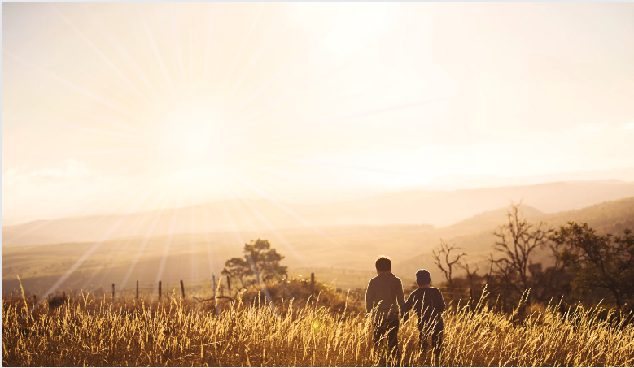
Ephesians
Living as children of light

Slide 2
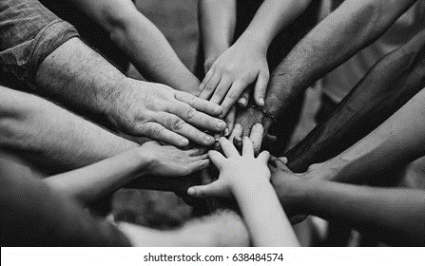
Be completely humble and gentle; be patient, bearing with one another in love. Make every effort to keep the unity of the Spirit through the bond of peace.
Ephesians 4:2-3

Slide 4
Ephesians
5:8-10
Live as children of light
Because…
We are no longer darkness (vs.8)
We are light! (vs.8)
- The contrast is clear: Light / Darkness
- In Christ / Outside of Christ
‘As for you, you were dead in your transgressions and sins’
Ephesians 2:1

Slide 5
Ephesians
5:8-10
Live as children of light
Because…
We are no longer darkness (vs.8)
We are light! (vs.8)
- The contrast is clear: Light / Darkness
- In Christ / Outside of Christ
‘As for you, you were dead in your transgressions and sins’… ‘But because of His great love for us, God who is rich in mercy, made us alive with Christ…’ Ephesians 2:1&4

Slide 6
Ephesians
5:8-10
Live as children of light
Because…
We are no longer darkness (vs.8)
We are light! (vs.8)
- The contrast is clear: Light / Darkness
- In Christ / Outside of Christ
- Dead / Alive (Ch2 vs.1 & 4)

Slide 7
Ephesians
5:8-10
Live as children of light
Lives that follow God’s example (vs.1)
That bear the fruit of the light (vs.9)
That do not partner with darkness (vs.7)
‘Do not be yoked together with unbelievers.’
2 Cor. 6:14

Slide 8
Ephesians
5:8-10
Live as children of light
Lives that follow God’s example (vs.1)
That bear the fruit of the light (vs.9)
That do not partner with darkness (vs.7)
‘Do not be yoked together with unbelievers. For what do righteousness and wickedness have in common? Or what fellowship can light have with darkness? What harmony is there between Christ and Belial? Or what does a believer have in common with an unbeliever?’ 2 Cor. 6:14-15

Slide 9
Ephesians
5:8-10
Live as children of light
Lives that follow God’s example (vs.1)
That bear the fruit of the light (vs.9)
That do not partner with darkness (vs.7)
That find out what pleases God (vs.10)
‘trying to learn what is pleasing to the Lord’
Eph.5:10 NASB95

Slide 10
Ephesians
5:8-10
Live as children of light
Lives that follow God’s example (vs.1)
That bear the fruit of the light (vs.9)
That do not partner with darkness (vs.7)
That find out what pleases God (vs.10)
That expose deeds of darkness (vs.11)

