Slide 1
Ephesians
Living as children of light

Slide 2
‘All Scripture is God-breathed and is useful for teaching, rebuking, correcting and training in righteousness, so that the servant of God may be thoroughly equipped for every good work.’
2 Timothy 3:16

Slide 3
The ‘riches’ of God in Ephesians!
‘The riches of God’s grace that He lavished on us’ 1:7
‘The riches of His glorious inheritance’ 1:18
‘The incomparable riches of His grace’ 2:7
‘The boundless riches of Christ’ 3:8
‘His glorious riches’ 3:16

Slide 4
God’s Apostle, God’s Holy People &
God’s Grace and Peace
Ephesians
1:1-2
God’s Apostle (vs.1)
- By God’s will
- With God’s authority

Slide 5
God’s Apostle, God’s Holy People &
God’s Grace and Peace
Ephesians
1:1-2
God’s Apostle (vs.1)
- By God’s will
- With God’s authority - Ephesians 2:19-20
‘Consequently, you are no longer foreigners and strangers, but fellow citizens with God’s people and also members of His household, built on the foundation of the apostles and prophets, with Christ Jesus Himself as the chief cornerstone.’

Slide 6
God’s Apostle, God’s Holy People &
God’s Grace and Peace
Ephesians
1:1-2
God’s Apostle (vs.1)
- By God’s will
- With God’s authority (2:20)
- Proclaiming God’s Word
“Repent and believe the good news!”
Mark 1:15

Slide 7
God’s Apostle, God’s Holy People &
God’s Grace and Peace
Ephesians
1:1-2
God’s Apostle (vs.1)
- By God’s will
- With God’s authority (2:20)
- Proclaiming God’s Word
“Whoever wants to be my disciple must deny themselves and take up their cross and follow me…” Mark 8:34

Slide 8
God’s Apostle, God’s Holy People &
God’s Grace and Peace
Ephesians
1:1-2
God’s Apostle (vs.1)
- By God’s will
- With God’s authority (2:20)
- Proclaiming God’s Word
- Doctrine and Duty (Rom 1-11 & 12-16)
- Serving God’s People

Slide 9
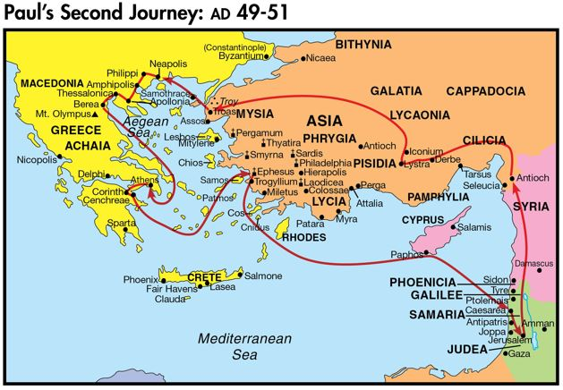
Ephesians
1:1-2

Slide 10
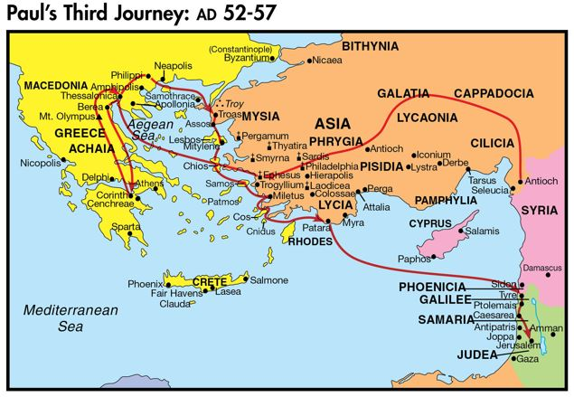
Ephesians
1:1-2

Slide 11
God’s Apostle, God’s Holy People &
God’s Grace and Peace
Ephesians
1:1-2
God’s Apostle (vs.1)
- By God’s will
- With God’s authority (2:20)
- Proclaiming God’s Word
- Doctrine and Duty (Rom 1-11 & 12-16)
- Serving God’s People
- Whatever the cost (3:1 & 4:1)

Slide 12
God’s Apostle, God’s Holy People &
God’s Grace and Peace
Ephesians
1:1-2
God’s Holy People (vs.1)
- In Ephesus?
‘After this letter has been read to you, see that is it also read in the church of the Laodiceans and that you in turn read the letter from Laodicea.’
Colossians 4:16

Slide 13
God’s Apostle, God’s Holy People &
God’s Grace and Peace
Ephesians
1:1-2
God’s Holy People (vs.1)
- In Ephesus (& likely surrounding area)

Slide 14
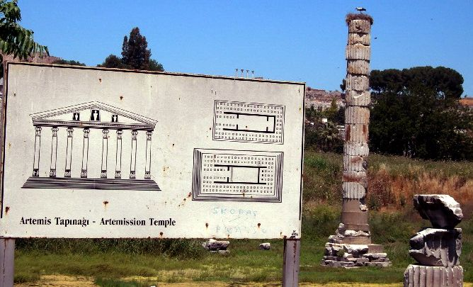
Ephesians
1:1-2

Slide 15
God’s Apostle, God’s Holy People &
God’s Grace and Peace
Ephesians
1:1-2
God’s Holy People (vs.1)
- In Ephesus (& likely surrounding area)
- In Christ Jesus!
God’s Grace and Peace (vs.2)
- For ALL believers
- Jew & Gentile

Slide 16
Ephesians
Living as children of light

