Slide 1
?

Slide 2
Psalm 139
God knows me

Slide 3
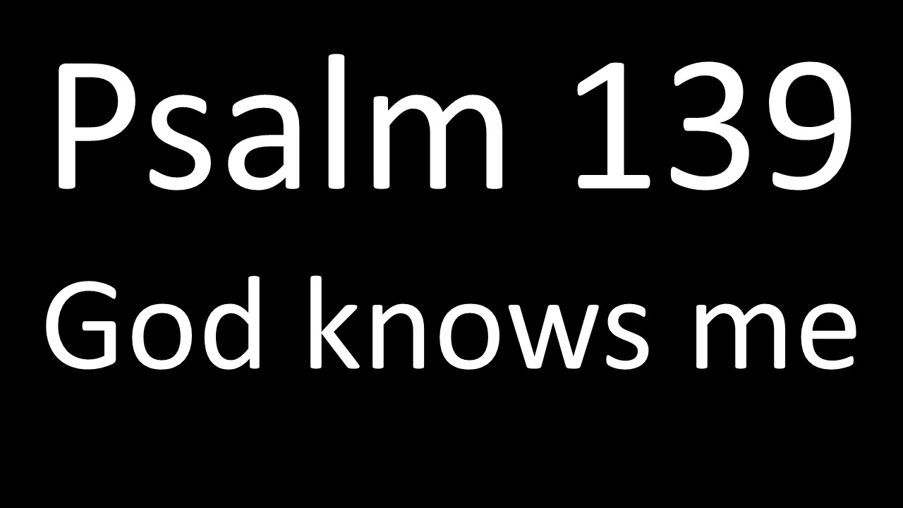
¹O Lord, you have searched me and you know me. ²You know when I sit and when I rise; you perceive my thoughts from afar. ³You discern my going out and my lying down; you are familiar with all my ways. ⁴Before a word is on my tongue you know it completely, O Lord.

Slide 4
²³Search me, O God, and know my heart; test me and know my anxious thoughts. ²⁴See if there is any offensive way in me, and lead me in the way everlasting.

Slide 5
Why David was anxious

Slide 6
Why David was anxious
¹⁹If only you would slay the wicked, O
God! Away from me, you bloodthirsty
men! ²⁰They speak of you with evil intent; your adversaries misuse your name.
²¹Do I not hate those who hate you, O
Lord, and abhor those who rise up
against you? ²²I have nothing but hatred for them; I count them my enemies.

Slide 7
Why David was anxious
¹⁹If only you would slay the wicked, O
God! Away from me, you bloodthirsty
men! ²⁰They speak of you with evil intent; your adversaries misuse your name.
²¹Do I not hate those who hate you, O
Lord, and abhor those who rise up
against you? ²²I have nothing but hatred for them; I count them my enemies.

Slide 8
Why David was anxious
¹⁹If only you would slay the wicked, O
God! Away from me, you bloodthirsty
men! ²⁰They speak of you with evil intent; your adversaries misuse your name.
²¹Do I not hate those who hate you, O
Lord, and abhor those who rise up
against you? ²²I have nothing but hatred for them; I count them my enemies.

Slide 9
Why David was anxious
¹⁹If only you would slay the wicked, O
God! Away from me, you bloodthirsty
men! ²⁰They speak of you with evil intent; your adversaries misuse your name.
²¹Do I not hate those who hate you, O
Lord, and abhor those who rise up
against you? ²²I have nothing but hatred for them; I count them my enemies.

Slide 10
Why David was anxious
¹⁹If only you would slay the wicked, O
God! Away from me, you bloodthirsty
men! ²⁰They speak of you with evil intent; your adversaries misuse your name.
²¹Do I not hate those who hate you, O
Lord, and abhor those who rise up
against you? ²²I have nothing but hatred for them; I count them my enemies.

Slide 11
Why David was anxious
¹⁹If only you would slay the wicked, O
God! Away from me, you bloodthirsty
men! ²⁰They speak of you with evil intent; your adversaries misuse your name.
²¹Do I not hate those who hate you, O
Lord, and abhor those who rise up
against you? ²²I have nothing but hatred for them; I count them my enemies.

Slide 12
Why David was anxious
²³Search me, O God, and know my heart; test me and know my anxious thoughts. ²⁴See if there is any offensive way in me, and lead me in the way everlasting.

Slide 13
How David dealt with his anxiety
²³Search me, O God, and know my heart; test me and know my anxious thoughts. ²⁴See if there is any offensive way in me, and lead me in the way everlasting.

Slide 14
How David dealt with his anxiety
¹O Lord, you have searched me and you know me. ²You know when I sit and when I rise; you perceive my thoughts from afar. ³You discern my going out and my lying down; you are familiar with all my ways. ⁴Before a word is on my tongue you know it completely, O Lord.

Slide 15
How David dealt with his anxiety
¹O Lord, you have searched me and you know me. ²You know when I sit and when I rise; you perceive my thoughts from afar. ³You discern my going out and my lying down; you are familiar with all my ways. ⁴Before a word is on my tongue you know it completely, O Lord.

Slide 16
How David dealt with his anxiety
¹O Lord, you have searched me and you know me. ²You know when I sit and when I rise; you perceive my thoughts from afar. ³You discern my going out and my lying down; you are familiar with all my ways. ⁴Before a word is on my tongue you know it completely, O Lord.

Slide 17
How David dealt with his anxiety
¹O Lord, you have searched me and you know me. ²You know when I sit and when I rise; you perceive my thoughts from afar. ³You discern my going out and my lying down; you are familiar with all my ways. ⁴Before a word is on my tongue you know it completely, O Lord.

Slide 18
How David dealt with his anxiety
¹O Lord, you have searched me and you know me. ²You know when I sit and when I rise; you perceive my thoughts from afar. ³You discern my going out and my lying down; you are familiar with all my ways. ⁴Before a word is on my tongue you know it completely, O Lord.

Slide 19
How David dealt with his anxiety
⁵You hem me in-behind and before; you
have laid your hand upon me.
⁶Such knowledge is too wonderful for
me, too lofty for me to attain.

Slide 20
How David dealt with his anxiety
⁵You hem me in-behind and before; you
have laid your hand upon me.
⁶Such knowledge is too wonderful for
me, too lofty for me to attain.

Slide 21
How David dealt with his anxiety
⁵You hem me in-behind and before; you
have laid your hand upon me.
⁶Such knowledge is too wonderful for
me, too lofty for me to attain.
The angel of the Lord encamps around those who fear him, and he delivers them (Psalm 34:7)

Slide 22
How David dealt with his anxiety
⁸If I go up to the heavens, you are there;
if I make my bed in the depths, you are
there. ⁹If I rise on the wings of the dawn, if I settle on the far side of the sea, ¹⁰even there your hand will guide me, your right hand will hold me fast.

Slide 23
How David dealt with his anxiety
¹¹If I say, "Surely the darkness will hide
me and the light become night around
me," ¹²even the darkness will not be dark to you; the night will shine like the day, for
darkness is as light to you.

Slide 24
How David dealt with his anxiety
¹³For you created my inmost being; you knit me together in my mother's womb. ¹⁴I praise you because I am fearfully and wonderfully made; your works are wonderful, I know that full well. ¹⁵My frame was not hidden from you when I was made in the secret place. When I was woven together in the depths of the earth, ¹⁶your eyes saw my unformed body. All the days ordained for me were written in your book before one of them came to be.

Slide 25
How David dealt with his anxiety
¹⁷How precious to me are your thoughts,
O God! How vast is the sum of them!
¹⁸Were I to count them, they would
outnumber the grains of sand. When I
awake, I am still with you.

Slide 26
How David dealt with his anxiety
¹⁷How precious to me are your thoughts,
O God! How vast is the sum of them!
¹⁸Were I to count them, they would
outnumber the grains of sand. When I
awake, I am still with you.

Slide 27
How David dealt with his anxiety
¹⁷How precious to me are your thoughts,
O God! How vast is the sum of them!
¹⁸Were I to count them, they would
outnumber the grains of sand. When I
awake, I am still with you.

Slide 28
?

Slide 29
¹Blessed is he whose transgressions are forgiven, whose sins are covered. ²Blessed is the man whose sin the Lord does not count against him and in whose spirit is no deceit. ³When I kept silent, my bones wasted away through my groaning all day long. ⁴For day and night your hand was heavy upon me; my strength was sapped as in the heat of summer. ⁵Then I acknowledged my sin to you and did not cover up my iniquity. I said, "I will confess my transgressions to the Lord "- and you forgave the guilt of my sin.
(Psalm 32:1-5)

Slide 30
¹⁸For Christ died for sins once for all, the righteous for the unrighteous, to bring you to God.
(1Peter 3:18)

Slide 31
?

