Slide 1
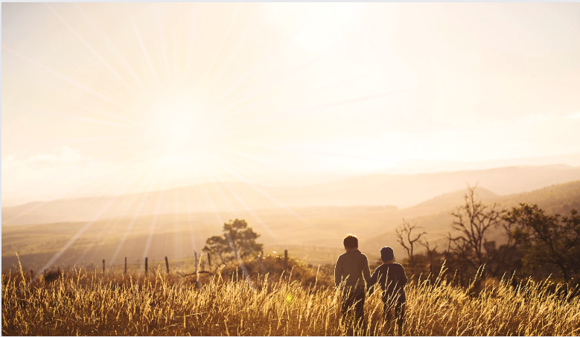
Ephesians
Living as children of light

Slide 2
The Wealth
of the Christian
Spiritual Blessings in Christ
3 key spiritual blessings:
Chosen for adoption by the Father (vs.4-6)
Redeemed and forgiven in Christ (vs.7-10)
Sealed for inheritance by the Spirit (vs.11-14)

Slide 3
The Wealth
of the Christian
Spiritual Blessings in Christ
3 key spiritual blessings:
Chosen for adoption by the Father (vs.4-6)
Redeemed and forgiven in Christ (vs.7-10)
Sealed for inheritance by the Spirit (vs.11-14)

Slide 4
The Wealth
of the Christian
(Part 3)
Redeemed and forgiven in Christ
The need to be redeemed and forgiven…
We are all sinners
‘There is no-one righteous, not even one...’
Romans 3:10
‘For all have sinned and fallen short of the glory of God…’
Romans 3:23
Ephesians
1:7-10

Slide 5
The Wealth
of the Christian
(Part 3)
Redeemed and forgiven in Christ
The need to be redeemed and forgiven…
We are all sinners (Romans 3:10 & 3:23)
‘Forgiveness of sins’ vs.7
Ephesians
1:7-10

Slide 6
The Wealth
of the Christian
(Part 3)
Redeemed and forgiven in Christ
The need to be redeemed and forgiven…
We are all sinners (Romans 3:10 & 3:23)
‘Forgiveness of our trespasses’ vs.7 (ESV)
‘We all, like sheep, have gone astray, each of us has turned to our own way…’
Isaiah 53:6
Ephesians
1:7-10

Slide 7
The Wealth
of the Christian
(Part 3)
Redeemed and forgiven in Christ
The need to be redeemed and forgiven…
We are all sinners (Romans 3:10 & 3:23)
‘Forgiveness of our trespasses’ vs.7 (ESV)
We have all ‘turned to our own way’ – Isaiah 53:6
‘Everyone who sins breaks the law; in fact, sin is lawlessness.’
1 John 3:4
Ephesians
1:7-10

Slide 8
The Wealth
of the Christian
(Part 3)
Redeemed and forgiven in Christ
The need to be redeemed and forgiven…
We are all sinners (Romans 3:10 & 3:23)
‘Forgiveness of our trespasses’ vs.7 (ESV)
We have all ‘turned to our own way’ – Isaiah 53:6
‘Against You, You only, have I sinned and done what is evil in your sight; so You are right in Your verdict and justified when You judge.’
Psalm 51:4
Ephesians
1:7-10

Slide 9
The Wealth
of the Christian
(Part 3)
Redeemed and forgiven in Christ
The need to be redeemed and forgiven…
We are all sinners (Romans 3:10 & 3:23)
‘Forgiveness of our trespasses’ vs.7 (ESV)
We have all ‘turned to our own way’ – Isaiah 53:6
And it is against God we have sinned – Psalm 51:4
Conclusion - We are guilty before God
Ephesians
1:7-10

Slide 10
The Wealth
of the Christian
(Part 3)
Redeemed and forgiven in Christ
The need to be redeemed and forgiven…
We are all sinners (Romans 3:10 & 3:23)
‘Redemption’ vs.7
‘Very truly I tell you, everyone who sins is a slave to sin.’ John 8:34
‘But thanks be to God that, though you used to be slaves to sin…’ Romans 6:17
Ephesians
1:7-10
= To pay a ransom to deliver someone out of captivity

Slide 11
The Wealth
of the Christian
(Part 3)
Redeemed and forgiven in Christ
The need to be redeemed and forgiven…
We are all sinners (Romans 3:10 & 3:23)
‘Redemption’ vs.7
We are slaves to sin – John 8:34 / Romans 6:17
‘The wages of sin is death…’
Romans 6:23
Ephesians
1:7-10
= To pay a ransom to deliver someone out of captivity

Slide 12
The Wealth
of the Christian
(Part 3)
Redeemed and forgiven in Christ
The need to be redeemed and forgiven…
We are all sinners (Romans 3:10 & 3:23)
‘Redemption’ vs.7
We are slaves to sin – John 8:34 / Romans 6:17
And the payment is death – Romans 6:23
Conclusion - We need to be set free
Ephesians
1:7-10
= To pay a ransom to deliver someone out of captivity

Slide 13
The Wealth
of the Christian
(Part 3)
Redeemed and forgiven in Christ
The need - We are all sinners
The source of redemption and forgiveness…
God’s Grace (vs.7)
‘in accordance with the riches of God’s grace that He lavished on us.’
Ephesians
1:7-10
= God’s free unmerited favour

Slide 14
The Wealth
of the Christian
(Part 3)
Redeemed and forgiven in Christ
The need - We are all sinners
The source - God’s Grace
The ground of redemption and forgiveness…
Through Jesus’ Blood - (vs.7)
Ephesians
1:7-10
‘Observe, it is not redemption through His power, it is through His blood. It is not redemption through His love, it is through His blood.’
Charles Spurgeon

Slide 15
The Wealth
of the Christian
(Part 3)
Redeemed and forgiven in Christ
The need - We are all sinners
The source - God’s Grace
The ground of redemption and forgiveness…
Through Jesus’ Blood - (vs.7)
Ephesians
1:7-10
“This is My blood of the covenant, which is poured out for many for the forgiveness of sins.”
Matthew 26:28

Slide 16
The Wealth
of the Christian
(Part 3)
Redeemed and forgiven in Christ
The need - We are all sinners
The source - God’s Grace
The ground of redemption and forgiveness…
Through Jesus’ Blood - (vs.7)
Ephesians
1:7-10
“This is My blood of the covenant, which is poured out for many for the forgiveness of sins.”
Matthew 26:28

Slide 17
The Wealth
of the Christian
(Part 3)
Redeemed and forgiven in Christ
The need - We are all sinners
The source - God’s Grace
The ground of redemption and forgiveness…
Through Jesus’ Blood - (vs.7)
Ephesians
1:7-10
‘For the life of a creature is in the blood, and I have given it to you to make atonement for yourselves on the altar; it is the blood that makes atonement for one’s life.’
Leviticus 17:11

Slide 18
The Wealth
of the Christian
(Part 3)
Redeemed and forgiven in Christ
The need - We are all sinners
The source - God’s Grace
The ground of redemption and forgiveness…
Through Jesus’ Blood - (vs.7)
Ephesians
1:7-10
‘“He Himself bore our sins” in His body on the cross, so that we might die to sins and live for righteousness; “by His wounds you have been healed.”’
1 Peter 2:24

Slide 19
The Wealth
of the Christian
(Part 3)
Redeemed and forgiven in Christ
The need - We are all sinners
The source - God’s Grace
The ground of redemption and forgiveness…
Through Jesus’ Blood - (vs.7)
Ephesians
1:7-10
‘…without the shedding of blood there is no forgiveness.’
Hebrews 9:22

Slide 20
The Wealth
of the Christian
(Part 3)
Redeemed and forgiven in Christ
The need - We are all sinners
The source - God’s Grace
The ground - Jesus’ Blood
The way of redemption and forgiveness…
By Faith - (vs.7 & 13)
“This is My Son, whom I love; with Him I am well pleased.” Matthew 3:17
“This is My Son, whom I love; with Him I am well pleased. Listen to Him!” Matthew 17:5
Ephesians
1:7-10

Slide 21
The Wealth
of the Christian
(Part 3)
Redeemed and forgiven in Christ
The need - We are all sinners
The source - God’s Grace
The ground - Jesus’ Blood
The way of redemption and forgiveness…
By Faith - (vs.7 & 13)
Which unites us with Christ (vs.3-14, 2:4, 2:6)
And unites us with each other (Ch4)
Ephesians
1:7-10

Slide 22
The Wealth
of the Christian
(Part 3)
Redeemed and forgiven in Christ
The need - We are all sinners
The source - God’s Grace
The ground - Jesus’ Blood
The way - By Faith
The assurance of being redeemed and forgiven…
Ephesians
1:7-10
‘In Him we have redemption through His blood, the forgiveness of sins…’ (vs.7)

Slide 23
The Wealth
of the Christian
(Part 3)
Redeemed and forgiven in Christ
The need - We are all sinners
The source - God’s Grace
The ground - Jesus’ Blood
The way - By Faith
The assurance of being redeemed and forgiven…
We have redemption & forgiveness (vs.7)
Ephesians
1:7-10
‘Therefore, since we have been justified through faith, we have peace with God through our Lord Jesus Christ…’
Romans 5:1

Slide 24
The Wealth
of the Christian
(Part 3)
Redeemed and forgiven in Christ
The need - We are all sinners
The source - God’s Grace
The ground - Jesus’ Blood
The way - By Faith
The assurance of being redeemed and forgiven…
We have redemption & forgiveness (vs.7)
We have peace (Romans 5:1)
Ephesians
1:7-10
‘For through Him we both have access to the Father by one Spirit.’ (2:18)

Slide 25
The Wealth
of the Christian
(Part 3)
Redeemed and forgiven in Christ
The need - We are all sinners
The source - God’s Grace
The ground - Jesus’ Blood
The way - By Faith
The assurance of being redeemed and forgiven…
We have redemption & forgiveness (vs.7)
We have peace (Romans 5:1)
We have access to the Father (2:18)
Ephesians
1:7-10

Slide 26
The Wealth
of the Christian
(Part 3)
Redeemed and forgiven in Christ
The need - We are all sinners
The source - God’s Grace
The ground - Jesus’ Blood
The way - By Faith
The assurance of being redeemed and forgiven…
We have redemption & forgiveness (vs.7)
We have peace (Romans 5:1)
We have access to the Father (2:18)
Ephesians
1:7-10

Slide 27
Ephesians
Living as children of light

