Slide 1
THE LOVE OF THE FATHER
Luke 15:11-32

Slide 2
A HEART FOR THE LOST
GOD HAS A HEART FOR THE LOST - ‘the Son of Man came to seek and to save the lost.” Luke 19:10
NOT EVERYONE AROUND JESUS HAD THE SAME HEART – ‘the tax collectors and sinners were all gathering around to hear Jesus. ² But the Pharisees and the teachers of the law muttered, “This man welcomes sinners and eats with them.” Luke 15:1-2
‘Then Jesus told them this parable…’ Luke 15:3

Slide 3
SOME OF US ARE LIKE THE YOUNGER SON…
1. THE YOUNGER SON WAS LOST IN OPEN SIN – ‘Jesus continued: “There was a man who had two sons. ¹² The younger one said to his father, ‘Father, give me my share of the estate.’ So he divided his property between them. ¹³ “Not long after that, the younger son got together all he had, set off for a distant country and there squandered his wealth in wild living.’ Luke 15:11-13

Slide 4
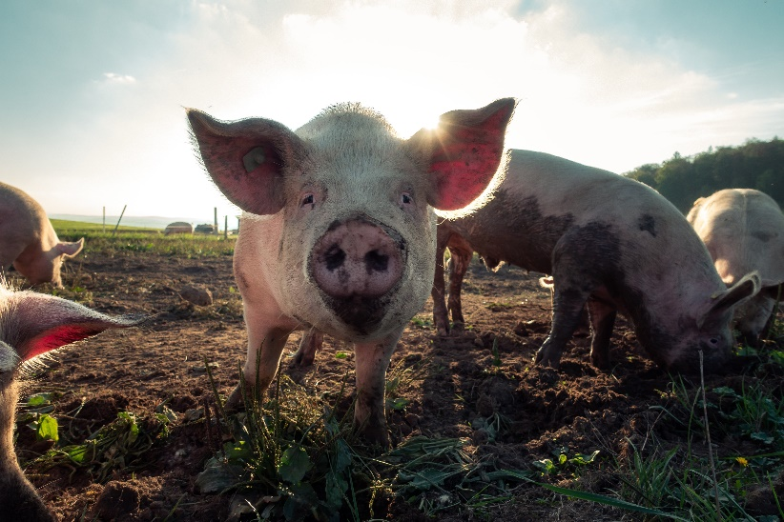
SOME OF US ARE LIKE THE YOUNGER SON…
2. THE YOUNGER SON WAS LOST IN THE CONSEQUENCES OF SIN - ‘After he had spent everything, there was a severe famine in that whole country, and he began to be in need. ¹⁵ So he went and hired himself out to a citizen of that country, who sent him to his fields to feed pigs. ¹⁶ He longed to fill his stomach with the pods that the pigs were eating, but no one gave him anything.’ Luke 15:14-16

Slide 5
SOME OF US ARE LIKE THE YOUNGER SON…
3. THE YOUNGER SON CAME TO HIS SENSES - “When he came to his senses, he said, ‘How many of my father’s hired servants have food to spare, and here I am starving to death! ¹⁸ I will set out and go back to my father and say to him: Father, I have sinned against heaven and against you. ¹⁹ I am no longer worthy to be called your son; make me like one of your hired servants.’ ²⁰ So he got up and went to his father.’ Luke 15:17-20a

Slide 6
SOME OF US ARE LIKE THE YOUNGER SON…
3. THE YOUNGER SON CAME TO HIS SENSES - “So he got up and went to his father. “But while he was still a long way off, his father saw him and was filled with compassion for him; he ran to his son, threw his arms around him and kissed him. ²¹ “The son said to him, ‘Father, I have sinned against heaven and against you. I am no longer worthy to be called your son.’ ²² “But the father said to his servants, ‘Quick! Bring the best robe and put it on him. Put a ring on his finger and sandals on his feet. ²³ Bring the fattened calf and kill it. Let’s have a feast and celebrate. ²⁴ For this son of mine was dead and is alive again; he was lost and is found.’ So they began to celebrate.’ Luke 15:20-24

Slide 7
SOME OF US ARE LIKE THE OLDER SON…
1. THE OLDER SON WAS LOST IN HIDDEN SIN - “Meanwhile, the older son was in the field. When he came near the house, he heard music and dancing. ²⁶ So he called one of the servants and asked him what was going on. ²⁷ ‘Your brother has come,’ he replied, ‘and your father has killed the fattened calf because he has him back safe and sound.’ ²⁸ “The older brother became angry and refused to go in. So his father went out and pleaded with him. ²⁹ But he answered his father, ‘Look! All these years I’ve been slaving for you and never disobeyed your orders. Yet you never gave me even a young goat so I could celebrate with my friends. ³⁰ But when this son of yours who has squandered your property with prostitutes comes home, you kill the fattened calf for him!’’ Luke 15:25-30

Slide 8
SOME OF US ARE LIKE THE OLDER SON…
2. THE OLDER SON HAD NOT YET COME TO HIS SENSES – ‘‘My son,’ the father said, ‘you are always with me, and everything I have is yours. ³² But we had to celebrate and be glad, because this brother of yours was dead and is alive again; he was lost and is found.’” Luke 15:31-32

