Slide 1
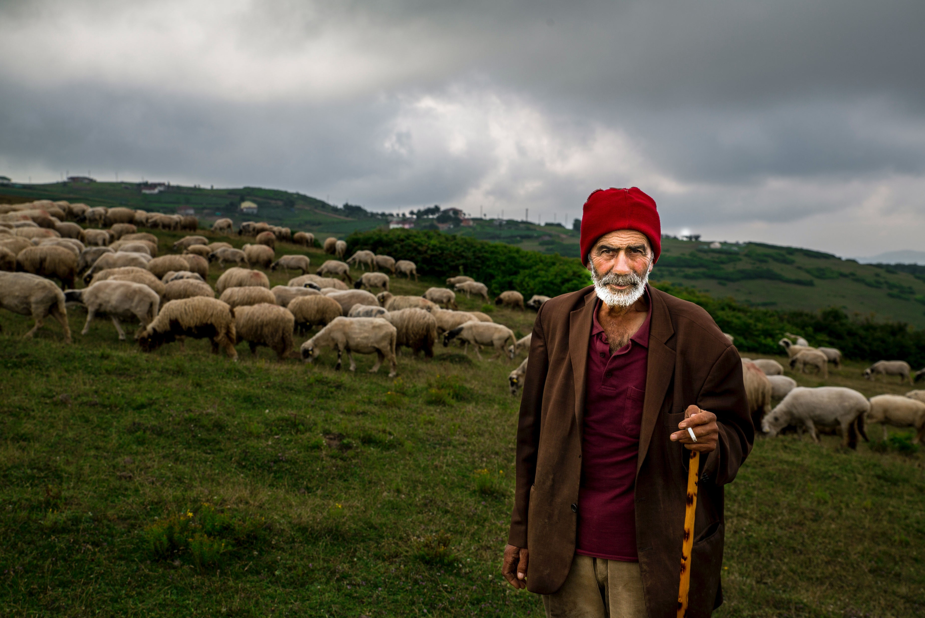
Loving, Following and Serving John 21:20-25

Slide 2
Loving, Following and Serving John 21:20-25
John’s Gospel = different

Slide 3
Loving, Following and Serving John 21:20-25
John’s Gospel = different
Overall structure:
Prologue 1:1-18 – like overture of a symphony
Book of Signs 1-12
Jewish Institutions 2:1-4:54
Jewish Festivals 5:1-10:39
Book of Glory 13-20
Farewell Discourse 13:31-16:33
Final prayer and Passion story 17-20
Epilogue 21

Slide 4
Loving, Following and Serving John 21:20-25
John’s Gospel = different
Overall structure:
Key words: “life”, “light/darkness”, “world”, “hour”
Prologue 1:1-18 – like overture of a symphony
Book of Signs 1-12
Jewish Institutions 2:1-4:54
Jewish Festivals 5:1-10:39
Book of Glory 13-20
Farewell Discourse 13:31-16:33
Final prayer and Passion story 17-20
Epilogue 21

Slide 5
Loving, Following and Serving John 21:20-25
John’s Gospel = different
Overall structure:
Key words: “life”, “light/darkness”, “world”, “hour”
Purpose: “Jesus performed many other signs in the presence of his disciples, which are not recorded in this book. But these are written that you may believe that Jesus is the Messiah, the Son of God, and that by believing you may have life in his name.

Slide 6
Loving, Following and Serving John 21:20-25
Post resurrection appearances

Slide 7
Loving, Following and Serving John 21:20-25
Post resurrection appearances
Disciples – confused

Slide 8
Loving, Following and Serving John 21:20-25
Post resurrection appearances
Disciples – confused
Peter - forgiven

Slide 9
Loving, Following and Serving John 21:20-25
Post resurrection appearances
Disciples – confused
Peter – forgiven
Call to love, follow and serve

Slide 10
Loving, Following and Serving John 21:20-25
1. Jesus calls his disciples to love, follow & serve

Slide 11
Loving, Following and Serving John 21:20-25
1. Jesus calls his disciples to love, follow & serve
“stretching out his hands”

Slide 12
Loving, Following and Serving John 21:20-25
1. Jesus calls his disciples to love, follow & serve
Initial lessons:

Slide 13
Loving, Following and Serving John 21:20-25
1. Jesus calls his disciples to love, follow & serve
Initial lessons:
Rejoice in suffering – 1 Peter 4:12-16 “Dear friends, do not be surprised at the fiery ordeal that has come on you to test you, as though something strange were happening to you. But rejoice inasmuch as you participate in the sufferings of Christ, so that you may be overjoyed when his glory is revealed. If you are insulted because of the name of Christ, you are blessed, for the Spirit of glory and of God rests on you. If you suffer, it should not be as a murderer or thief or any other kind of criminal, or even as a meddler. However, if you suffer as a Christian, do not be ashamed, but praise God that you bear that name.”

Slide 14
Loving, Following and Serving John 21:20-25
1. Jesus calls his disciples to love, follow & serve
Initial lessons:
Rejoice in suffering
No trouble-free life

Slide 15
Loving, Following and Serving John 21:20-25
1. Jesus calls his disciples to love, follow & serve
Initial lessons:
Rejoice in suffering
No trouble-free life
“Some faced jeers and flogging, and even chains and imprisonment. They were put to death by stoning; they were sawn in two; they were killed by the sword. They went about in sheepskins and goatskins, destitute, persecuted and ill-treated – the world was not worthy of them. They wandered in deserts and mountains, living in caves and in holes in the ground” Heb.11: 36-38

Slide 16
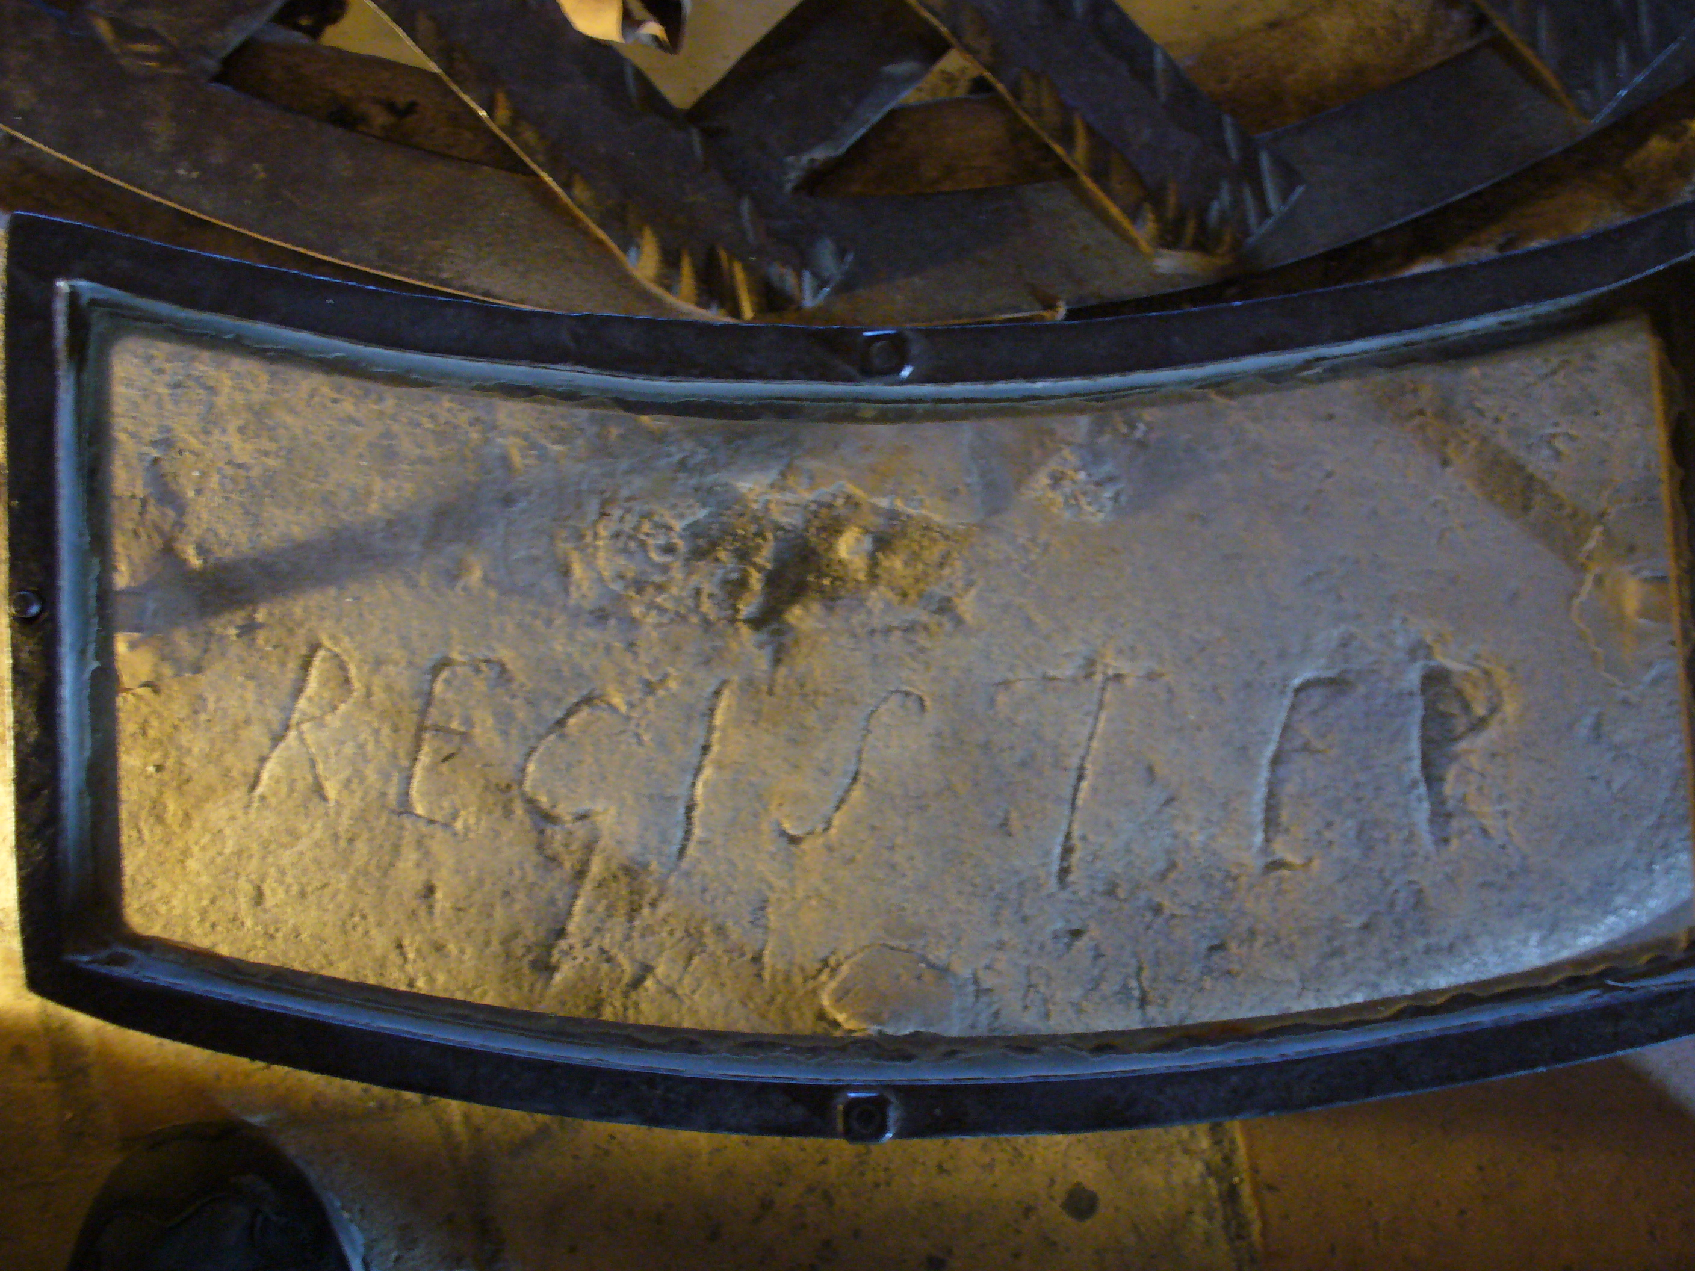
Loving, Following and Serving John 21:20-25
1. Jesus calls his disciples to love, follow & serve
Initial lessons:
Rejoice in suffering
No trouble-free life
Marie-Durand 1711- 1776 French protestant imprisoned for 38 years in the Tour de Constance, Southern France.

Slide 17
Loving, Following and Serving John 21:20-25
1. Jesus calls his disciples to love, follow & serve
Initial lessons:
Rejoice in suffering
No trouble-free life
All mortal – how will serve in times of trial?

Slide 18
Loving, Following and Serving John 21:20-25
Jesus calls his disciples to love, follow & serve
Jesus calls each disciple to love, follow and serve
Peter turned and saw that the disciple whom Jesus loved was following them. (This was the one who had leaned back against Jesus at the supper and had said, ‘Lord, who is going to betray you?’) When Peter saw him, he asked, ‘Lord, what about him?’

Slide 19
Loving, Following and Serving John 21:20-25
Jesus calls his disciples to love, follow & serve
Jesus calls each disciple to love, follow and serve
Jesus is Lord of each and every believer

Slide 20
Loving, Following and Serving John 21:20-25
Jesus calls his disciples to love, follow & serve
Jesus calls each disciple to love, follow and serve
Jesus is Lord of each and every believer
He uses our different personalities for His glory

Slide 21
Loving, Following and Serving John 21:20-25
Jesus calls his disciples to love, follow & serve
Jesus calls each disciple to love, follow and serve
Jesus is Lord of each and every believer
He uses our different personalities for His glory
Avoid comparisons!!

Slide 22
Loving, Following and Serving John 21:20-25
Jesus calls his disciples to love, follow & serve
Jesus calls each disciple to love, follow and serve
Jesus calls each disciple to love, follow and serve until he returns!
“Jesus answered, ‘If I want him to remain alive until I return, what is that to you? You must follow me’” (v.22)

Slide 23
Loving, Following and Serving John 21:20-25
Jesus calls his disciples to love, follow & serve
Jesus calls each disciple to love, follow and serve
Jesus calls each disciple to love, follow and serve until he returns!
No date setting!

Slide 24
Loving, Following and Serving John 21:20-25
Jesus calls his disciples to love, follow & serve
Jesus calls each disciple to love, follow and serve
Jesus calls each disciple to love, follow and serve until he returns!
No date setting!
Keep watch
“You will hear of wars and rumours of wars, but see to it that you are not alarmed. Such things must happen, but the end is still to come…these are the beginnings of birth-pains…Therefore, keep watch…!” (Matthew 24:6-7,42)

Slide 25
Loving, Following and Serving John 21:20-25
Jesus calls his disciples to love, follow & serve
Jesus calls each disciple to love, follow and serve
Jesus calls each disciple to love, follow and serve until he returns!
Jesus calls each disciple to love, follow and serve until he calls them home

Slide 26
Loving, Following and Serving John 21:20-25
Jesus calls his disciples to love, follow & serve
Jesus calls each disciple to love, follow and serve
Jesus calls each disciple to love, follow and serve until he returns!
Jesus calls each disciple to love, follow and serve until he calls them home
Conclusion: Have we accepted Him? Do we love Him? Do we trust Him? Are we following Him? Are we serving Him?

Slide 27
Loving, Following and Serving John 21:20-25
Jesus calls his disciples to love, follow & serve
Jesus calls each disciple to love, follow and serve
Jesus calls each disciple to love, follow and serve until he returns!
Jesus calls each disciple to love, follow and serve until he calls them home
Conclusion: Have we accepted Him? Do we love Him? Do we trust Him? Are we following Him? Are we serving Him?
“Let us run with perseverance the race marked out for us, fixing our eyes on Jesus, the pioneer and perfecter of our faith” Heb.12:1/2

