Slide 1
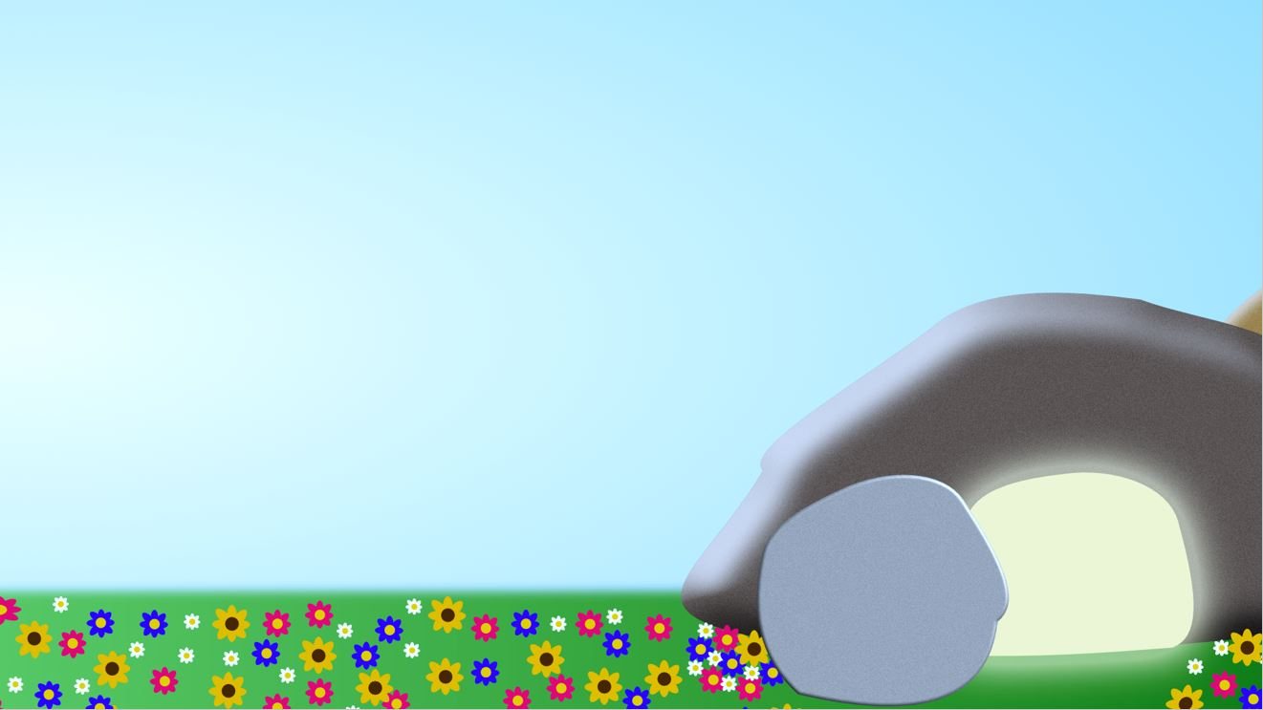
The Garden of Eden where…
Man was DISOBEDIENT
Man thought of HIMSELF
Man’s choice led to DEATH
The Garden of Gethsemane

Slide 2
The Garden of Eden where…
Man was DISOBEDIENT
Man thought of HIMSELF
Man’s choice led to DEATH
‘For I have come down from heaven not to do my will but to do the will of Him who sent me.’
John 6:38
‘The reason my Father loves me is that I lay down my life-only to take it up again.’
John 10:17
The Garden of Gethsemane where…
Jesus was OBEDIENT
‘Yet not as I will, but as You will.’
Matthew 26:39

Slide 3
The Garden of Eden where…
Man was DISOBEDIENT
Man thought of HIMSELF
Man’s choice led to DEATH
‘…each person is tempted when they are dragged away by their own evil desire and enticed. Then, after desire has conceived, it gives birth to sin; and sin, when it is full-grown, gives birth to death.’ James 1:14-15
‘For just as through the disobedience of the one man the many were made sinners, so also through the obedience of the one man the many will be made righteous.’ Romans 5:19
‘I am the good shepherd. The good shepherd lays down His life for the sheep.’
John 10:11
The Garden of Gethsemane where…
Jesus was OBEDIENT
Jesus thought of OTHERS
Jesus chose DEATH to give us LIFE!

Slide 4
The Garden of Eden where…
Man was DISOBEDIENT
Man thought of HIMSELF
Man’s choice led to DEATH
The Garden of Gethsemane where…
Jesus was OBEDIENT
Jesus thought of OTHERS
Jesus chose DEATH to give us LIFE!

Slide 5
The Garden of the Empty Tomb where…
Jesus proved Himself to be the Son of God
Jesus’ victory gives certain HOPE to ALL believers
‘The reason my Father loves me is that I lay down my life-only to take it up again. No one takes it from me, but I lay it down of my own accord. I have authority to lay it down and authority to take it up again.’
John 10:17-18
‘Early on the first day of the week, while it was still dark, Mary Magdalene went to the tomb…’ John 20:1
‘Destroy this temple, and I will raise it again in three days.’
John 2:19

Slide 6
The Garden of the Empty Tomb where…
Jesus proved Himself to be the Son of God
Jesus’ victory gives certain HOPE to ALL believers
‘“Where, O death, is your victory? Where, O death, is your sting?”
The sting of death is sin, and the power of sin is the law. But thanks be to God! He gives us the victory through our Lord Jesus Christ’
1 Corinthians 15:55-57

Slide 7
The Garden of the Empty Tomb where…
Jesus proved Himself to be the Son of God
Jesus’ victory gives certain HOPE to ALL believers
‘…so that in Him we might become the righteousness of God.’
2 Corinthians 5:21

Slide 8
The Garden of Eden where…
Man was DISOBEDIENT
Man thought of HIMSELF
Man’s choice led to DEATH
The Garden of Gethsemane where…
Jesus was OBEDIENT
Jesus thought of OTHERS
Jesus chose DEATH to give us LIFE!

Slide 9
The Garden of the Empty Tomb where…
Jesus proved Himself to be the Son of God
Jesus’ victory gives certain HOPE to ALL believers

