Slide 1
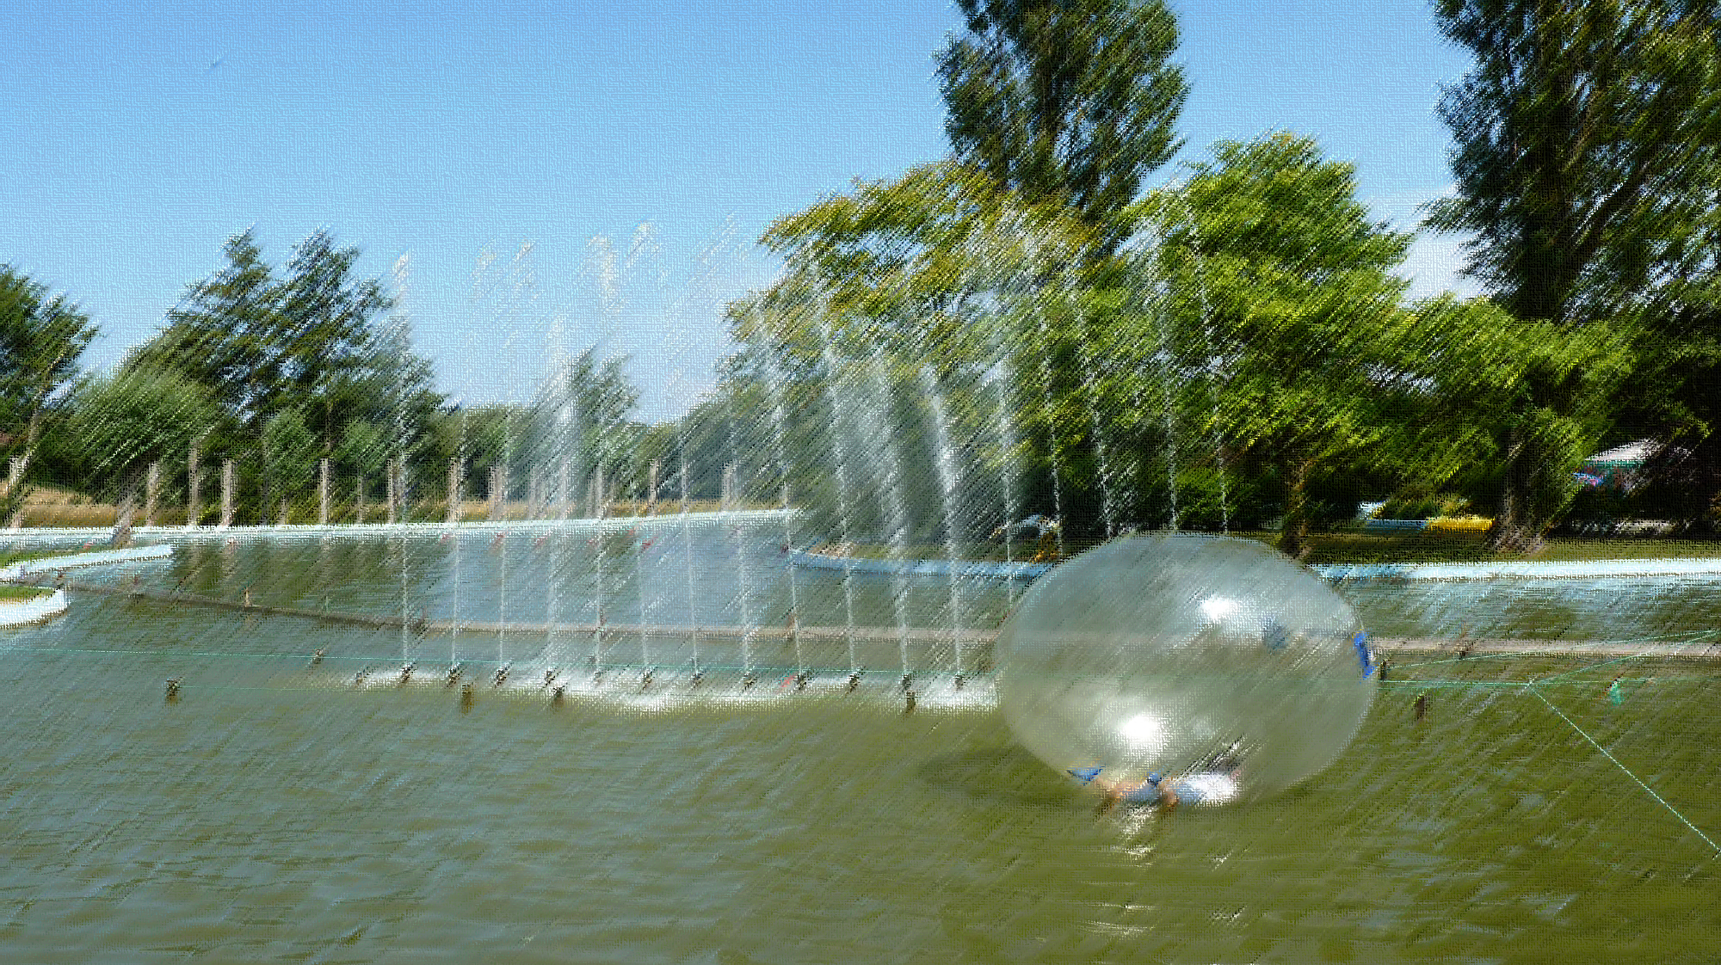
“Trivial Pursuits”
Ecclesiastes 1:12-2:26

Slide 2
“Trivial Pursuits”
Ecclesiastes 1:12-2:26
Dissatisfaction

Slide 3
“Trivial Pursuits”
Ecclesiastes 1:12-2:26
Dissatisfaction
Appearance

Slide 4
“Trivial Pursuits”
Ecclesiastes 1:12-2:26
Dissatisfaction
Appearance
Education

Slide 5
“Trivial Pursuits”
Ecclesiastes 1:12-2:26
Dissatisfaction
Appearance
Education
Wealth

Slide 6
“Trivial Pursuits”
Ecclesiastes 1:12-2:26
Dissatisfaction
Appearance
Education
Wealth
Relationships

Slide 7
“Trivial Pursuits”
Ecclesiastes 1:12-2:26
Dissatisfaction
Appearance
Education
Wealth
Relationships
Occupation

Slide 8
“Trivial Pursuits”
Ecclesiastes 1:12-2:26
Dissatisfaction
Solomon’s experience

Slide 9
“Trivial Pursuits”
Ecclesiastes 1:12-2:26
1. Satisfaction not found in better education 1:12-18
“I, the Professor, was king over Israel in Jerusalem. I applied my mind to study and to explore by wisdom all that is done under the heavens. What a heavy burden…I have seen all the things that are done under the sun; all of them are meaningless, I said to myself, ‘Look, I have increased in wisdom more than anyone…before me; I applied myself to the understanding of wisdom, and also of madness and folly,…this, too, is a chasing after the wind. For with much wisdom comes much sorrow, the more knowledge, the more grief.’”

Slide 10
“Trivial Pursuits”
Ecclesiastes 1:12-2:26
1. Satisfaction not found in better education 1:12-18
Gift of wisdom to analyse life

Slide 11
“Trivial Pursuits”
Ecclesiastes 1:12-2:26
1. Satisfaction not found in better education 1:12-18
Gift of wisdom to analyse life
Received excellent education

Slide 12
“Trivial Pursuits”
Ecclesiastes 1:12-2:26
1. Satisfaction not found in better education 1:12-18
Gift of wisdom to analyse life
Received excellent education
“Hebel” (futile)

Slide 13
“Trivial Pursuits”
Ecclesiastes 1:12-2:26
1. Satisfaction not found in better education 1:12-18
Gift of wisdom to analyse life
Received excellent education
“Hebel” (futile)
Surely study is important?

Slide 14
“Trivial Pursuits”
Ecclesiastes 1:12-2:26
1. Satisfaction not found in better education 1:12-18
Gift of wisdom to analyse life
Received excellent education
“Hebel” (futile)
Surely study is important?
Yes, but understanding isn’t everything

Slide 15
“Trivial Pursuits”
Ecclesiastes 1:12-2:26
1. Satisfaction not found in better education 1:12-18
Gift of wisdom to analyse life
Received excellent education
“Hebel” (futile)
Surely study is important?
Yes, but understanding isn’t everything
Too many “sound bites”!

Slide 16
“Trivial Pursuits”
Ecclesiastes 1:12-2:26
Satisfaction not found in better education 1:12-18
Satisfaction not found in mockery 2:1-3
“I said to myself, ‘Come now, I will test you with pleasure to find out what is good.’ But that also proved to be meaningless. ‘Laughter,’ I said, ‘is madness,’ and what does pleasure accomplish? I tried cheering myself with wine and embracing folly - my mind still guiding me with wisdom. I wanted to see what was good for people to do under the heavens during the few days of their lives.”

Slide 17
“Trivial Pursuits”
Ecclesiastes 1:12-2:26
Satisfaction not found in better education 1:12-18
Satisfaction not found in mockery 2:1-3
“Eat, drink and merry goes round!”

Slide 18
“Trivial Pursuits”
Ecclesiastes 1:12-2:26
Satisfaction not found in better education 1:12-18
Satisfaction not found in mockery 2:1-3
“Eat, drink and merry goes round!”
Hollow and empty…

Slide 19
“Trivial Pursuits”
Ecclesiastes 1:12-2:26
Satisfaction not found in better education 1:12-18
Satisfaction not found in mockery 2:1-3
“Eat, drink and merry goes round!”
Hollow and empty
Cover-up artists

Slide 20
“Trivial Pursuits”
Ecclesiastes 1:12-2:26
Satisfaction not found in better education 1:12-18
Satisfaction not found in mockery 2:1-3
3. Satisfaction not found in great projects 2:4-11
House & garden “I undertook great projects: I built houses for myself and planted vineyards. I made gardens and parks and planted all kinds of fruit trees in them. I made reservoirs to water groves of flourishing trees. I bought male and female slaves and I had other slaves who were born in my house. I also owned more herds flocks than anyone in Jerusalem before me” (2:4-7)

Slide 21
“Trivial Pursuits”
Ecclesiastes 1:12-2:26
Satisfaction not found in better education 1:12-18
Satisfaction not found in mockery 2:1-3
3. Satisfaction not found in great projects 2:4-11
House & garden
“Design for living” “We’re terribly house and garden, at number 7B.
We live in a most amusing muse,
Ever so contemporary.
We’re terribly ‘house and garden’,
The money that one spends.
To make a place that won’t disgrace
Our house and garden friends.”

Slide 22
“Trivial Pursuits”
Ecclesiastes 1:12-2:26
Satisfaction not found in better education 1:12-18
Satisfaction not found in mockery 2:1-3
3. Satisfaction not found in great projects 2:4-11
House & garden 2:4-7
Wealth “I amassed silver and gold for myself, and the treasure of kings and provinces. I acquired male and female singers and a harem as well. I became greater by far than anyone in Jerusalem. In all this, my wisdom stayed with me.” 2:8-9

Slide 23
“Trivial Pursuits”
Ecclesiastes 1:12-2:26
Satisfaction not found in better education 1:12-18
Satisfaction not found in mockery 2:1-3
3. Satisfaction not found in accomplishments 2:4-11
House & garden 2:4-7
Wealth 2:8-9
Accomplishments “I denied myself nothing eyes desired; I refused my heart no pleasure. My heart took delight in all my labour, and this was the reward for all my toil. Yet when I surveyed all that my hands had done and what I had toiled to achieve, everything was meaningless, a chasing after the wind; nothing was gained under the sun” (2:10-11)

Slide 24
“Trivial Pursuits”
Ecclesiastes 1:12-2:26
Satisfaction not found in better education 1:12-18
Satisfaction not found in mockery 2:1-3
3. Satisfaction not found in accomplishments 2:4-11
4. Satisfaction not found in dignified death 2:12-16
“Then I turned my thoughts to consider wisdom, and also madness and folly… I saw that wisdom is better than folly, just as light is better than darkness. The wise have eyes in their heads, while the fool walks in the darkness; but I came to realise that the same fate overtakes them both. Then I said to myself, "The fate of the fool will overtake me also. What then do I gain by being wise?" … "This too is meaningless." … Like the fool, the wise too must die! “

Slide 25
“Trivial Pursuits”
Ecclesiastes 1:12-2:26
Satisfaction not found in better education 1:12-18
Satisfaction not found in mockery 2:1-3
3. Satisfaction not found in accomplishments 2:4-11
4. Satisfaction not found in dignified death 2:12-16
All in the dark!

Slide 26
“Trivial Pursuits”
Ecclesiastes 1:12-2:26
Satisfaction not found in better education 1:12-18
Satisfaction not found in mockery 2:1-3
3. Satisfaction not found in accomplishments 2:4-11
4. Satisfaction not found in dignified death 2:12-16
All in the dark!
“Total eclipse of the heart…”

Slide 27
“Trivial Pursuits”
Ecclesiastes 1:12-2:26
Satisfaction not found in better education 1:12-18
Satisfaction not found in mockery 2:1-3
3. Satisfaction not found in accomplishments 2:4-11
4. Satisfaction not found in dignified death 2:12-16
5. Satisfaction not even found in living 2:17-23
So I hated life, because the work that is done under the sun was grievous to me. All of it is meaningless…I hated all the things I had toiled for under the sun, because I must leave them to the one who comes after me. And who knows whether that person will be wise or foolish? Yet they will have control over the fruit of my toil into which I have poured my effort…This too is meaningless. So my heart began to despair over all my toilsome labour under the sun…”

Slide 28
“Trivial Pursuits”
Ecclesiastes 1:12-2:26
Satisfaction not found in better education 1:12-18
Satisfaction not found in mockery 2:1-3
3. Satisfaction not found in accomplishments 2:4-11
4. Satisfaction not found in dignified death 2:12-16
5. Satisfaction not even found in living 2:17-23
Rehoboam

Slide 29
“Trivial Pursuits”
Ecclesiastes 1:12-2:26
Satisfaction not found in better education 1:12-18
Satisfaction not found in mockery 2:1-3
3. Satisfaction not found in accomplishments 2:4-11
4. Satisfaction not found in dignified death 2:12-16
5. Satisfaction not even found in living 2:17-23
Solomon’s conclusion – 2:24-26
“A person can do nothing better than to eat and drink and find satisfaction in their own toil. This too, I see, is from the hand of God, for without him, who can eat and find enjoyment? To the person who pleases him, God gives wisdom, knowledge and happiness, but to the sinner he gives the task of gathering and storing up wealth to hand it over to the one who pleases God. This too is meaningless, a chasing after the wind.”

Slide 30
“Trivial Pursuits”
Ecclesiastes 1:12-2:26
Satisfaction not found in better education 1:12-18
Satisfaction not found in mockery 2:1-3
3. Satisfaction not found in accomplishments 2:4-11
4. Satisfaction not found in dignified death 2:12-16
5. Satisfaction not even found in living 2:17-23
Solomon’s conclusion – 2:24-26
Limited enjoyment only

Slide 31
“Trivial Pursuits”
Ecclesiastes 1:12-2:26
Satisfaction not found in better education 1:12-18
Satisfaction not found in mockery 2:1-3
3. Satisfaction not found in accomplishments 2:4-11
4. Satisfaction not found in dignified death 2:12-16
5. Satisfaction not even found in living 2:17-23
Solomon’s conclusion – 2:24-26
Limited enjoyment only
True fulfilment on higher plane

Slide 32
“Trivial Pursuits”
Ecclesiastes 1:12-2:26
Satisfaction not found in better education 1:12-18
Satisfaction not found in mockery 2:1-3
3. Satisfaction not found in accomplishments 2:4-11
4. Satisfaction not found in dignified death 2:12-16
5. Satisfaction not even found in living 2:17-23
Solomon’s conclusion – 2:24-26
Limited enjoyment only
True fulfilment on higher plane
Satisfaction found only in God

Slide 33
“Trivial Pursuits”
Ecclesiastes 1:12-2:26
Satisfaction not found in better education 1:12-18
Satisfaction not found in mockery 2:1-3
3. Satisfaction not found in accomplishments 2:4-11
4. Satisfaction not found in dignified death 2:12-16
5. Satisfaction not even found in living 2:17-23
Solomon’s conclusion – 2:24-26
Limited enjoyment only
True fulfilment on higher plane
Satisfaction found only in God
Broken cisterns versus “living water”!

