Slide 1
Ephesians
Living as children of light

Slide 2
‘There is neither Jew nor Gentile, neither slave nor free, nor is there male and female, for you are all one in Christ Jesus.’
Galatians 3:28

Slide 3
Ephesians 1 – It’s not just about me!
Vs.3 ‘Praise be to the God and Father of our Lord Jesus Christ who has blessed US…’
Vs.4 ‘For He chose US in Him…’
Vs.5 ‘He predestined US for adoption…’
Vs.6 ‘He has freely given US in the One He loves’
Vs.7 ‘In Him WE have redemption…’
Vs.8 ‘that He lavished on US…’
Vs.9 ‘He made know to US the mystery…’

Slide 4
Ephesians 2 – It’s not just about me!
Vs.3 ‘ALL of us also lived among them…’
Vs.3 ‘like the rest WE were by nature deserving of wrath…’
Vs.4 ‘But because of His great love to US…’
Vs.5 ‘made US alive with Christ even when WE were dead in transgressions…’
Vs.10 ‘For WE are God’s handiwork, created in Christ Jesus to do good works…’

Slide 5
The Wealth
of the Christian
(Part 11)
Ephesians
2:11-13
Remember, Remember and Rejoice!
Remember the division (vs.11)
Remember the despair (vs.12)
Rejoice in the death of Christ (vs.13)
‘But now in Christ Jesus you who once were far away have been brought near by the blood of Christ.’

Slide 6
The Wealth
of the Christian
(Part 12)
Ephesians
2:14-18
Jesus is the Christian’s peace
Jesus made peace (vs.14-16)
Jesus proclaimed peace (vs.17)
Jesus gives us peace (vs.18)
“Peace, peace, to those far and near,” says the Lord
Isaiah 57:19

Slide 7
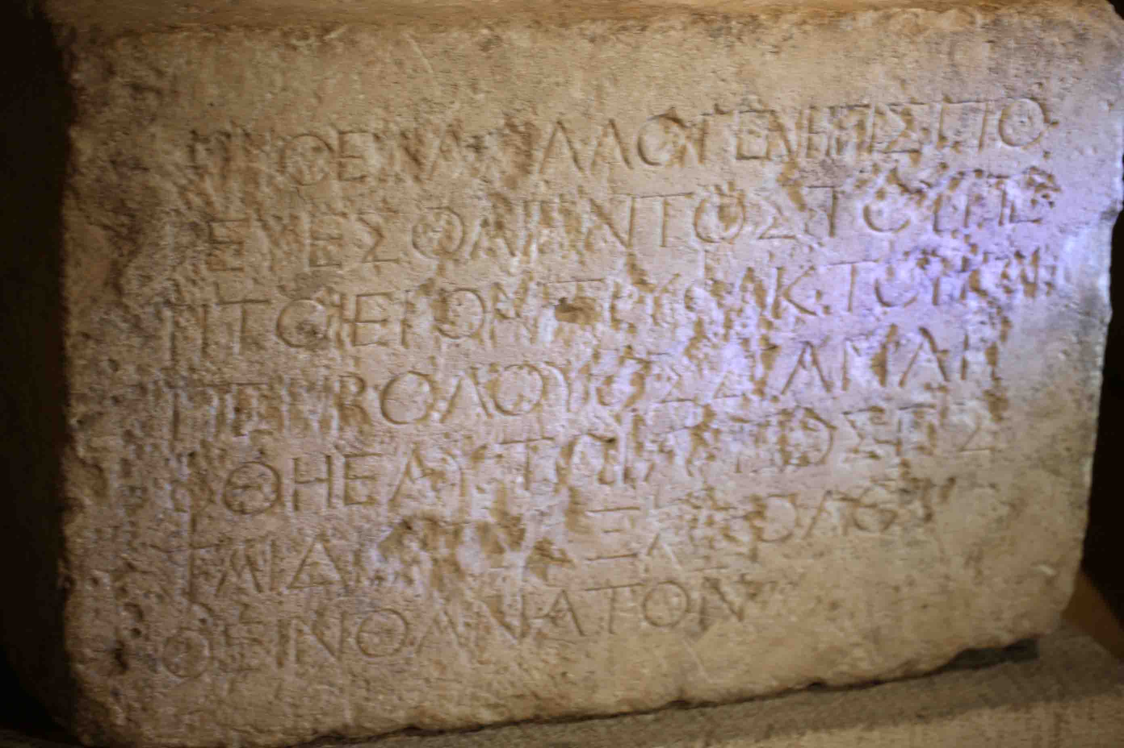
The Wealth
of the Christian
(Part 12)
Ephesians
2:14-18
Jesus is the Christian’s peace
Jesus made peace (vs.14-16)
‘Therefore no one will be declared righteous in God's sight by the works of the law; rather, through the law we become conscious of our sin.’
Romans 3:20
“Do not think that I have come to abolish the Law or the Prophets; I have not come to abolish them but to fulfil them.”
Matthew 5:17
…He said “Is it not written: ‘My house will be called a house of prayer for all nations’?”
Mark 11:17

Slide 8
The Wealth
of the Christian
(Part 12)
Ephesians
2:14-18
Jesus is the Christian’s peace
Jesus made peace (vs.14-16)
- By abolishing the law
“Do not think that I have come to abolish the Law or the Prophets; I have not come to abolish them but to fulfil them.”
Matthew 5:17

Slide 9
The Wealth
of the Christian
(Part 12)
Ephesians
2:14-18
Jesus is the Christian’s peace
Jesus made peace (vs.14-16)
- By abolishing the law
“Do not think that I have come to abolish the Law or the Prophets; I have not come to abolish them but to fulfil them.”
Matthew 5:17

Slide 10
The Wealth
of the Christian
(Part 12)
Ephesians
2:14-18
Jesus is the Christian’s peace
Jesus made peace (vs.14-16)
- By abolishing the law
- By creating one new humanity
“My prayer is not for them alone. I pray also for those who will believe in me through their message, that all of them may be one, Father, just as you are in me and I am in you.”
John 17:20-21

Slide 11
The Wealth
of the Christian
(Part 12)
Ephesians
2:14-18
Jesus is the Christian’s peace
Jesus made peace (vs.14-16)
- By abolishing the law
- By creating one new humanity
- By reconciling us through the cross
‘Because the law brings wrath’ - Romans 4:15
“He Himself bore our sins” in His body on the cross, so that we might die to sins and live for righteousness; “by His wounds you have been healed.”
1 Peter 2:24

Slide 12
The Wealth
of the Christian
(Part 12)
Ephesians
2:14-18
Jesus is the Christian’s peace
Jesus made peace (vs.14-16)
- By abolishing the law
- By creating one new humanity
- By reconciling us through the cross
“Peace I leave with you, my peace I give you. I do not give as the world gives. Do not let your hearts be troubled and do not be afraid.”
John 14:27

Slide 13
The Wealth
of the Christian
(Part 12)
Ephesians
2:14-18
Jesus is the Christian’s peace
Jesus made peace (vs.14-16)
Jesus proclaimed peace (vs.17)
- To ALL!
- When Jesus was on earth
- Before Jesus left (Matt 28:19)
- Now Jesus is in heaven (Acts 9:15)
- ‘Peace’ is at the heart of the gospel! (6:15)

Slide 14
The Wealth
of the Christian
(Part 12)
Ephesians
2:14-18
Jesus is the Christian’s peace
Jesus made peace (vs.14-16)
Jesus proclaimed peace (vs.17)
Jesus gives us peace (vs.18)
- We both have access to the Father
- Through Jesus
- By one Spirit
“I am the way and the truth and the life. No one comes to the Father except through me.”
John 14:6

Slide 15
The Wealth
of the Christian
(Part 12)
Ephesians
2:14-18
Jesus is the Christian’s peace
Jesus made peace (vs.14-16)
Jesus proclaimed peace (vs.17)
Jesus gives us peace (vs.18)
- We both have access to the Father
- Through Jesus
- By one Spirit
‘What other nation is so great as to have their gods near them the way the LORD our God is near us whenever we pray to Him?’ Deut. 4:7

Slide 16
Ephesians
Living as children of light

