Slide 1
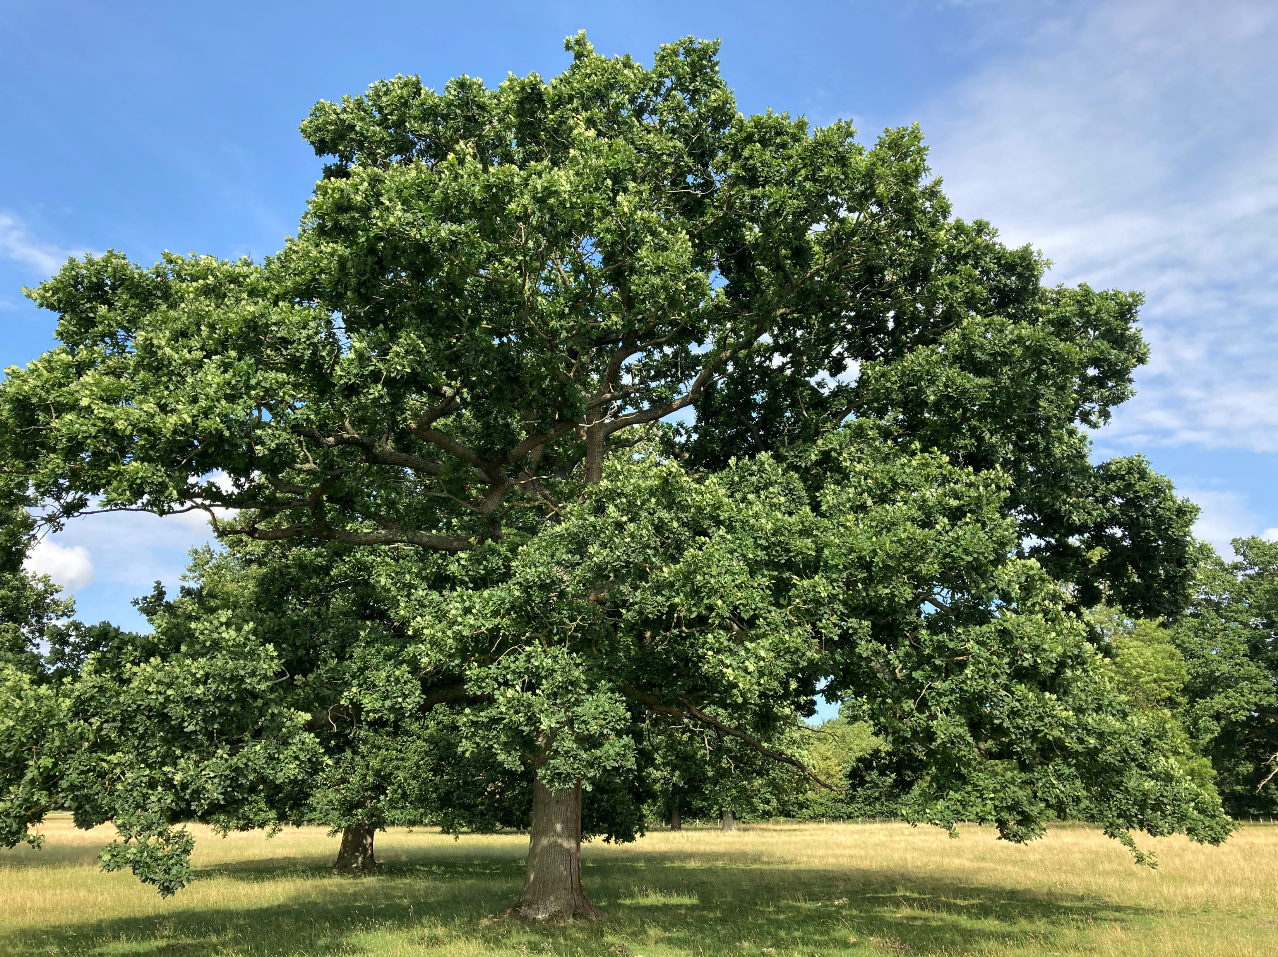
Zacchaeus
Luke 19:1-10

Slide 2
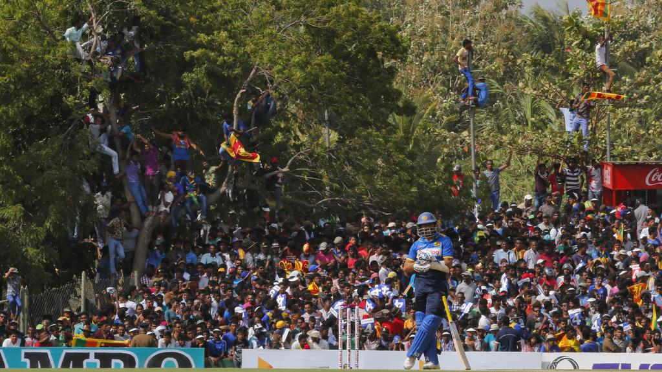

Slide 4
Zacchaeus
Luke 19:1-10

Slide 5
‘For the Son of Man came to seek and to save the lost.’
Luke 19:10

Slide 6
Zacchaeus was lost
He was a ‘sinner’ (vs.7-8)
Really?... (vs.1-2)
Great place to live
Great job
Great wealth
Although... (vs.3 & 7)
He was short
He was not liked
Luke 19:1-10

Slide 7
Zacchaeus was lost
He was a ‘sinner’ (vs.7-8)
- Sin separates us from God
‘But your iniquities have separated you from your God’
Isaiah 59:2
Luke 19:1-10

Slide 8
Zacchaeus was lost
He was a ‘sinner’ (vs.7-8)
- Sin separates us from God
- We are all sinners
‘For all have sinned and fall short of the glory of God’
Romans 3:23

Slide 9
Zacchaeus was lost
He was a ‘sinner’ (vs.7-8)
- Sin separates us from God
- We are all sinners
He wanted to see who Jesus WAS (vs.3)
‘You will seek me and find me when you seek me with all your heart.’ Jeremiah 29:13
Luke 19:1-10

Slide 10
Zacchaeus was lost
He was a ‘sinner’ (vs.7-8)
- Sin separates us from God
- We are all sinners
He wanted to see who Jesus WAS (vs.3)
‘For everyone who asks receives; the one who seeks finds; and to the one who knocks, the door will be opened.’
Matthew 7:7-8
Luke 19:1-10

Slide 11
Zacchaeus was found and saved by Jesus!
Jesus knew his name (vs.5)
Jesus had time for him (vs.5-9)
Jesus saved him (vs.6-10)
Evidenced by: Obedience
Actions
Jesus’ Words
Luke 19:1-10

Slide 12
‘For Christ also suffered once for sins, the righteous for the unrighteous, to bring you to God.’
1 Peter 3:18

Slide 13
‘For the Son of Man came to seek and to save the lost.’
Luke 19:10

Slide 14
Zacchaeus
Luke 19:1-10

