Slide 1
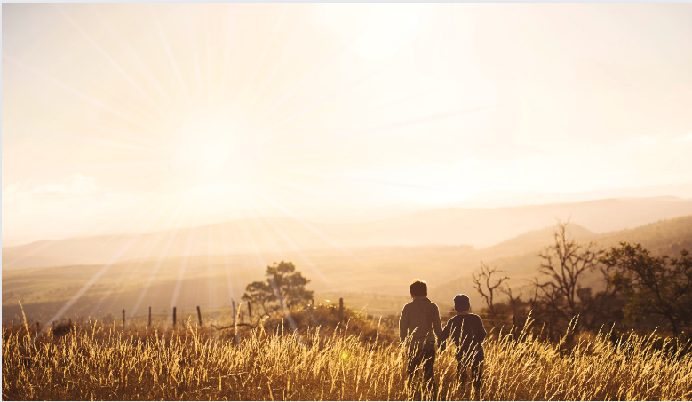
Ephesians
Living as children of light

Slide 2
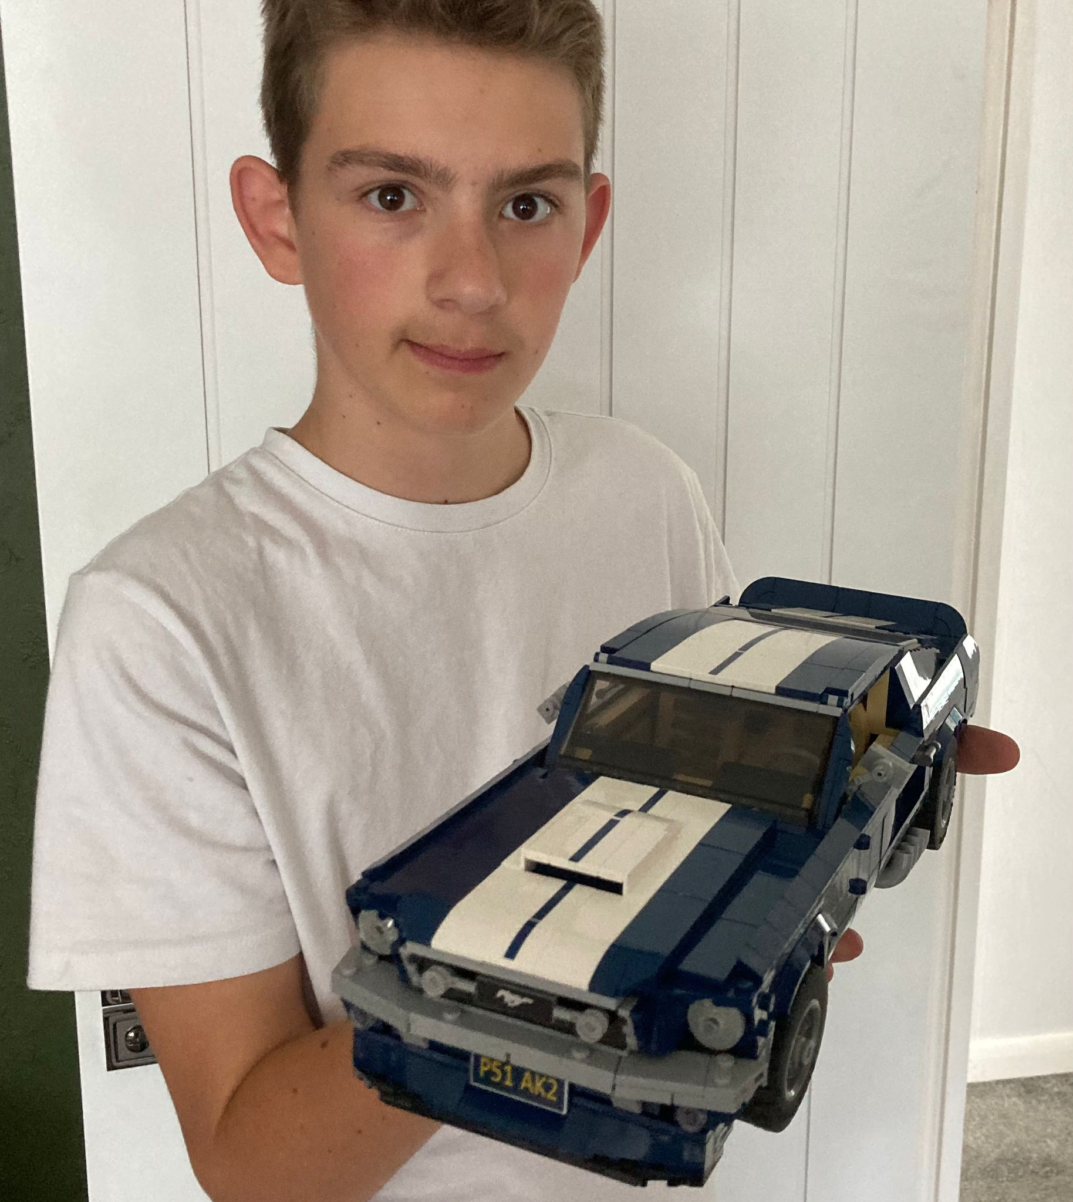
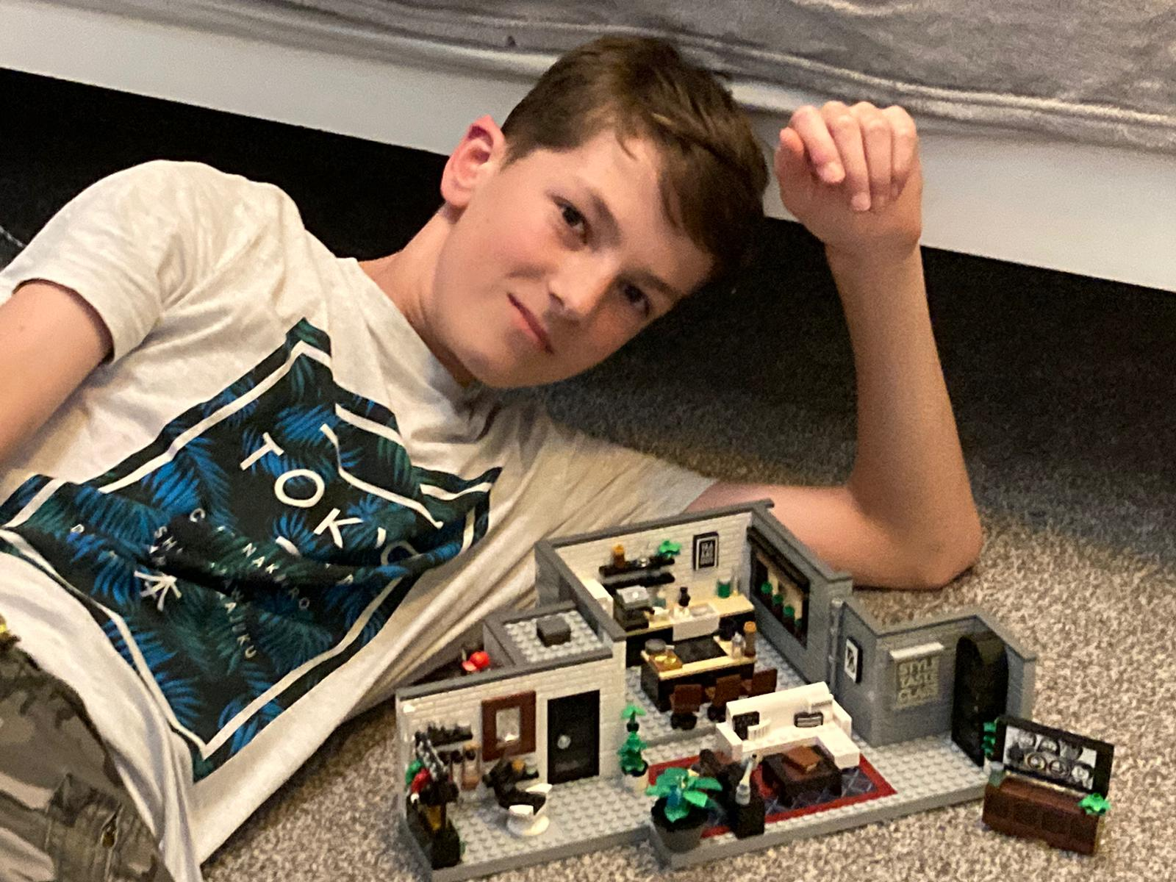
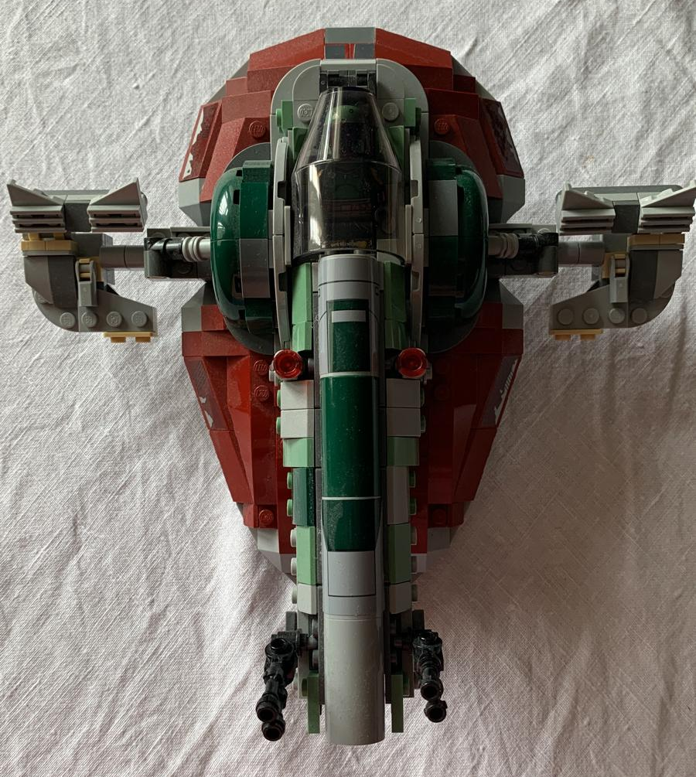
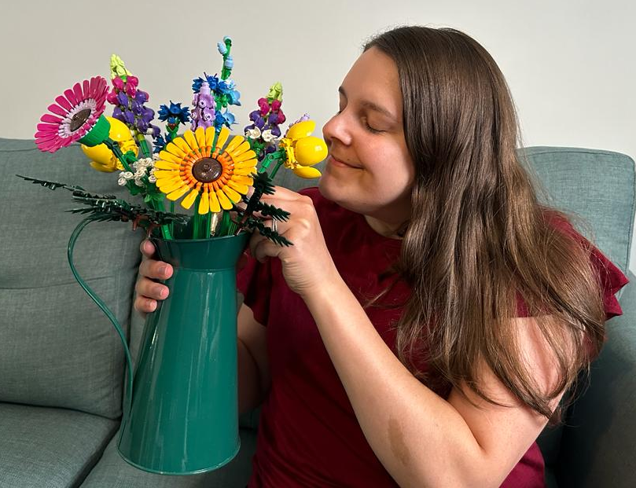
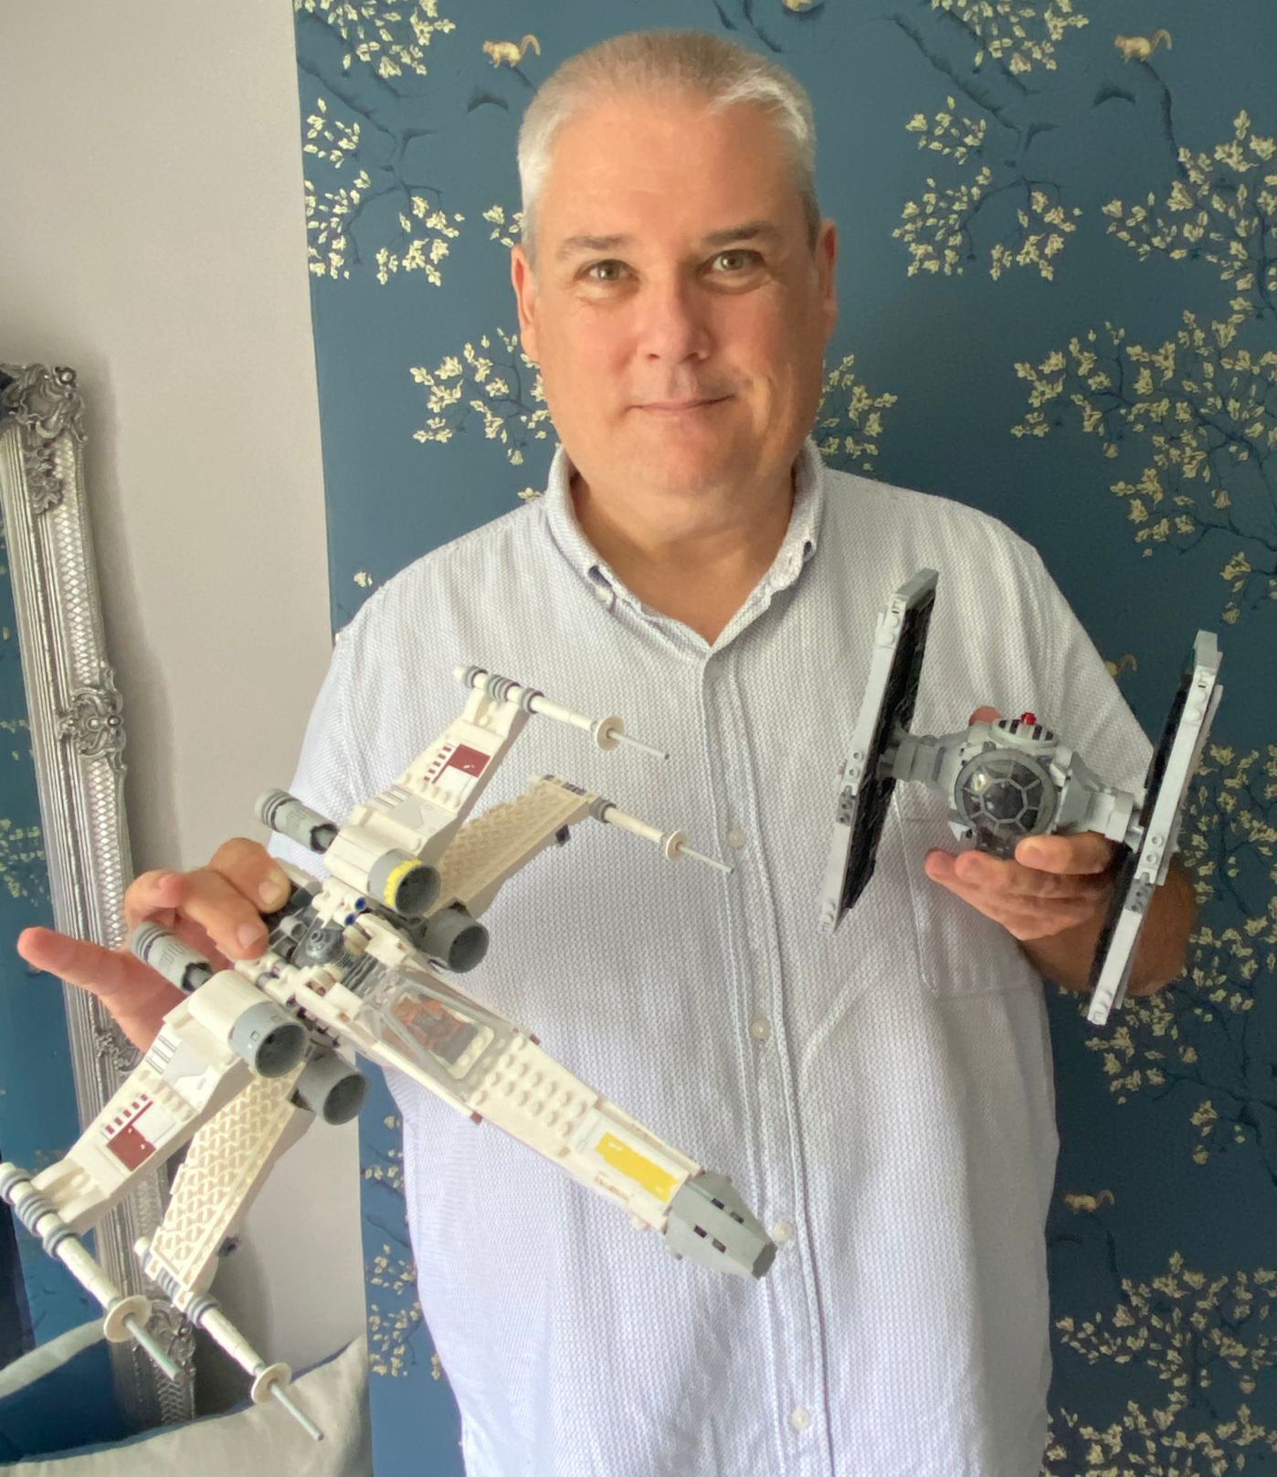
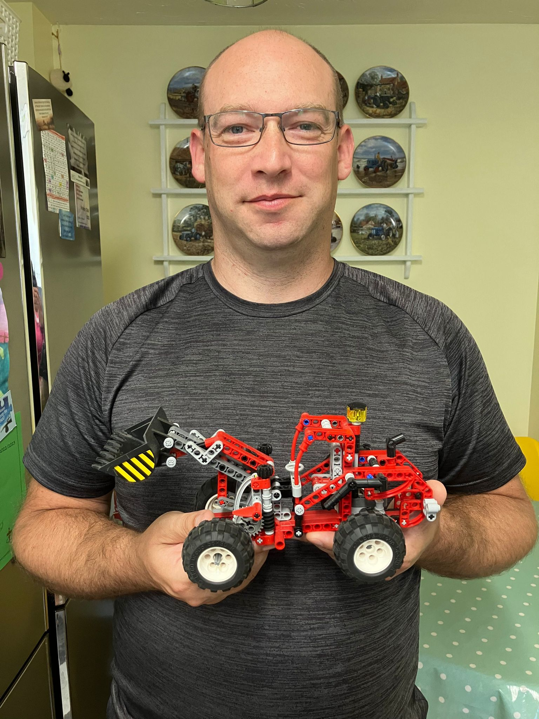
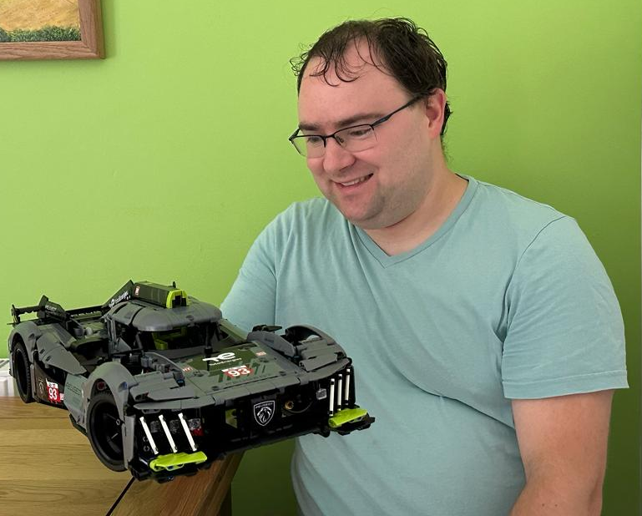
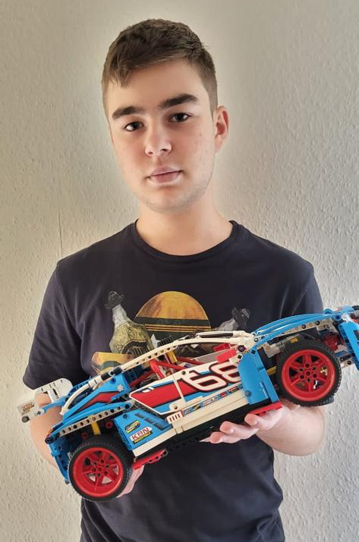
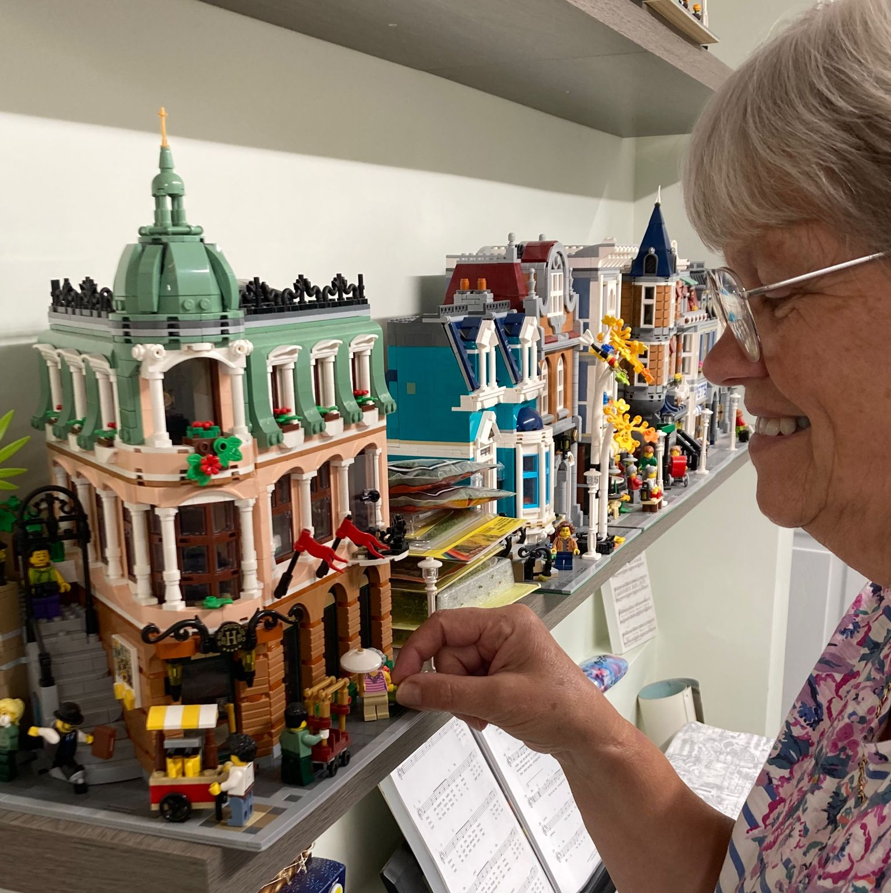

Slide 3
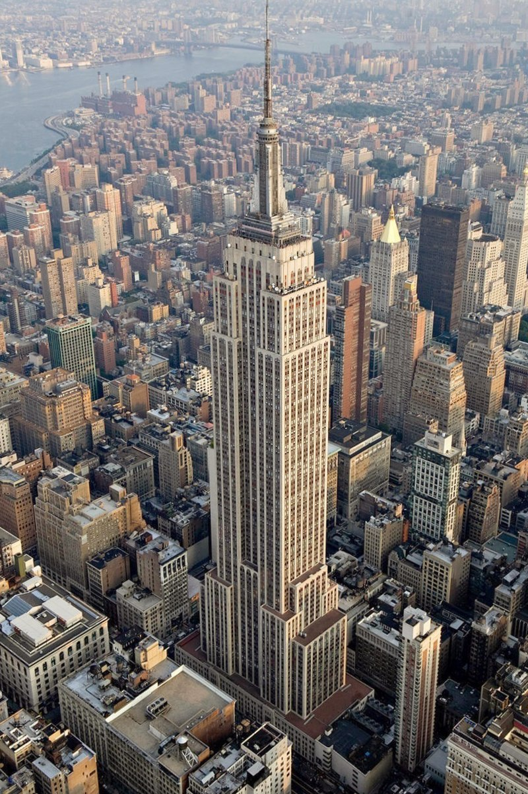
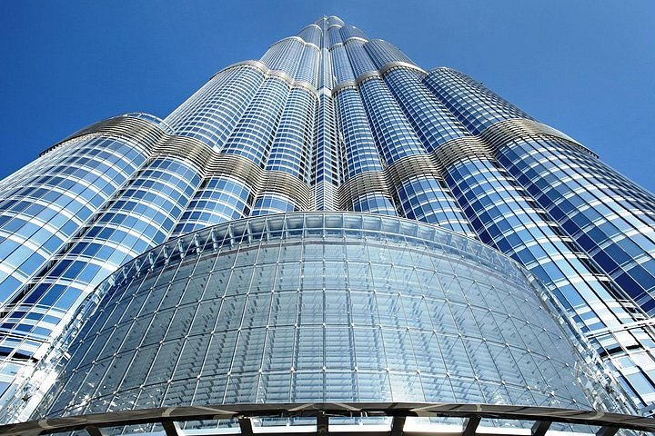
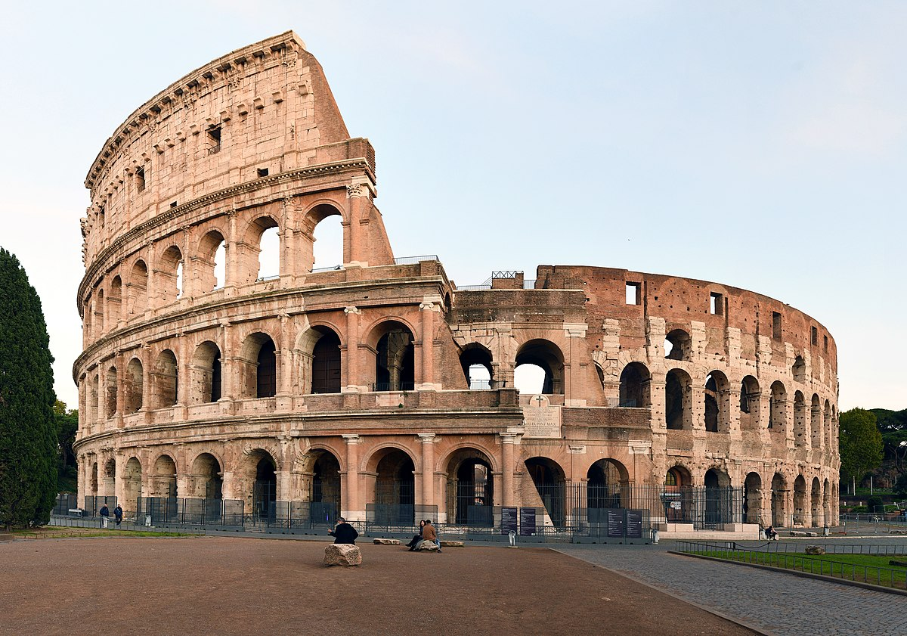
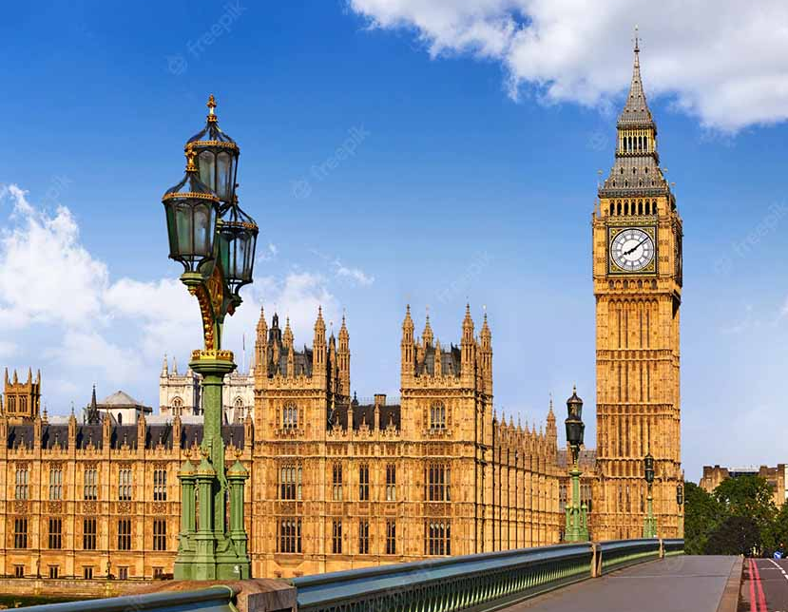
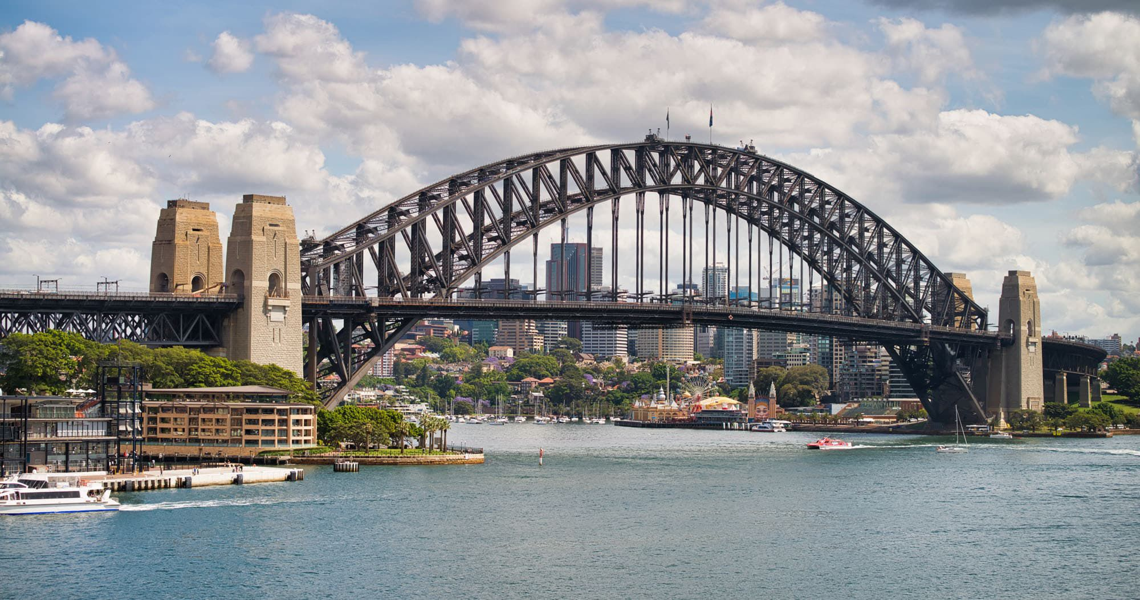
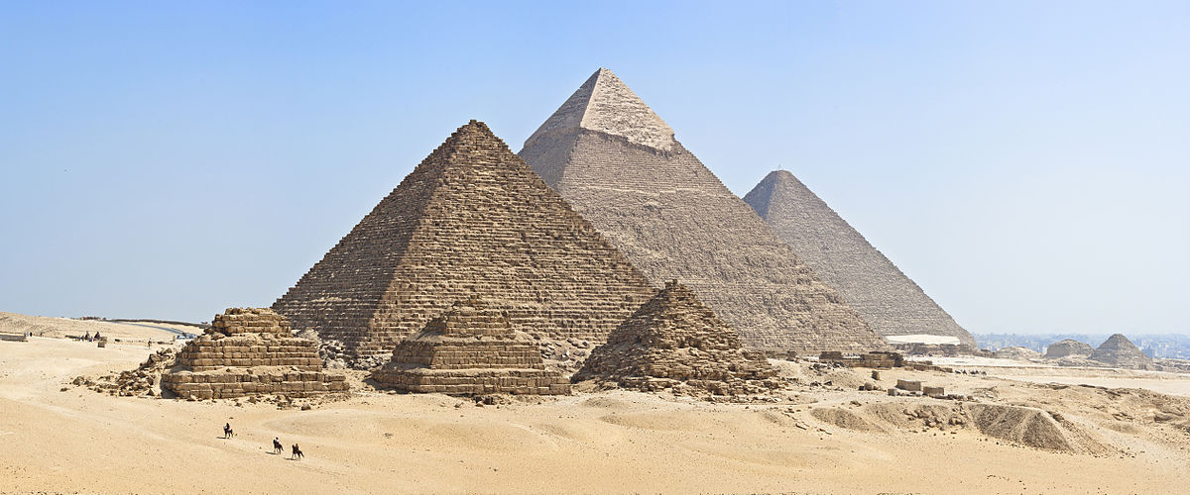

Slide 4
‘So God created mankind in His own image, in the image of God He created them; male and female He created them.’
Genesis 1:27

Slide 5
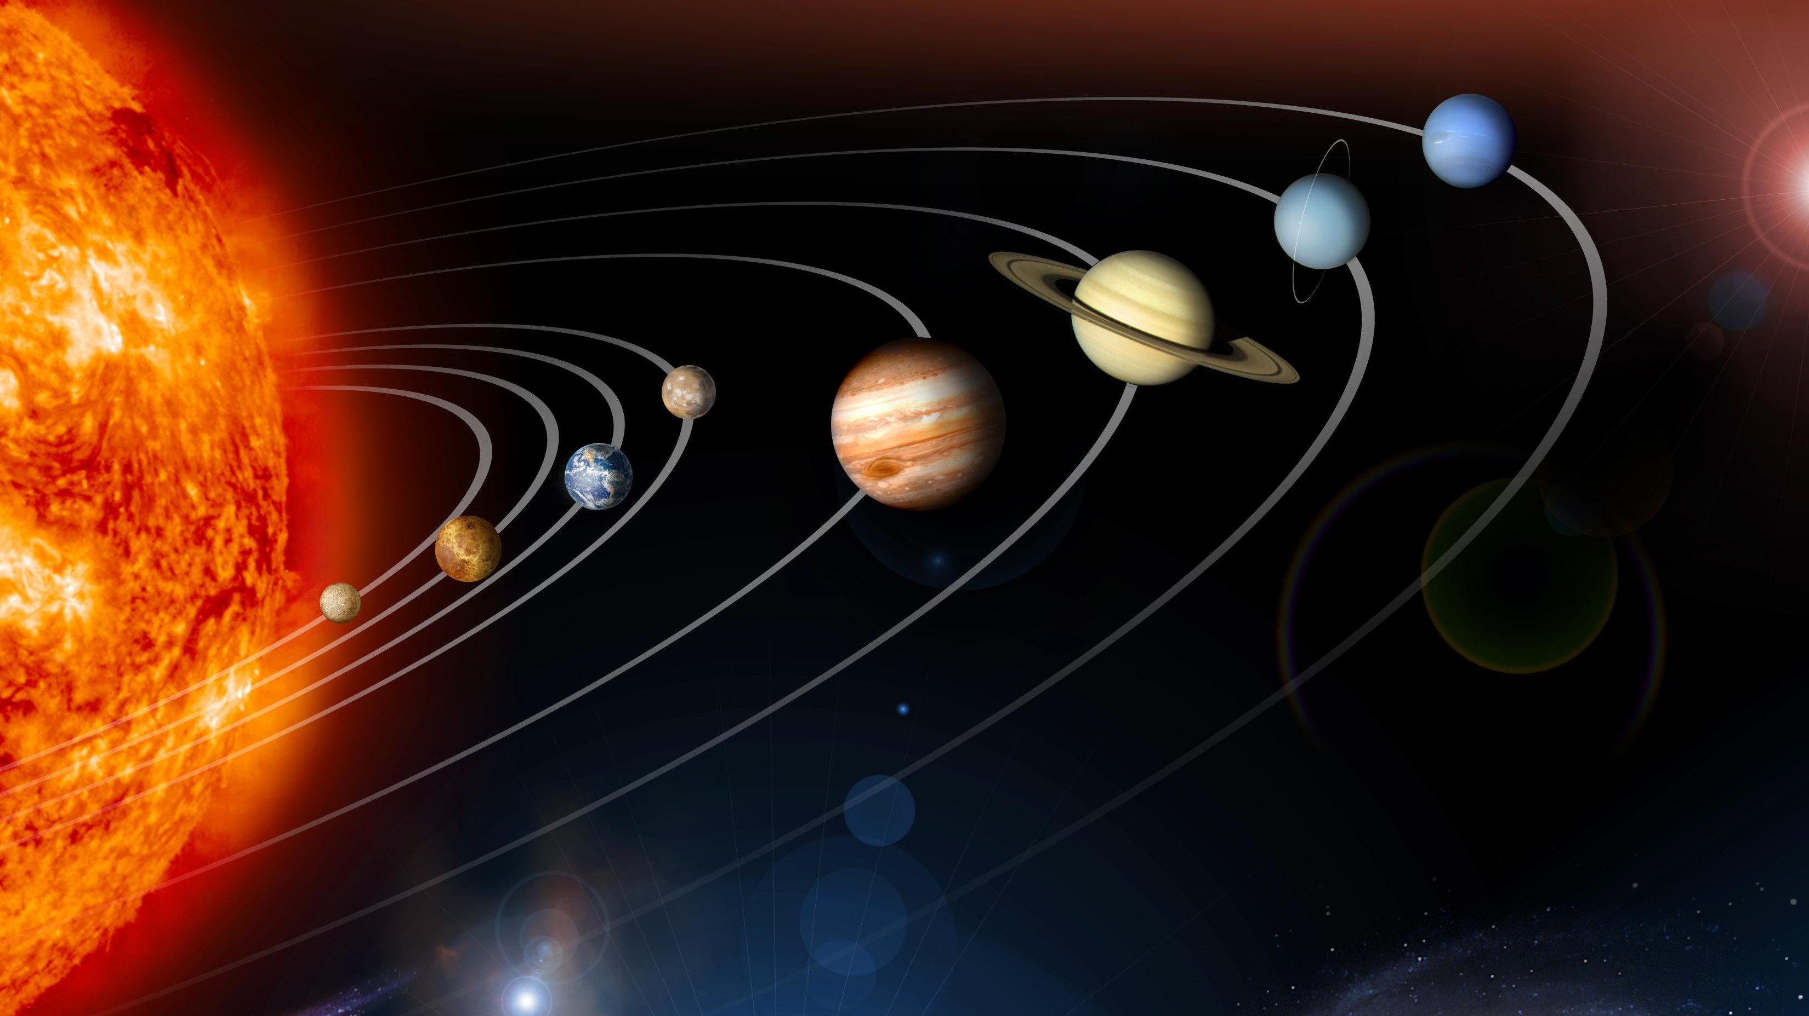
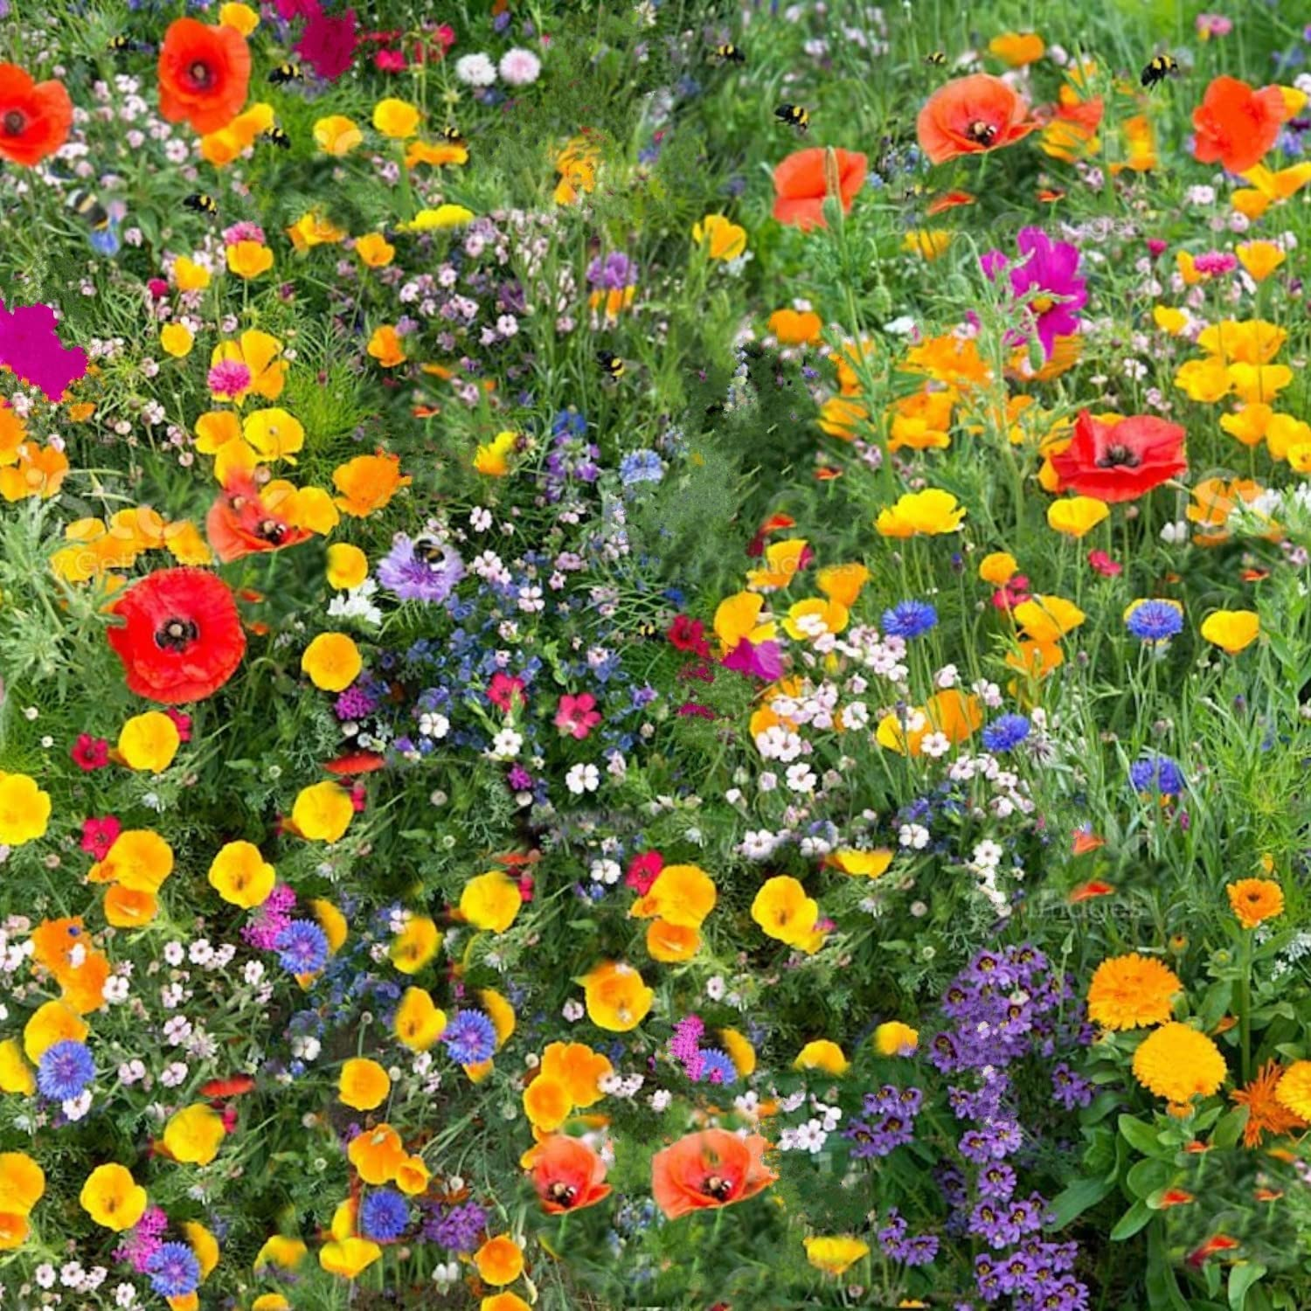
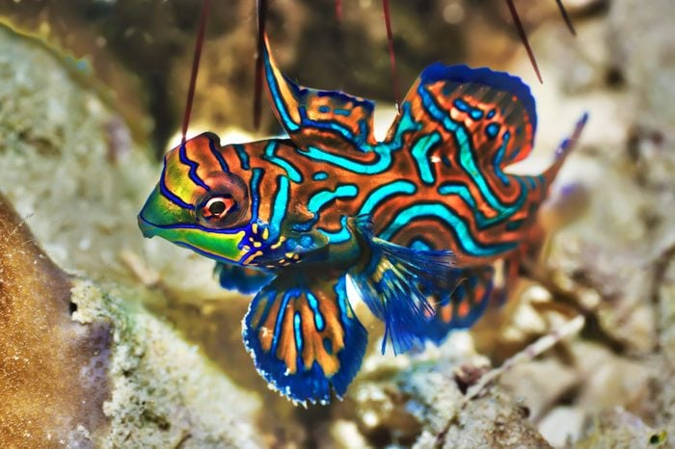
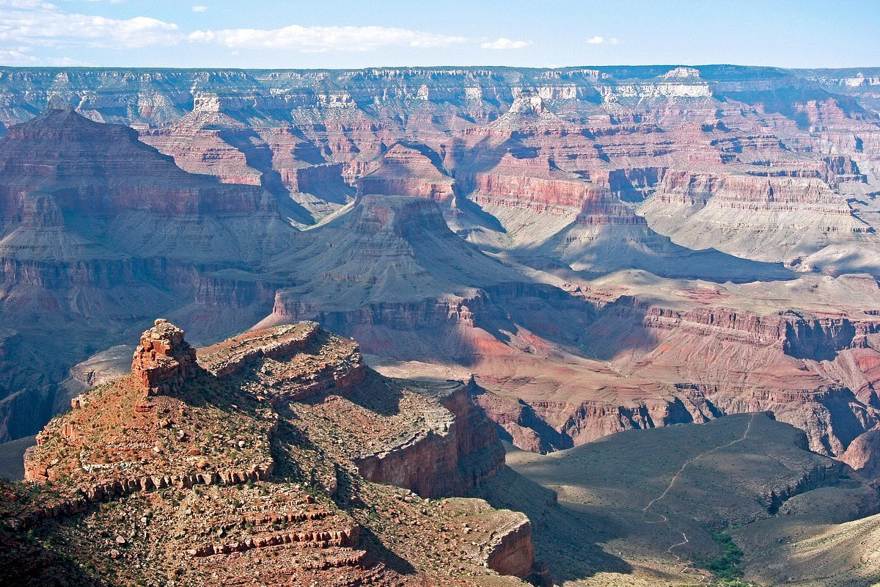
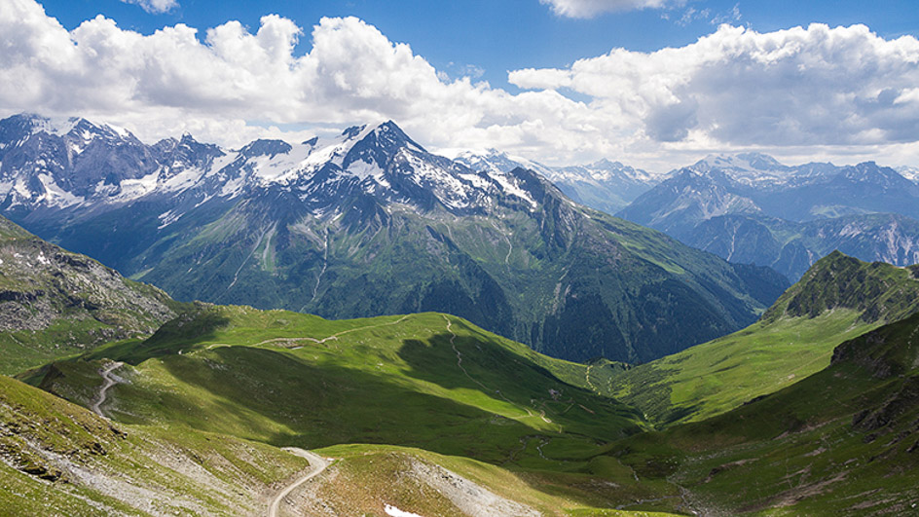
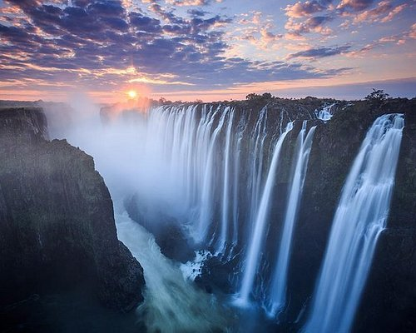
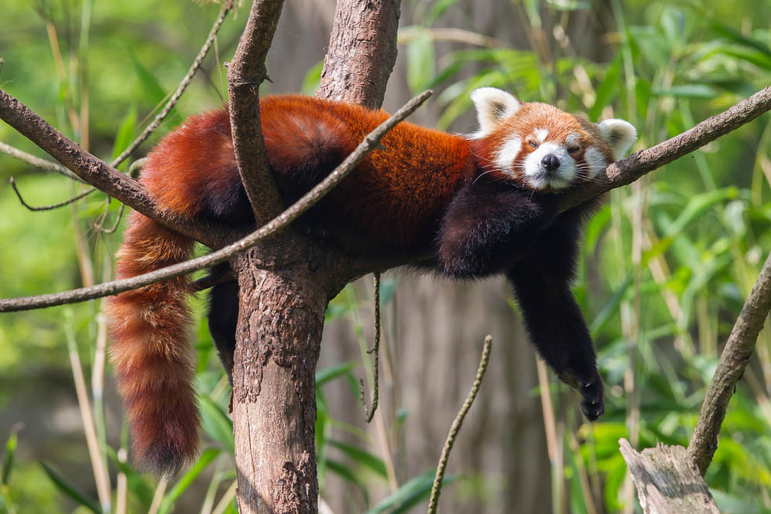

Slide 6
The Wealth
of the Christian
(Part 13)
Ephesians
2:19-22
God is building His church
‘And in Him you too are being built together to become a dwelling in which God lives by his Spirit.’
(vs.22)

Slide 7
The Wealth
of the Christian
(Part 13)
Ephesians
2:19-22
God is building His church
No longer foreigners…
We are citizens (vs.19)
‘He came to that which was His own, but His own did not receive Him. Yet to all who did receive Him, to those who believed in His name, He gave the right to become children of God - children born not of natural descent, nor of human decision or a husband’s will, but born of God.’
John 1:11-13

Slide 8
The Wealth
of the Christian
(Part 13)
Ephesians
2:19-22
God is building His church
No longer foreigners…
We are citizens (vs.19)
Our identity
‘Therefore, as God’s chosen people, holy and dearly loved, clothe yourselves with compassion, kindness, humility, gentleness and patience. Bear with each other and forgive one another if any of you has a grievance against someone. Forgive as the Lord forgave you. And over all these virtues put on love, which binds them all together in perfect unity.’ Colossians 3:12-14

Slide 9
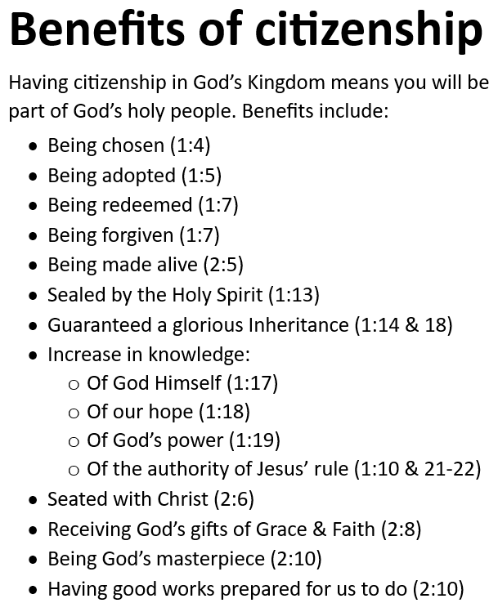
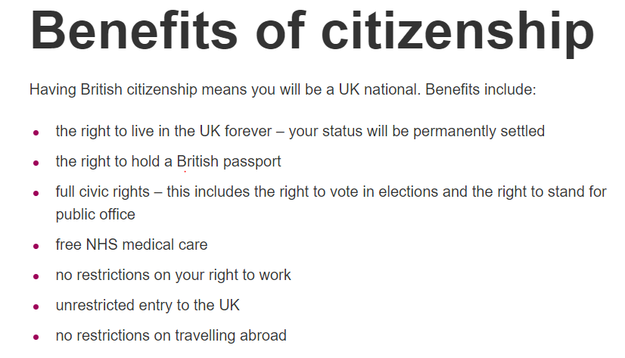
The Wealth
of the Christian
(Part 13)
Ephesians
2:19-22
God is building His church
No longer foreigners…
We are citizens (vs.19)
Our identity
Our benefits

Slide 10
The Wealth
of the Christian
(Part 13)
Ephesians
2:19-22
God is building His church
No longer foreigners…
We are citizens (vs.19)
We are family (vs.19)
God is our Father (1:5, 2:18, 3:14-15)
- Making us brothers and sisters!
‘Make every effort to keep the unity of the Spirit through the bond of peace.’
Ephesians 4:3

Slide 11
The Wealth
of the Christian
(Part 13)
Ephesians
2:19-22
God is building His church
No longer foreigners…
We are citizens (vs.19)
We are family (vs.19)
God is our Father (1:5, 2:18, 3:14-15)
- Making us brothers and sisters!
‘Be completely humble and gentle; be patient, bearing with one another in love.’
Ephesians 4:2

Slide 12
The Wealth
of the Christian
(Part 13)
Ephesians
2:19-22
God is building His church
No longer foreigners…
We are citizens (vs.19)
We are family (vs.19)
We are His holy temple (vs.21-22)
Living stones (1 Peter 2:4-5)
‘As you come to Him, the living Stone-rejected by humans but chosen by God and precious to Him-you also, like living stones, are being built into a spiritual house to be a holy priesthood, offering spiritual sacrifices acceptable to God through Jesus Christ.’
‘For where two or three gather in my name, there am I with them.’
Matthew 18:20

Slide 13
The Wealth
of the Christian
(Part 13)
Ephesians
2:19-22
God is building His church
No longer foreigners…
We are citizens (vs.19)
We are family (vs.19)
We are His holy temple (vs.21-22)
Built on a foundation that is…
Finished and sufficient (vs.20)
‘The stone the builders rejected has become the cornerstone; the Lord has done this, and it is marvellous in our eyes.’ Psalm 118:22

Slide 14
The Wealth
of the Christian
(Part 13)
Ephesians
2:19-22
God is building His church
No longer foreigners…
We are citizens (vs.19)
We are family (vs.19)
We are His holy temple (vs.21-22)
Built on a foundation that is…
Finished and sufficient (vs.20)
‘See, I lay a stone in Zion, a tested stone, a precious cornerstone for a sure foundation.’
Isaiah 28:16

Slide 15
Ephesians
Living as children of light

