Slide 1
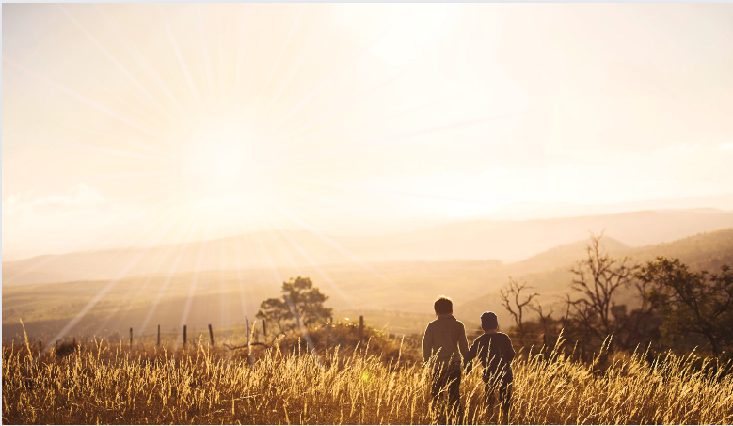
Ephesians
Living as children of light

Slide 2
Ephesians
The Wealth of the Christian = Ch1-3
The Walk of the Christian = Ch4-6:9
The Warfare of the Christian = Ch6:10-24

Slide 3
The Wealth
of the Christian
(Part 14)
Ephesians
3:1-2
God’s prisoner and steward
Paul practiced what he preached…
Rejoicing in Christ’s rule
A prisoner not of Rome, but of Christ (vs.1)

Slide 4
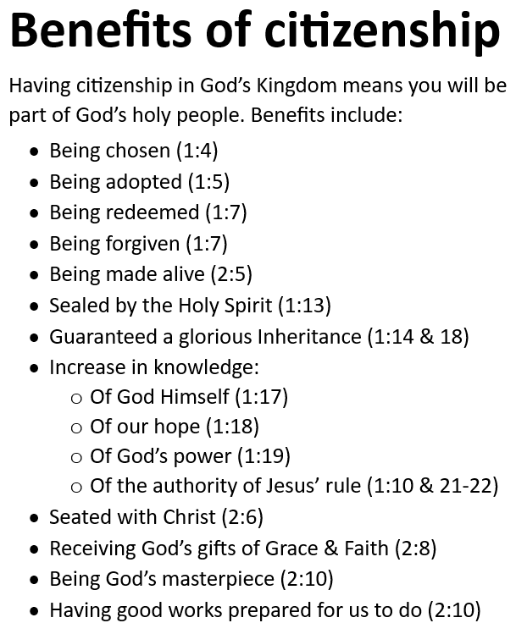
The Wealth
of the Christian
(Part 13)
Ephesians
2:19-22
God is building His church
No longer foreigners…
We are citizens (vs.19)
Our identity
Our benefits

Slide 5
The Wealth
of the Christian
(Part 14)
Ephesians
3:1-2
God’s prisoner and steward
Paul practiced what he preached…
Rejoicing in Christ’s rule
A prisoner not of Rome, but of Christ (vs.1)
‘Now I want you to know, brothers and sisters, that what has happened to me has actually served to advance the gospel. As a result, it has become clear throughout the whole palace guard and to everyone else that I am in chains for Christ. And because of my chains, most of the brothers and sisters have become confident in the Lord and dare all the more to proclaim the gospel without fear.’
Philippians 1:12-14
‘You intended to harm me, but God intended it for good to accomplish what is now being done, the saving of many lives.’
Genesis 50:20

Slide 6
The Wealth
of the Christian
(Part 14)
Ephesians
3:1-2
God’s prisoner and steward
Paul practiced what he preached…
Rejoicing in Christ’s rule
A prisoner not of Rome, but of Christ (vs.1)
Relaying the gospel of peace
‘There is neither Jew nor Gentile, neither slave nor free, nor is there male and female, for you are all one in Christ Jesus.’
Galatians 3:28

Slide 7
The Wealth
of the Christian
(Part 14)
Ephesians
3:1-2
God’s prisoner and steward
Paul practiced what he preached…
Rejoicing in Christ’s rule
A prisoner not of Rome, but of Christ (vs.1)
Relaying the gospel of peace
A prisoner not for himself, but for others (vs.1)
.
Responsible for God’s revelation
A steward not of his making, but of God’s (vs.2)
‘We have different gifts, according to the grace given to each of us.’ Romans 12:6

Slide 8
Ephesians
Living as children of light

