Slide 1
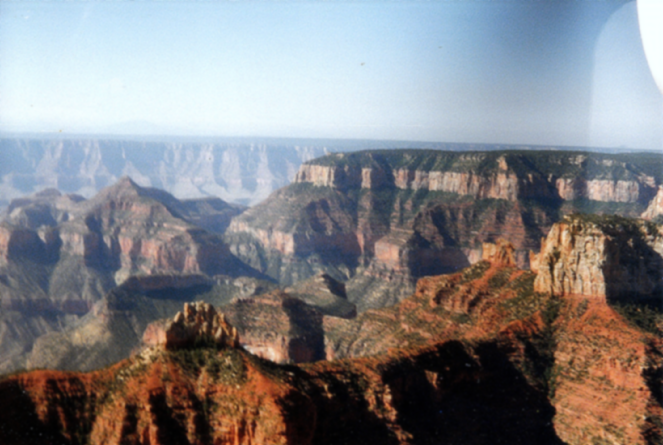
The Seasons of Life Ecclesiastes 3:1-15

Slide 2
The Seasons of Life Ecclesiastes 3:1-15
1. The Times and the Seasons (vv.1-8)

Slide 3
The Seasons of Life Ecclesiastes 3:1-15
1. The Times and the Seasons (vv.1-8)
”Appointed time” – see NASB and NET

Slide 4
The Seasons of Life Ecclesiastes 3:1-15
1. The Times and the Seasons (vv.1-8)
”Appointed time” – see NASB and NET
“to be born/die; to plant/uproot” v.2

Slide 5
The Seasons of Life Ecclesiastes 3:1-15
1. The Times and the Seasons (vv.1-8)
”Appointed time” – see NASB and NET
“to be born/die; to plant/uproot” v.2
Animals and plants

Slide 6
The Seasons of Life Ecclesiastes 3:1-15
1. The Times and the Seasons (vv.1-8)
”Appointed time” – see NASB and NET
“to be born/die; to plant/uproot” v.2
Animals and plants
Choices

Slide 7
The Seasons of Life Ecclesiastes 3:1-15
1. The Times and the Seasons (vv.1-8)
”Appointed time” – see NASB and NET
“to be born/die; to plant/uproot” v.2
“to kill/heal; to tear down/build” v.3

Slide 8
The Seasons of Life Ecclesiastes 3:1-15
1. The Times and the Seasons (vv.1-8)
”Appointed time” – see NASB and NET
“to be born/die; to plant/uproot” v.2
“to kill/heal; to tear down/build” v.3
“life seems to be strangely fixed between a battle-field and a first-aid station!” Chuck Swindoll

Slide 9
The Seasons of Life Ecclesiastes 3:1-15
1. The Times and the Seasons (vv.1-8)
”Appointed time” – see NASB and NET
“to be born/die; to plant/uproot” v.2
“to kill/heal; to tear down/build” v.3
Cell replacement

Slide 10
The Seasons of Life Ecclesiastes 3:1-15
1. The Times and the Seasons (vv.1-8)
”Appointed time” – see NASB and NET
“to be born/die; to plant/uproot” v.2
“to kill/heal; to tear down/build” v.3
Cell replacement
Life expectancy of buildings

Slide 11
The Seasons of Life Ecclesiastes 3:1-15
1. The Times and the Seasons (vv.1-8)
”Appointed time” – see NASB and NET
“to be born/die; to plant/uproot” v.2
“to kill/heal; to tear down/build” v.3
Cell replacement
Life expectancy of buildings
Break-up of relationships

Slide 12
The Seasons of Life Ecclesiastes 3:1-15
1. The Times and the Seasons (vv.1-8)
”Appointed time” – see NASB and NET
“to be born/die; to plant/uproot” v.2
“to kill/heal; to tear down/build” v.3
“to weep/laugh; to mourn/dance” v.4

Slide 13
The Seasons of Life Ecclesiastes 3:1-15
1. The Times and the Seasons (vv.1-8)
”Appointed time” – see NASB and NET
“to be born/die; to plant/uproot” v.2
“to kill/heal; to tear down/build” v.3
“to weep/laugh; to mourn/dance” v.4
It’s OK to cry!

Slide 14
The Seasons of Life Ecclesiastes 3:1-15
1. The Times and the Seasons (vv.1-8)
”Appointed time” – see NASB and NET
“to be born/die; to plant/uproot” v.2
“to kill/heal; to tear down/build” v.3
“to weep/laugh; to mourn/dance” v.4
“to scatter/gather; to embrace/refrain” v.5

Slide 15
The Seasons of Life Ecclesiastes 3:1-15
1. The Times and the Seasons (vv.1-8)
”Appointed time” – see NASB and NET
“to be born/die; to plant/uproot” v.2
“to kill/heal; to tear down/build” v.3
“to weep/laugh; to mourn/dance” v.4
“to scatter/gather; to embrace/refrain” v.5
“to search/give up; to keep/throw away” v.6

Slide 16
The Seasons of Life Ecclesiastes 3:1-15
1. The Times and the Seasons (vv.1-8)
”Appointed time” – see NASB and NET
“to be born/die; to plant/uproot” v.2
“to kill/heal; to tear down/build” v.3
“to weep/laugh; to mourn/dance” v.4
“to scatter/gather; to embrace/refrain” v.5
“to search/give up; to keep/throw away” v.6
downsizing

Slide 17
The Seasons of Life Ecclesiastes 3:1-15
1. The Times and the Seasons (vv.1-8)
”Appointed time” – see NASB and NET
“to be born/die; to plant/uproot” v.2
“to kill/heal; to tear down/build” v.3
“to weep/laugh; to mourn/dance” v.4
“to scatter/gather; to embrace/refrain” v.5
“to search/give up; to keep/throw away” v.6
“to tear/mend; to be silent/speak” v.7

Slide 18
The Seasons of Life Ecclesiastes 3:1-15
1. The Times and the Seasons (vv.1-8)
”Appointed time” – see NASB and NET
“to be born/die; to plant/uproot” v.2
“to kill/heal; to tear down/build” v.3
“to weep/laugh; to mourn/dance” v.4
“to scatter/gather; to embrace/refrain” v.5
“to search/give up; to keep/throw away” v.6
“to tear/mend; to be silent/speak” v.7
“to love/hate; for war/peace” v.8

Slide 19
The Seasons of Life Ecclesiastes 3:1-15
1. The Times and the Seasons (vv.1-8)
”Appointed time” – see NASB and NET
“to be born/die; to plant/uproot” v.2
“to kill/heal; to tear down/build” v.3
“to weep/laugh; to mourn/dance” v.4
“to scatter/gather; to embrace/refrain” v.5
“to search/give up; to keep/throw away” v.6
“to tear/mend; to be silent/speak” v.7
“to love/hate; for war/peace” v.8
war and peace v.8b

Slide 20
The Seasons of Life Ecclesiastes 3:1-15
1. The Times and the Seasons (vv.1-8)
”Appointed time” – see NASB and NET
“to be born/die; to plant/uproot” v.2
“to kill/heal; to tear down/build” v.3
“to weep/laugh; to mourn/dance” v.4
“to scatter/gather; to embrace/refrain” v.5
“to search/give up; to keep/throw away” v.6
“to tear/mend; to be silent/speak” v.7
“to love/hate; for war/peace” v.8
war and peace v.8b
war = sometimes necessary, but peace = the objective

Slide 21
The Seasons of Life Ecclesiastes 3:1-15
1. The Times and the Seasons (vv.1-8)
2. The Need to Accept Limits (vv.9-11)
“What do workers gain?”

Slide 22
The Seasons of Life Ecclesiastes 3:1-15
1. The Times and the Seasons (vv.1-8)
2. The Need to Accept Limits (vv.9-11)
“What do workers gain?”
God-given burden (vv.10)

Slide 23
The Seasons of Life Ecclesiastes 3:1-15
1. The Times and the Seasons (vv.1-8)
2. The Need to Accept Limits (vv.9-11)
“What do workers gain?”
God-given burden (vv.10)
Beautiful and eternal (vv.11)

Slide 24
The Seasons of Life Ecclesiastes 3:1-15
1. The Times and the Seasons (vv.1-8)
2. The Need to Accept Limits (vv.9-11)
“What do workers gain?”
God-given burden (vv.10)
Beautiful and eternal (vv.11)
Made for God

Slide 25
The Seasons of Life Ecclesiastes 3:1-15
1. The Times and the Seasons (vv.1-8)
2. The Need to Accept Limits (vv.9-11)
3. Invitation to enjoy life (vv.12-13)

Slide 26
The Seasons of Life Ecclesiastes 3:1-15
1. The Times and the Seasons (vv.1-8)
2. The Need to Accept Limits (vv.9-11)
3. Invitation to enjoy life (vv.12-13)
“Do you love life? Then do not squander time, for it is the stuff life is made of” (Benjamin Franklin)

Slide 27
The Seasons of Life Ecclesiastes 3:1-15
1. The Times and the Seasons (vv.1-8)
2. The Need to Accept Limits (vv.9-11)
3. Invitation to enjoy life (vv.12-13)
4. The Need to Fear God (vv.14-15)

Slide 28
The Seasons of Life Ecclesiastes 3:1-15
1. The Times and the Seasons (vv.1-8)
2. The Need to Accept Limits (vv.9-11)
3. Invitation to enjoy life (vv.12-13)
4. The Need to Fear God (vv.14-15)
Not terror but reverent awe

Slide 29
The Seasons of Life Ecclesiastes 3:1-15
1. The Times and the Seasons (vv.1-8)
2. The Need to Accept Limits (vv.9-11)
3. Invitation to enjoy life (vv.12-13)
4. The Need to Fear God (vv.14-15)
Not terror but reverent awe
Illustrations from nature

Slide 30
The Seasons of Life Ecclesiastes 3:1-15
1. The Times and the Seasons (vv.1-8)
2. The Need to Accept Limits (vv.9-11)
3. Invitation to enjoy life (vv.12-13)
4. The Need to Fear God (vv.14-15)
Not terror but reverent awe
Illustrations from nature
Everything is temporary

Slide 31
The Seasons of Life Ecclesiastes 3:1-15
1. The Times and the Seasons (vv.1-8)
2. The Need to Accept Limits (vv.9-11)
3. Invitation to enjoy life (vv.12-13)
4. The Need to Fear God (vv.14-15)
Not terror but reverent awe
Illustrations from nature
Everything is temporary
God is eternal.

