Slide 1
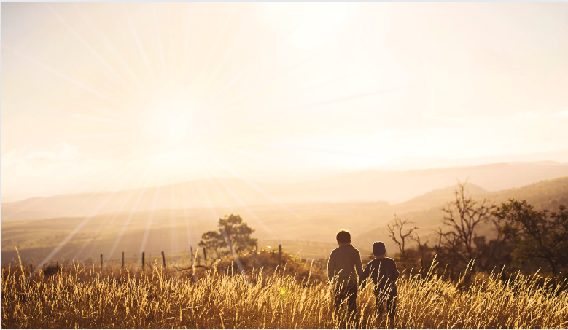
Ephesians
Living as children of light

Slide 2
The Wealth
of the Christian
(Part 18)
Ephesians
3:14-21
A prayer for us to experience God (1)
A prayer revealing a pastor’s heart (vs.14)
- Humility before God
‘I kneel before the Father’
The importance of teach, pray, repeat!
‘I planted the seed, Apollos watered it, but God has been making it grow. So, neither the one who plants nor the one who waters is anything, but only God, who makes things grow.’
1 Corinthians 3:6-7

Slide 3
The Wealth
of the Christian
(Part 18)
Ephesians
3:14-21
A prayer for us to experience God (1)
A prayer revealing a pastor’s heart (vs.14)
- Humility before God
‘I kneel before the Father’
The importance of teach, pray, repeat!
- Hunger for God’s people to grow

Slide 4
The Wealth
of the Christian
(Part 18)
Ephesians
3:14-21
A prayer for us to experience God (1)
A prayer revealing a pastor’s heart (vs.14)
A prayer for every believer (vs.18)
- Not just for Ephesians
- Not just for ‘super’ saints

Slide 5
The Wealth
of the Christian
(Part 18)
Ephesians
3:14-21
A prayer for us to experience God (1)
A prayer revealing a pastor’s heart (vs.14)
A prayer for every believer (vs.16 & 18)
A prayer for believers to experience:
Christ’s presence (vs.16-17)
Christ’s love (vs.17-19)
The fullness of God! (vs.19)

Slide 6
The Wealth
of the Christian
(Part 18)
Ephesians
3:14-21
A prayer for us to experience God (1)
A prayer revealing a pastor’s heart (vs.14)
A prayer for every believer (vs.16 & 18)
A prayer for believers to experience:
Christ’s presence (vs.16-17)
Christ’s love (vs.17-19)
The fullness of God! (vs.19)
‘When you believed, you were marked in Him with a seal, the promised Holy Spirit, who is a deposit guaranteeing our inheritance…’ Ephesians 1:13-14*

Slide 7
The Wealth
of the Christian
(Part 18)
Ephesians
3:14-21
A prayer for us to experience God (1)
A prayer revealing a pastor’s heart (vs.14)
A prayer for every believer (vs.16 & 18)
A prayer for believers to experience:
Christ’s presence (vs.16-17)
Christ’s love (vs.17-19)
The fullness of God! (vs.19)
‘On that day you will realise that I am in my Father, and you are in me, and I am in you.’
John 14:20

Slide 8
The Wealth
of the Christian
(Part 18)
Ephesians
3:14-21
A prayer for us to experience God (1)
A prayer revealing a pastor’s heart (vs.14)
A prayer for every believer (vs.16 & 18)
A prayer for believers to experience:
Christ’s presence (vs.16-17)
Christ’s love (vs.17-19)
The fullness of God! (vs.19)
‘And if anyone does not have the Spirit of Christ, they do not belong to Christ.’
Romans 8:9

Slide 9
The Wealth
of the Christian
(Part 18)
Ephesians
3:14-21
A prayer for us to experience God (1)
A prayer revealing a pastor’s heart (vs.14)
A prayer for every believer (vs.16 & 18)
A prayer for believers to experience:
Christ’s presence (vs.16-17)
Christ’s love (vs.17-19)
The fullness of God! (vs.19)

Slide 10
Ephesians
Living as children of light

