Slide 1
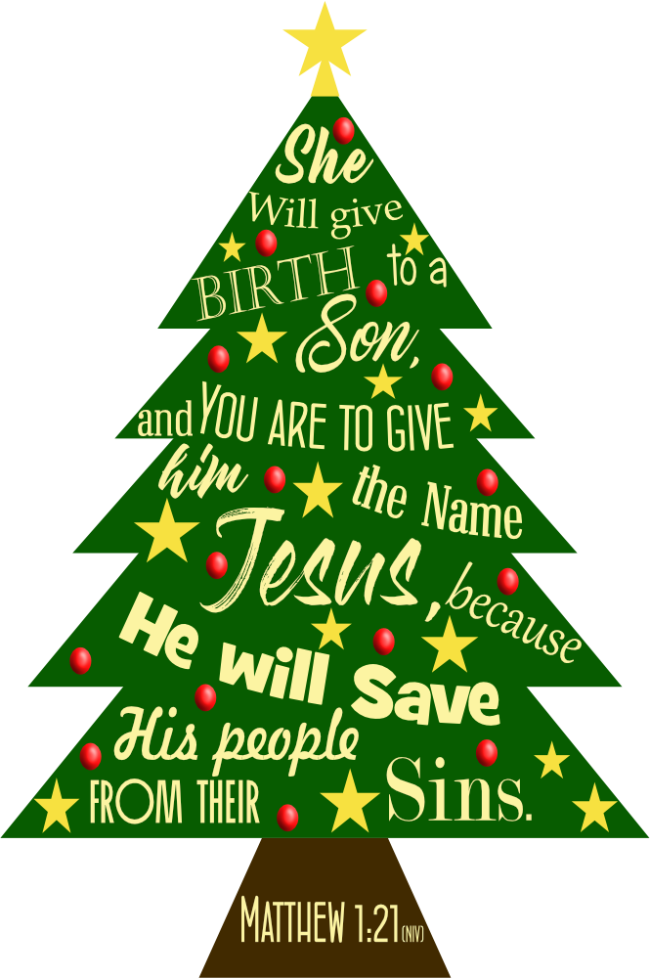
Christmas @ Grace 2023!
Part 3

Slide 2
Preparing for Christmas –
The Hope of Christmas –
Anticipating Christmas – Now!
Anticipation -
A feeling of excitement about something that is going to happen in the near future

Slide 3
Preparing for Christmas –
The Hope of Christmas –
Anticipating Christmas – Now!
Anticipation -
A feeling of excitement about something that is going to happen in the near future

Slide 4
Anticipation – examples
1. The audience waited in great anticipation, but nothing happened.
2. The city was filled with anticipation in the weeks before the festival.
3. We stood on the platform in anticipation, only to be told that the train was cancelled.
4. The children jumped up and down in anticipation as the presents were produced.
5. After months of anticipation, the holiday was a bit of a disappointment actually.

Slide 5
Preparing for Christmas –
The Hope of Christmas –
Anticipating Christmas – Now!
Mary’s
Anticipation
A feeling of excitement about something she knew was going to happen in the near future!
=

Slide 6
Anticipating Christmas
God’s people:
Are those who magnify the Lord! (vs.46-47)
Luke 1:46-55

Slide 7
Anticipating Christmas
God’s people:
Are those who magnify the Lord! (vs.46-47)
Are those who are humble (vs.48-52)
- Aware of God’s power
- Healthy fear of God (vs.50)
(vs.49, 51 & 52)
‘The fear of the LORD is the beginning of wisdom.’ Proverbs 9:10
Luke 1:46-55

Slide 8
Anticipating Christmas
God’s people:
Are those who magnify the Lord! (vs.46-47)
Are those who are humble (vs.48-52)
Are those who have been saved (vs.47)
- Trusting in God’s promises (vs.54)
- Knowing God personally (vs.46-49)
Luke 1:46-55

Slide 9
Christmas @ Grace 2023!

