Slide 1
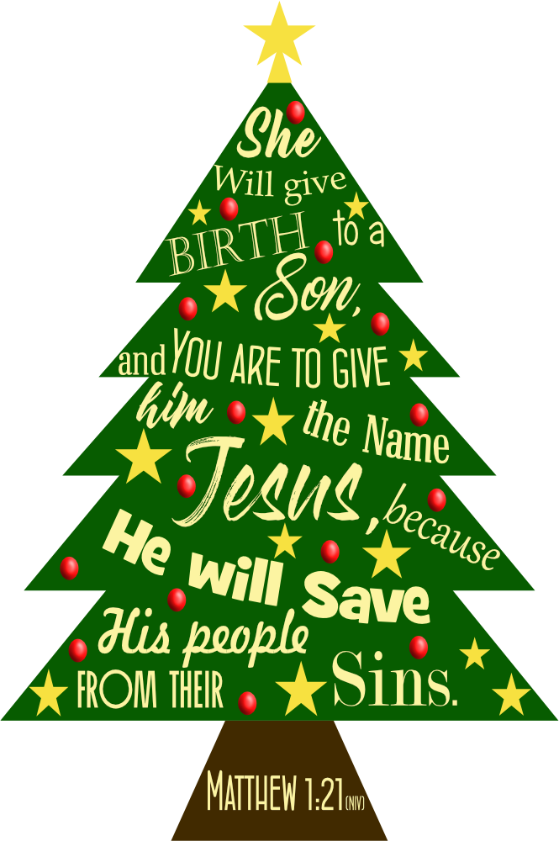
Christmas @ Grace 2023!
Part 5

Slide 2
Preparing for Christmas –
The Hope of Christmas –
Anticipating Christmas –
Unwrapping Christmas –
Rejoicing in Christmas – Now!

Slide 3
Rejoicing in Christmas
Is to Trust God
Is to Thank God
Is to Tell others about God
Luke 2:25-40

Slide 4
Rejoicing in Christmas
Is to Trust God
‘He was waiting for the consolation of Israel…’ (vs.25)
‘…who was righteous and devout.’
(vs.25)
‘She never left the temple but worshiped night and day, fasting and praying.’
(vs.37)
Luke 2:25-40

Slide 5
Rejoicing in Christmas
Is to Trust God
Is to Thank God
‘Coming up to them at that very moment, she gave thanks to God…’ (vs.38)
‘And without faith it is impossible to please God…’ (Hebrews 11:6)
Luke 2:25-40

Slide 6
Rejoicing in Christmas
Is to Trust God
Is to Thank God
Is to Tell others about God
‘Simeon took Him in his arms and praised God, saying…’ (vs.28)
‘…and spoke about the child to all…’ (vs.38)
Luke 2:25-40

Slide 7
Christmas @ Grace 2023!

