Slide 1
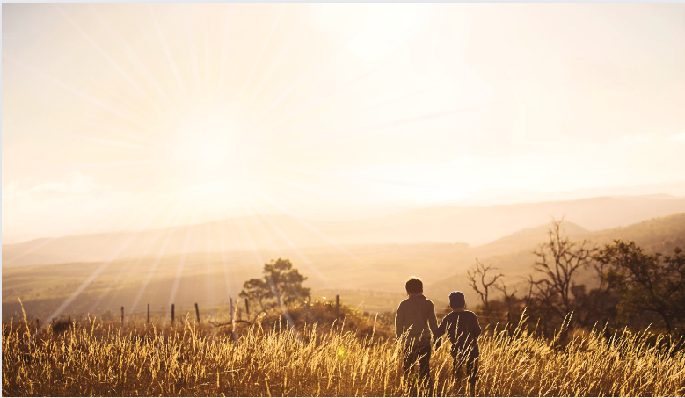
Ephesians
Living as children of light

Slide 2
Ephesians
Chapters 1-3
Doctrine
(What the Christian needs to know)
Chapters 4-6
Duty
(How the Christian is to live)

Slide 3
Ephesians
The Wealth of the Christian = Ch1-3
The Walk of the Christian = Ch4-6:9
The Warfare of the Christian = Ch6:10-24

Slide 4
The Walk
of the Christian
(Intro)
Micah
6:1-8
&
Ephesians
3:20-21
Walking humbly with God
Is to listen to God (Micah 6:1-5)
And to know God
‘When you were dead in your sins and in the uncircumcision of your flesh, God made you alive with Christ. He forgave us all our sins, having cancelled the charge of our legal indebtedness, which stood against us and condemned us; He has taken it away, nailing it to the cross.’
Colossians 2:13-14

Slide 5
The Walk
of the Christian
(Intro)
Micah
6:1-8
&
Ephesians
3:20-21
Walking humbly with God
Is to listen to God (Micah 6:1-5)
And to know God
‘I keep asking that the God of our Lord Jesus Christ, the glorious Father, may give you the Spirit of wisdom and revelation, so that you may know Him better.’
Ephesians 1:17
‘and to know this love that surpasses knowledge’
Ephesians 3:19

Slide 6
The Walk
of the Christian
(Intro)
Micah
6:1-8
&
Ephesians
3:20-21
Walking humbly with God
Is to listen to God (Micah 6:1-5)
And to know God
When peace like a river attendeth my way,
when sorrows like sea billows roll;
whatever my lot, thou hast taught me to say,
"It is well, it is well with my soul.“
Horatio Gates Spafford (1873)

Slide 7
The Walk
of the Christian
(Intro)
Micah
6:1-8
&
Ephesians
3:20-21
Walking humbly with God
Is to listen to God (Micah 6:1-5)
And to know God
When peace like a river attendeth my way,
when sorrows like sea billows roll;
whatever my lot, thou hast taught me to say,
"It is well, it is well with my soul.“
Horatio Gates Spafford (1873)

Slide 8
The Walk
of the Christian
(Intro)
Micah
6:1-8
&
Ephesians
3:20-21
Walking humbly with God
Is to listen to God (Micah 6:1-5)
And to know God
Is to learn from God (Micah 6:6-8)
What is NOT required (vs.6-7)
‘I hate, I despise your religious festivals; your assemblies are a stench to Me. Even though you bring Me burnt offerings and grain offerings, I will not accept them. Though you bring choice fellowship offerings, I will have no regard for them. Away with the noise of your songs! I will not listen to the music of your harps.’ Amos 5:21-23

Slide 9
The Walk
of the Christian
(Intro)
Micah
6:1-8
&
Ephesians
3:20-21
Walking humbly with God
Is to listen to God (Micah 6:1-5)
And to know God
Is to learn from God (Micah 6:6-8)
What is NOT required (vs.6-7)
What IS required (vs.8)
‘But Samuel replied: “Does the LORD delight in burnt offerings and sacrifices as much as in obeying the LORD? To obey is better than sacrifice, and to heed is better than the fat of rams.’
1 Samuel 15:22

Slide 10
The Walk
of the Christian
(Intro)
Micah
6:1-8
&
Ephesians
3:20-21
Walking humbly with God
Is to listen to God (Micah 6:1-5)
And to know God
Is to learn from God (Micah 6:6-8)
What is NOT required (vs.6-7)
What IS required (vs.8)
‘Therefore, I urge you, brothers and sisters, in view of God’s mercy, to offer your bodies as a living sacrifice, holy and pleasing to God - this is your true and proper worship.’
Romans 12:1

Slide 11
The Walk
of the Christian
(Intro)
Micah
6:1-8
&
Ephesians
3:20-21
Walking humbly with God
Is to listen to God (Micah 6:1-5)
And to know God
Is to learn from God (Micah 6:6-8)
What is NOT required
What IS required
Is to look to God (Micah 6:8)
His power at work in us (Ephesians 3:20)
His glory in the church and in Jesus
(Ephesians 3:21)

Slide 12
Ephesians
Walking humbly with God

