Slide 2
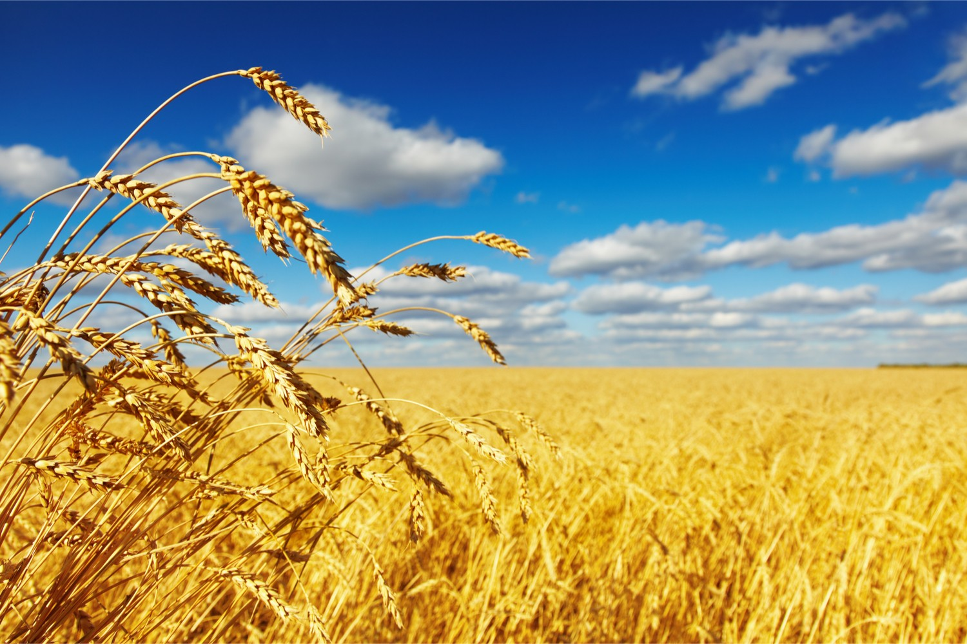
A Walk Through The Book Of Ruth – Love Actually
R
U T H
1. Introduction

Slide 3
A Walk Through The Book Of Ruth – Love Actually
R
U T H
1. Introduction
Four main characters

Slide 4
A Walk Through The Book Of Ruth – Love Actually
R
U T H
1. Introduction
Four main characters
Five possible reasons

Slide 5
A Walk Through The Book Of Ruth – Love Actually
R
U T H
1. Introduction
Four main characters
Five possible reasons
A love story – four for the price of one!

Slide 6
A Walk Through The Book Of Ruth – Love Actually
R
U T H
1. Introduction
Four main characters
Five possible reasons
A love story – four for the price of one!
Love story #1 – Ruth & Naomi (daughter-in-law and mother-in-law)

Slide 7
A Walk Through The Book Of Ruth – Love Actually
R
U T H
Love story #1 – Ruth & Naomi (v.11-14)
¹¹ But Naomi said, “Return home, my daughters. Why would you come with me? Am I going to have any more sons, who could become your husbands? ¹² Return home, my daughters; I am too old to have another husband. Even if I thought there was still hope for me—even if I had a husband tonight and then gave birth to sons— ¹³ would you wait until they grew up? Would you remain unmarried for them? No, my daughters. It is more bitter for me than for you because the Lord’s hand has turned against me!” ¹⁴ At this they wept aloud again. Then Orpah kissed her mother-in-law goodbye, but Ruth clung to her.

Slide 8
A Walk Through The Book Of Ruth – Love Actually
R
U T H
Love story #1 – Ruth & Naomi (v.15-18)
¹⁵ “Look,” said Naomi, “your sister-in-law is going back to her people and her gods. Go back with her.” ¹⁶ But Ruth replied, “Don’t urge me to leave you or to turn back from you. Where you go, I will go, and where you stay, I will stay. Your people will be my people and your God my God. ¹⁷ Where you die, I will die, and there I will be buried. May the Lord deal with me, be it ever so severely, if even death separates you and me.” ¹⁸ When Naomi realized that Ruth was determined to go with her, she stopped urging her.

Slide 9
A Walk Through The Book Of Ruth – Love Actually
R
U T H
1. Introduction
Four main characters
Five possible reasons
A love story – four for the price of one!
Love story #1 – Ruth & Naomi
Love story #2 – Ruth & the God of Israel

Slide 10
A Walk Through The Book Of Ruth – Love Actually
R
U T H
2. God’s loving Providence

Slide 11
A Walk Through The Book Of Ruth – Love Actually
R
U T H
2. God’s loving Providence
To the Israelites – escape and settlement

Slide 12
A Walk Through The Book Of Ruth – Love Actually
R
U T H
2. God’s loving Providence
To the Israelites – escape and settlement
To Naomi – Ruth, returning home, harvests, and a saviour

Slide 13
A Walk Through The Book Of Ruth – Love Actually
R
U T H
2. God’s loving Providence
To the Israelites – escape and settlement
To Naomi – Ruth, returning home, harvests, and a saviour
In the days of the Judges

Slide 14
A Walk Through The Book Of Ruth – Love Actually
R
U T H
2. God’s loving Providence
To His enemies – to us (Rom 5:10)
‘For if, while we were God’s enemies, we were reconciled to him through the death of his Son, how much more, having been reconciled, shall we be saved through his life!’

Slide 15
A Walk Through The Book Of Ruth – Love Actually
R
U T H
2. God’s loving Providence
To those dead in sin – that’s us (Eph 2:1-6)
‘As for you, you were dead in your transgressions and sins, ² in which you used to live when you followed the ways of this world and of the ruler of the kingdom of the air, the spirit who is now at work in those who are disobedient. ³ All of us also lived among them at one time, gratifying the cravings of our flesh and following its desires and thoughts.

Slide 16
A Walk Through The Book Of Ruth – Love Actually
R
U T H
2. God’s loving Providence
To those dead in sin – that’s us (Eph 2:1-6)
‘Like the rest, we were by nature deserving of wrath. ⁴ But because of his great love for us, God, who is rich in mercy, ⁵ made us alive with Christ even when we were dead in transgressions—it is by grace you have been saved. ⁶ And God raised us up with Christ and seated us with him in the heavenly realms in Christ Jesus,’

Slide 17
A Walk Through The Book Of Ruth – Love Actually
R
U T H
2. God’s loving Providence
To the Israelites – escape and settlement
To Naomi – Ruth, returning home, harvests, and a saviour
In the days of the Judges
To His enemies
To those who are dead in sin
To Naomi – a grandson!

Slide 18
A Walk Through The Book Of Ruth – Love Actually
R
U T H
2. God’s loving Providence
To Naomi – a grandson (4:16 & 1:3-5)
‘Then Naomi took the child in her arms and cared for him.’
³ Now Elimelek, Naomi’s husband, died, and she was left with her two sons. ⁴ They married Moabite women, one named Orpah and the other Ruth. After they had lived there about ten years, ⁵ both Mahlon and Kilion also died, and Naomi was left without her two sons and her husband.

Slide 19
A Walk Through The Book Of Ruth – Love Actually
R
U T H
3. Looking forward to the greatest love story

Slide 20
A Walk Through The Book Of Ruth – Love Actually
R
U T H
3. Looking forward to the greatest love story
Enter Boaz (2:20)
“The Lord bless him!” Naomi said to her daughter-in-law. “He has not stopped showing his kindness to the living and the dead.” She added, “That man is our close relative; he is one of our guardian-redeemers.”

Slide 21
A Walk Through The Book Of Ruth – Love Actually
R
U T H
3. Looking forward to the greatest love story
Enter Boaz (2:20)
The Lord provides (4:13)
‘So, Boaz took Ruth, and she became his wife. When he made love to her, the Lord enabled her to conceive, and she gave birth to a son.’

Slide 22
A Walk Through The Book Of Ruth – Love Actually
R
U T H
3. Looking forward to the greatest love story
Enter Boaz (2:20)
The Lord provides (4:14-15)
^{‘14} The women said to Naomi: “Praise be to the Lord, who this day has not left you without a guardian-redeemer. May he become famous throughout Israel! ¹⁵ He will renew your life and sustain you in your old age. For your daughter-in-law, who loves you and who is better to you than seven sons, has given him birth.”’

Slide 23
A Walk Through The Book Of Ruth – Love Actually
R
U T H
3. Looking forward to the greatest love story
Enter Boaz (2:20)
The Lord provides (4:14-15)
A forerunner of King Jesus via king David (4:17b)
‘And they named him Obed. He was the father of Jesse, the father of David.’

