Slide 1
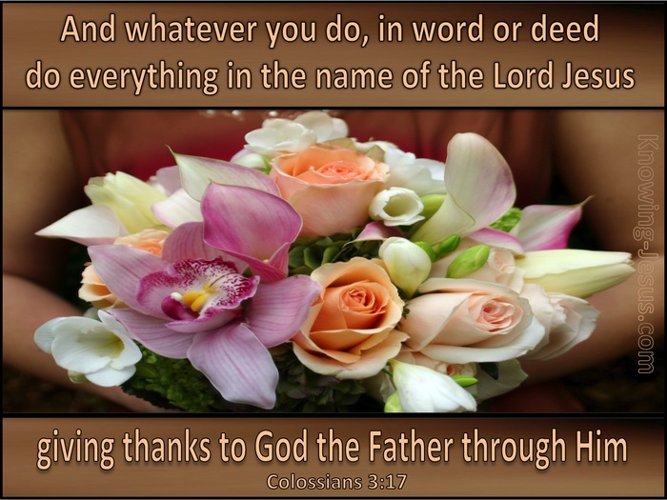

Slide 2
¹² Therefore, as God’s chosen people, holy and dearly loved, clothe yourselves with compassion, kindness, humility, gentleness and patience. ¹³ Bear with each other and forgive one another if any of you has a grievance against someone. Forgive as the Lord forgave you. ¹⁴ And over all these virtues put on love, which binds them all together in perfect unity.
¹⁵ Let the peace of Christ rule in your hearts, since as members of one body you were called to peace. And be thankful. ¹⁶ Let the message of Christ dwell among you richly as you teach and admonish one another with all wisdom through psalms, hymns, and songs from the Spirit, singing to God with gratitude in your hearts. ¹⁷ And whatever you do, whether in word or deed, do it all in the name of the Lord Jesus, giving thanks to God the Father through Him.

Slide 3
Colossians c3 v17
And whatever you do, whether in word or deed, do it all in the name of the Lord Jesus, giving thanks to God the Father through Him.

Slide 4
Three Points:
Point 1 Do our Words glorify Jesus
Point 2 Do our deeds glorify Jesus
Point 3 Do it all in The name of the Lord Jesus.

Slide 5
Pastor and teacher John Stott
This verse teaches that I am to treat other people as if I were Jesus Christ. For that is the meaning of doing everything in His name, of doing it as His representative. I must learn to treat other people as Jesus would treat them.

Slide 6
Col C2 v 6 - 7
⁶ So then, just as you received Christ Jesus as Lord, continue to live your lives in Him, ⁷ rooted and built up in Him, strengthened in the faith as you were taught, and overflowing with thankfulness.

Slide 7
Words of Jesus
Mark c11 v 24
Therefore I tell you, whatever you ask for in prayer, believe that you have received it, and it will be yours.
John c14 v13
And I will do whatever you ask in my name, so that the Father may be glorified in the Son.
The Apostle Paul
1 Cor c7 v17
¹⁷ Nevertheless, each person should live as a believer in whatever situation the Lord has assigned to them, just as God has called them.

Slide 8
Titus
C3 v1
Remind the people to be subject to rulers and authorities, to be obedient, to be ready to do whatever is good,
The Apostle Peter
1 Peter c4 v10
Each of you should use whatever gift you have received to serve others, as faithful stewards of God’s grace in its various forms.
Then we have the Apostle John
1 John c 5 v15
And if we know that He hears us – whatever we ask – we know that we have what we asked of Him.

Slide 9
James c3 v1-4
Not many of you should become teachers, my fellow believers, because you know that we who teach will be judged more strictly. ² We all stumble in many ways. Anyone who is never at fault in what they say is perfect, able to keep their whole body in check.
³ When we put bits into the mouths of horses to make them obey us, we can turn the whole animal. ⁴ Or take ships as an example. Although they are so large and are driven by strong winds, they are steered by a very small rudder wherever the pilot wants to go.
v5-8
⁵ Likewise, the tongue is a small part of the body, but it makes great boasts. Consider what a great forest is set on fire by a small spark. ⁶ The tongue also is a fire, a world of evil among the parts of the body. It corrupts the whole body, sets the whole course of one’s life on fire, and is itself set on fire by hell.
⁷ All kinds of animals, birds, reptiles and sea creatures are being tamed and have been tamed by mankind, ⁸ but no human being can tame the tongue. It is a restless evil, full of deadly poison.

Slide 10
V9-10
⁹ With the tongue we praise our Lord and Father, and with it we curse human beings, who have been made in God’s likeness. 10 Out of the same mouth comes praise and cursing. My brothers and sisters, this should not be.
V 11 -12
¹¹ Can both fresh water and salt water flow from the same spring? ¹² My brothers and sisters, can a fig-tree bear olives, or a grapevine bear figs? Neither can a salt spring produce fresh water.

Slide 11
Psalm 141 v 3-4
³ Set a guard over my mouth, Lord;
keep watch over the door of my lips.
⁴ Do not let my heart be drawn to what is evil
so that I take part in wicked deeds
along with those who are evildoers;
do not let me eat their delicacies.
Matthew c15 v18
But the things that come out of a person’s mouth come from the heart, and these defile them.

Slide 12
T = Is it True
H = Is it Helpful
I = Is it Influencing
N = Is it Necessary
Kind = Is it Kind.

Slide 13
Colossians c3 v 17
And whatever you do, whether in word or deed, do it all in the name of the Lord Jesus, giving thanks to God the Father through Him.

Slide 14
Galatians c6 v 9-10
⁹ Let us not become weary in doing good, for at the proper time we will reap a harvest if we do not give up. ¹⁰ Therefore, as we have opportunity, let us do good to all people, especially to those who belong to the family of believers.

Slide 15
Philippians c2 v 9 - 11
⁹ Therefore God exalted Him to the highest place
and gave Him the name that is above every name,
¹⁰ that at the name of Jesus every knee should bow,
in heaven and on earth and under the earth,
¹¹ and every tongue acknowledge that Jesus Christ is Lord,
to the glory of God the Father.
John c14 v 14
¹⁴ You may ask me for anything in My name, and I will do it.
Acts c2 v38
³⁸ Peter replied, ‘Repent and be baptised, every one of you, in the name of Jesus Christ for the forgiveness of your sins. And you will receive the gift of the Holy Spirit.

Slide 16
Pastor John Macarthur said this of this passage
I want to be Christ in this world. I want to put Him on. I want His virtue to be my virtue, His life to be my life, His lifestyle to be my lifestyle. And since He elected me, and since He made me holy, and since I am His beloved, it seems a rather consistent thing to be what He wants me to be, and to put on the clothes of the new man, and so live to glorify His name.

