Slide 1


Slide 2
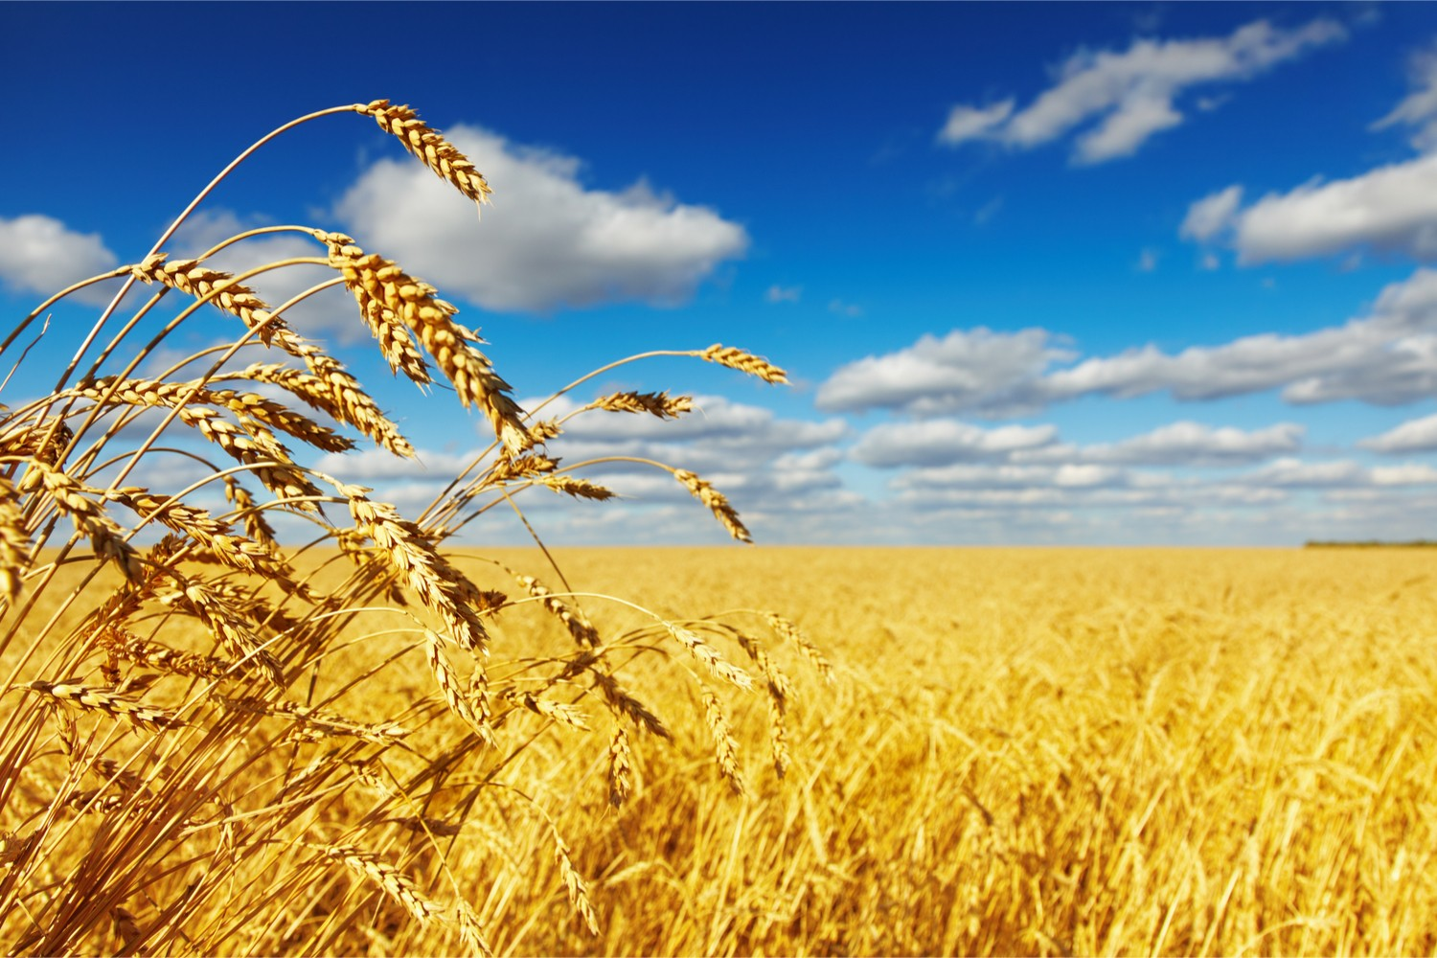
A Walk Through The Book Of Ruth – Chapter 1 -When the rubber hits the road
R
U
T
H
Introduction

Slide 3
A Walk Through The Book Of Ruth – Chapter 1 -When the rubber hits the road
R
U
T
H
Introduction
Confrontation

Slide 4
A Walk Through The Book Of Ruth – Chapter 1 -When the rubber hits the road
R
U
T
H
Introduction
Confrontation
Challenge

Slide 5
A Walk Through The Book Of Ruth – Chapter 1 -When the rubber hits the road
R
U
T
H
Introduction
Confrontation
Challenge
Commitment

Slide 6
A Walk Through The Book Of Ruth – Chapter 1 -When the rubber hits the road
R
U
T
H
1. Introduction
2. Confrontation with a major decision (v.1-5)

Slide 7
A Walk Through The Book Of Ruth – Chapter 1 -When the rubber hits the road
R
U
T
H
1. Introduction
Confrontation with a major decision (v.1-5)
    Historical context (Judges 21:25)
    ‘In those days Israel had no king; everyone did as they saw fit.’

Slide 8
A Walk Through The Book Of Ruth – Chapter 1 -When the rubber hits the road
R
U
T
H
1. Introduction
Confrontation with a major decision (v.1-5)
    Famine (Deuteronomy 28:15-29)
    ¹⁵ However, if you do not obey the Lord your God and do not carefully follow all his commands and decrees, I am giving you today, all these curses will come on you and overtake you…²² The Lord will strike you with wasting disease, with fever and inflammation, with scorching heat and drought, with blight and mildew, which will plague you until you perish. ²³ The sky over your head will be bronze, the ground beneath you, iron. ²⁴ The Lord will turn the rain of your country into dust and powder; it will come down from the skies until you are destroyed.

Slide 9
A Walk Through The Book Of Ruth – Chapter 1 -When the rubber hits the road
R
U
T
H
1. Introduction
Confrontation with a major decision (v.1-5)
    Intermarrying (Deuteronomy 7:1-4)
    ‘When the Lord your God brings you into the land you are entering to possess and drives out before you many nations…³ Do not intermarry with them. Do not give your daughters to their sons or take their daughters for your sons, ⁴ for they will turn your children away from following me to serve other gods, and the Lord’s anger will burn against you and will quickly destroy you.’

Slide 10
A Walk Through The Book Of Ruth – Chapter 1 -When the rubber hits the road
R
U
T
H
1. Introduction
Confrontation with a major decision (v.1-5)
3. Challenged to decide (v.6-14)

Slide 11
A Walk Through The Book Of Ruth – Chapter 1 -When the rubber hits the road
R
U
T
H
1. Introduction
Confrontation with a major decision (v.1-5)
3. Challenged to decide (v.6-14)
    Bitterness

Slide 12
A Walk Through The Book Of Ruth – Chapter 1 -When the rubber hits the road
R
U
T
H
1. Introduction
Confrontation with a major decision (v.1-5)
3. Challenged to decide (v.6-14)
    Bitterness
    God’s mercy

Slide 13
A Walk Through The Book Of Ruth – Chapter 1 -When the rubber hits the road
R
U
T
H
1. Introduction
Confrontation with a major decision (v.1-5)
3. Challenged to decide (v.6-14)
4. Commitment like no other (v.15-22)

Slide 14
A Walk Through The Book Of Ruth – Chapter 1 -When the rubber hits the road
R
U
T
H
1. Introduction
Confrontation with a major decision (v.1-5)
3. Challenged to decide (v.6-14)
4. Commitment like no other (v.15-22)
    Declaration of love

Slide 15
A Walk Through The Book Of Ruth – Chapter 1 -When the rubber hits the road
R
U
T
H
1. Introduction
Confrontation with a major decision (v.1-5)
3. Challenged to decide (v.6-14)
4. Commitment like no other (v.15-22)
    Declaration of love
    Contradictions

Slide 16
A Walk Through The Book Of Ruth – Chapter 1 -When the rubber hits the road
R
U
T
H
1. Introduction
Confrontation with a major decision (v.1-5)
3. Challenged to decide (v.6-14)
4. Commitment like no other (v.15-22)
5. Application

Slide 17
A Walk Through The Book Of Ruth – Chapter 1 -When the rubber hits the road
R
U
T
H
1. Introduction
Confrontation with a major decision (v.1-5)
3. Challenged to decide (v.6-14)
4. Commitment like no other (v.15-22)
5. Application
    The journey we have walked this morning started in the ‘house of bread’, went through a famine, and ends with bountiful harvests. Where are we? Which road are we travelling on?

