Slide 1
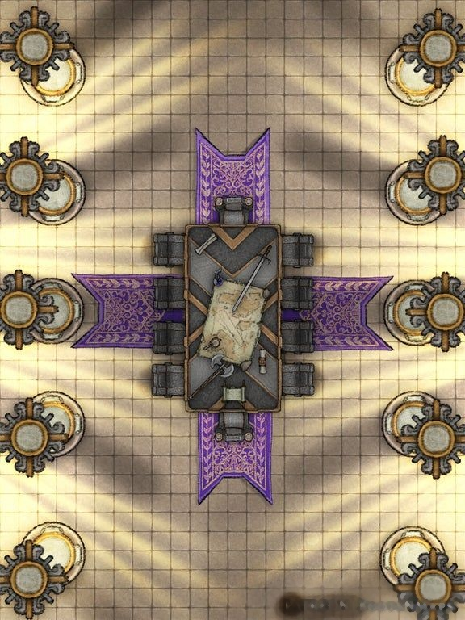
His Majesty the King requests the pleasure of your company at the marriage supper of the Lamb
Formal attire is mandatory
A guided tour of the Palace will precede the supper

Slide 2
God’s Throne in Heaven
Revelation 4:1-11; Isaiah 6:1-7
Indescribable glory

Slide 3
God’s Throne in Heaven
Revelation 4:1-11; Isaiah 6:1-7
Indescribable glory
Mission control

Slide 4
God’s Throne in Heaven
Revelation 4:1-11; Isaiah 6:1-7
Indescribable glory
Mission control
Word pictures

Slide 5
God’s Throne in Heaven
Revelation 4:1-11; Isaiah 6:1-7
Indescribable glory
Mission control
Word pictures
Bookends – 1:8; 22:13

Slide 6
God’s Throne in Heaven
Revelation 4:1-11; Isaiah 6:1-7
Indescribable glory
Mission control
Word pictures
Bookends – 1:8; 22:13
OT images

Slide 7
God’s Throne in Heaven
Revelation 4:1-11; Isaiah 6:1-7
Indescribable glory
Mission control
Word pictures
Bookends – 1:8; 22:13
OT images
Symbolic numbers

Slide 8
God’s Throne in Heaven
Revelation 4:1-11; Isaiah 6:1-7
Indescribable glory
Mission control
Word pictures
Bookends – 1:8; 22:13
OT images
Symbolic numbers
Importance of context

Slide 9
God’s Throne in Heaven
Revelation 4:1-11; Isaiah 6:1-7
1.The Invitation v.1
“ After this I looked, and there before me was a door standing open in heaven. And the voice I had first heard speaking to me like a trumpet said, ‘Come up here, and I will show you what must take place after this.’”

Slide 10
God’s Throne in Heaven
Revelation 4:1-11; Isaiah 6:1-7
1.The Invitation v.1
The Open Door

Slide 11
God’s Throne in Heaven
Revelation 4:1-11; Isaiah 6:1-7
1.The Invitation v.1
The Open Door
“I was in the Spirit”

Slide 12
God’s Throne in Heaven
Revelation 4:1-11; Isaiah 6:1-7
1.The Invitation v.1
The Open Door
“I was in the Spirit”
Identical voice

Slide 13
God’s Throne in Heaven
Revelation 4:1-11; Isaiah 6:1-7
The Invitation v.1
The Throne in Heaven vv.2-3
“At once I was in the Spirit, and there before me was a throne in heaven with someone sitting on it. And the one sitting on it had the appearance of jasper and ruby. A rainbow that shone like and emerald encircled the throne.”

Slide 14
God’s Throne in Heaven
Revelation 4:1-11; Isaiah 6:1-7
The Invitation v.1
The Throne in Heaven vv.2-3
“At once I was in the Spirit, and there before me was a throne in heaven with someone sitting on it. And the one sitting on it had the appearance of jasper and ruby. A rainbow that shone like and emerald encircled the throne.”
Compare Ezekiel 1:28 “Like the appearance of a rainbow in the clouds on a rainy day, so was the radiance around him. This was the appearance of the likeness of the glory of the LORD…”

Slide 15
God’s Throne in Heaven
Revelation 4:1-11; Isaiah 6:1-7
The Invitation v.1
The Throne in Heaven vv.2-3
“At once I was in the Spirit, and there before me was a throne in heaven with someone sitting on it. And the one sitting on it had the appearance of jasper and ruby. A rainbow that shone like and emerald encircled the throne.”
A fake throne (13:4) “People worshipped the dragon…and they also worshipped the beast and asked, ‘Who is like the beast? Who can wage war against it?’”

Slide 16
God’s Throne in Heaven
Revelation 4:1-11; Isaiah 6:1-7
The Invitation v.1
The Throne in Heaven vv.2-3
“At once I was in the Spirit, and there before me was a throne in heaven with someone sitting on it. And the one sitting on it had the appearance of jasper and ruby. A rainbow that shone like and emerald encircled the throne.”
Importance of renewed vision !

Slide 17
God’s Throne in Heaven
Revelation 4:1-11; Isaiah 6:1-7
The Invitation v.1
The Throne in Heaven vv.2-3
The Lavish throne room vv.4-8a
“ Surrounding the throne were twenty-four other thrones, and seated on them were twenty-four elders. They were dressed in white and had crowns of gold on their heads. From the throne came flashes of lightening, rumbling and peals of thunder. In front of the throne, seven lamps were blazing. These are the seven spirits of God. Also, in front of the throne there was what looked like a sea of glass, clear as crystal. In the centre, round the throne, were four living creatures, and they were covered in eyes, in front and behind. The first living creature was like a lion, the second was like an ox, the third had a face like a man, the fourth was like a flying eagle. Each of the four living creatures had six wings and was covered with eyes all around, even under its wings.”

Slide 18
God’s Throne in Heaven
Revelation 4:1-11; Isaiah 6:1-7
The Invitation v.1
The Throne in Heaven vv.2-3
The Lavish throne room vv.4-8a
Twenty-four elders

Slide 19
God’s Throne in Heaven
Revelation 4:1-11; Isaiah 6:1-7
The Invitation v.1
The Throne in Heaven vv.2-3
The Lavish throne room vv.4-8a
Twenty-four elders
Thunder and lightning – compare Exodus 19:16-19

Slide 20
God’s Throne in Heaven
Revelation 4:1-11; Isaiah 6:1-7
The Invitation v.1
The Throne in Heaven vv.2-3
The Lavish throne room vv.4-8a
Twenty-four elders
Thunder and lightning – compare Exodus 19:16-19
Blazing lamps – compare Zechariah 4

Slide 21
God’s Throne in Heaven
Revelation 4:1-11; Isaiah 6:1-7
The Invitation v.1
The Throne in Heaven vv.2-3
The Lavish throne room vv.4-8a
Twenty-four elders
Thunder and lightning – compare Exodus 19:16-19
Blazing lamps – compare Zechariah 4
Sea of glass – compare Ezekiel 1:22

Slide 22
God’s Throne in Heaven
Revelation 4:1-11; Isaiah 6:1-7
The Invitation v.1
The Throne in Heaven vv.2-3
The Lavish throne room vv.4-8a
Twenty-four elders
Thunder and lightning – compare Exodus 19:16-19
Blazing lamps – compare Zechariah 4
Sea of glass – compare Ezekiel 1:22
Four living creatures – compare Ezekiel 1:5 and Isaiah 6

Slide 23
God’s Throne in Heaven
Revelation 4:1-11; Isaiah 6:1-7
The Invitation v.1
The Throne in Heaven vv.2-3
The Lavish throne room vv.4-8a
Heavenly worship vv.8b-11
“ Day and night they never stop saying: ‘Holy, holy, holy is the Lord God Almighty, who was and is and is to come.’ Whenever the living creatures give glory, honour and thanks to him who sits on the throne and who lives forever and ever, the twenty-four elders fall down before him who sits on the throne and worship him who lives forever and ever. They lay their crowns before the throne and say: ‘You are worthy, our Lord and God, to receive glory and honour and power, for you created all things, and by your will they were created and have their being.’”

Slide 24
God’s Throne in Heaven
Revelation 4:1-11; Isaiah 6:1-7
The Invitation v.1
The Throne in Heaven vv.2-3
The Lavish throne room vv.4-8a
Heavenly worship vv.8b-11
The cherubim worship v.8 (compare seraphim Isaiah 6)

Slide 25
God’ Throne in Heaven
Revelation 4:1-11; Isaiah 6:1-7
The Invitation v.1
The Throne in Heaven vv.2-3
The Lavish throne room vv.4-8a
Heavenly worship vv.8b-11
The cherubim worship v.8 (compare seraphim Isaiah 6)
The elders worship v.10

Slide 26
God’s Throne in Heaven
Revelation 4:1-11; Isaiah 6:1-7
The Invitation v.1
The Throne in Heaven vv.2-3
The Lavish throne room vv.4-8a
Heavenly worship vv.8b-11
Reflections on worship

Slide 27
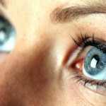
God’s Throne in Heaven
Revelation 4:1-11; Isaiah 6:1-7
The Invitation v.1
The Throne in Heaven vv.2-3
The Lavish throne room vv.4-8a
Heavenly worship vv.8b-11
Reflections on worship
True worship focuses on the one on the true throne

Slide 28
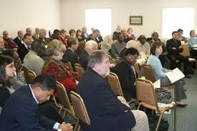
God’s Throne in Heaven
Revelation 4:1-11; Isaiah 6:1-7
The Invitation v.1
The Throne in Heaven vv.2-3
The Lavish throne room vv.4-8a
Heavenly worship vv.8b-11
Reflections on worship
True worship focuses on the one on the true throne
True worship is corporate

Slide 29
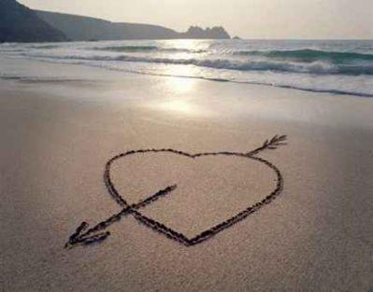
God’s Throne in Heaven
Revelation 4:1-11; Isaiah 6:1-7
The Invitation v.1
The Throne in Heaven vv.2-3
The Lavish throne room vv.4-8a
Heavenly worship vv.8b-11
Reflections on worship
True worship focuses on the one on the true throne
True worship is corporate
True worship is responsive

